Slide 1
CHAPTER 16
Union/Management Relations

Slide 2
Nature of Unions
Union
  A formal association of workers that promotes the interests of its members through collective action.
Why Employees Unionize
  They are dissatisfied with how they are treated by their employers.
  They believe that unions can improve their work situations.

Slide 3
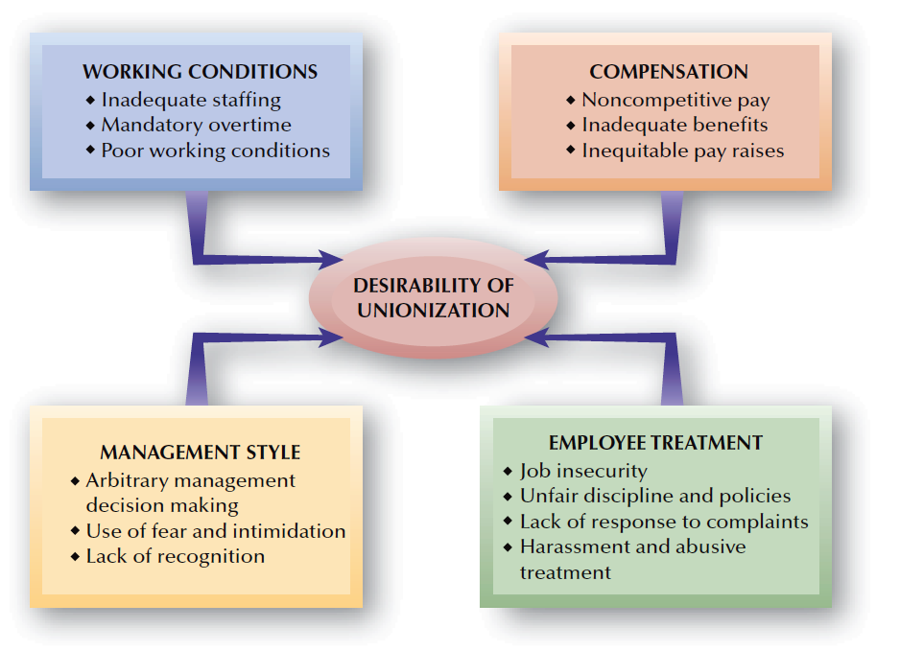
FIGURE 16–1
Factors Leading to Employee Unionization

Slide 4
Nature of Unions (cont’d)
Why Employers Resist Unions
  Unionization constrains what managers can and cannot do in a number of areas.
  Unionization can result in higher wages and benefits.

Slide 5
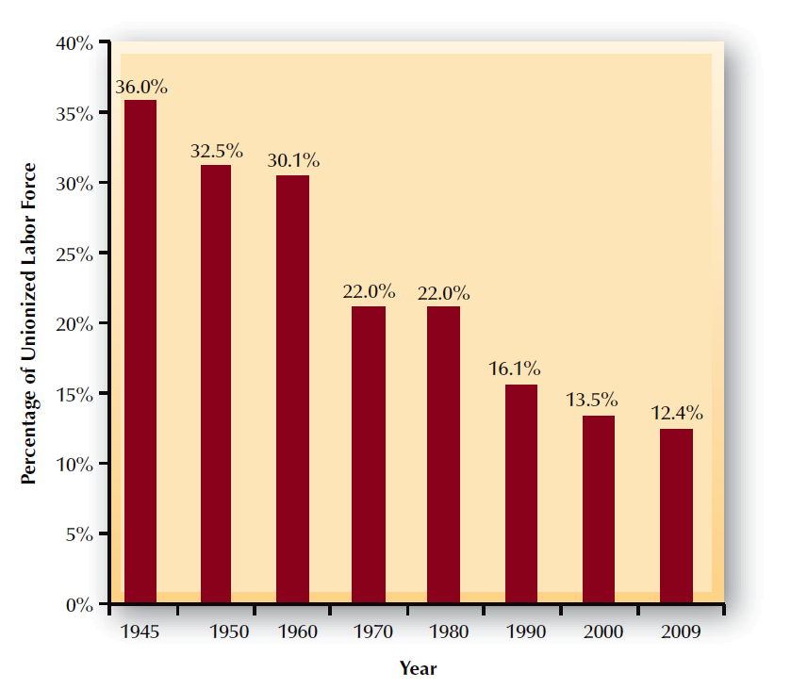
FIGURE 16–2
Union Membership as a Percentage of the U.S. Civilian Workforce
Source: U.S. Department of Labor, Bureau of Labor Statistics, 2010.

Slide 6
Unions Globally
Union membership is falling in advanced countries.
  High unemployment is creating pressure for change.
In some countries, unions are closely tied to political parties.
Child labor is an issue in some countries.
Co-determination
  A practice whereby union or worker representatives are given positions on a firm’s board of directors.

Slide 7

U.S. and Global Differences in
Union-Management Relations
Key Differences
Focus on Economic
Issues
Organization
by Job and Employer
Collective Agreements as “Contracts”
Competitive Relations

Slide 8
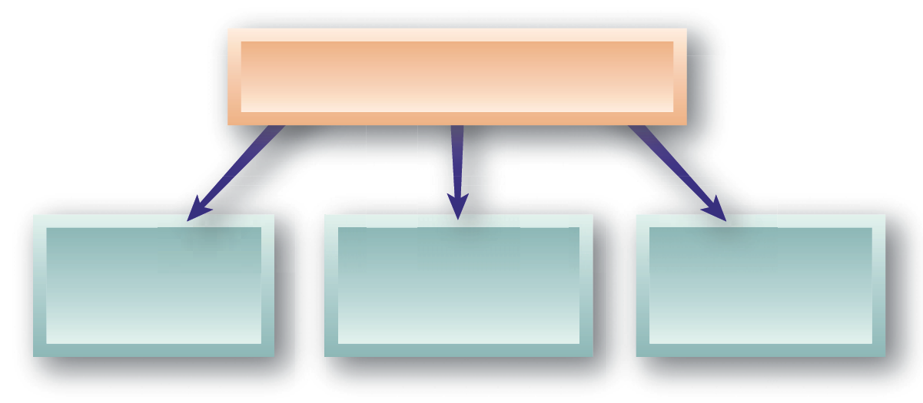
Reasons for U.S. Union Membership Decline
Causes of Membership Decline
Geographic Changes
Industrial
Changes
Workforce Changes

Slide 9
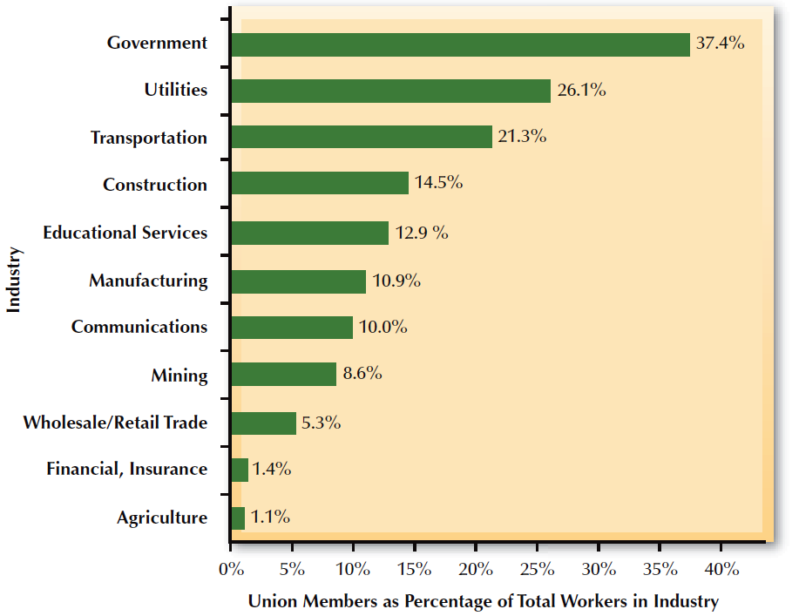
FIGURE 16–3
Union Membership by Industry
Source: U.S. Department of Labor, Bureau of Labor Statistics, 2010.

Slide 10
Union Targets for Membership Growth
Focus of Union Organizing
Low-Skill
Workers and Immigrants
Contingent and
Part-Time Workers
Health Care Professionals

Slide 11
Historical Evolution of U.S. Unions
1794 Shoemakers’ strike
1806 Shoemakers’ strike (“criminal conspiracy”)
1886 American Federation of Labor (AFL)
1938 Congress of Industrial Organizations (CIO)
1957 AFL-CIO merger
2005 Change to Win Federation (CTWF)

Slide 12
Union Structure
Craft Union
  A union whose members do one type of work, often using specialized skills and training.
Industrial Union
  A union that includes many persons working in the same industry or company regardless of jobs held.
Federation
  A group of autonomous national and international unions.
National and International Unions
  Groups of local union units

Slide 13
Union Structure (cont’d)
Local Union
  A union centered around either a particular employer or a particular geographic location.
Business Agent
  A full-time union official who operates the union office and assists union members.
Union Stewart
  An employee elected by local members to serve as the first-line representative of unionized employees.

Slide 14
U.S. Labor Laws
1926 Railway Labor Act (RLA)
1932 Norris-LaGuardia Act
1935 National Labor Relations Act (Wagner Act)
    Employee rights to organize
    Employer unfair labor practices
    National Labor Relations Board
1947 Taft-Hartley Act
    Union conduct
    National emergency strikes
    Right-to-work
1959 Landrum-Griffin Act
    Union democracy restored
1978 Civil Service Reform Act

Slide 15
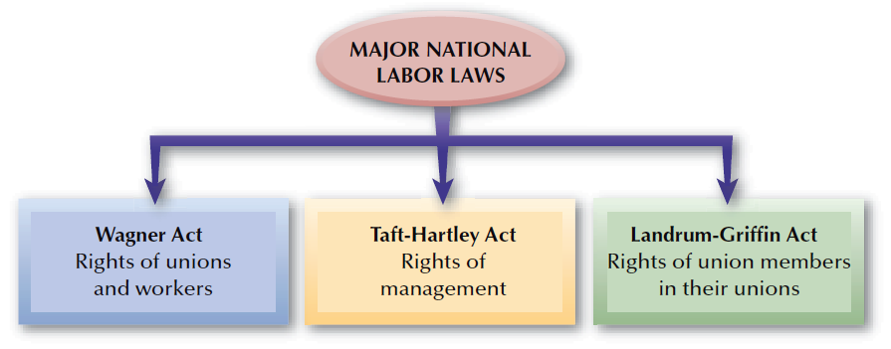
FIGURE 16–4
Major National Labor Laws

Slide 16
Employer Unfair Labor Practices
Interfering with the organizing and collective bargaining rights of employees.
Dominating or interfering with any labor organization.
Encouraging or discouraging membership in a particular union.
Discharging persons for organizing activities or union membership.
Refusing to bargain collectively.

Slide 17
Taft-Hartley (Labor-Management Relations) Act
Right-to-Work Laws
  State laws that prohibit contracts requiring employees to join unions to obtain or continuing employment.
Types of Shops
Maintenance-of-Membership Shop
Closed Shop
Union Shop
Agency Shop

Slide 18
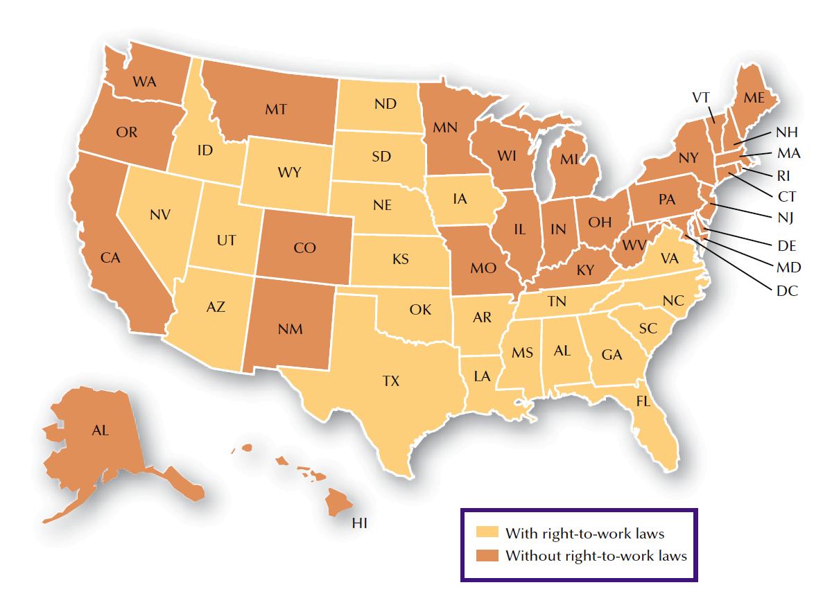
FIGURE 16–5
Right-to-Work States

Slide 19
Right-to-Work Laws – California
Allows employees to refrain from becoming union members, even in a unionized environment.
Employers may have an open shop
  Employees can’t be required to join the union
  Employees can’t be required to pay dues to a union
Prohibits closed shop except in construction-related occupations
  Concern that union may control who is hired
  Closed shop - Individuals must join union in order to be hired

Slide 20
No Right-to-Work Laws in Some States
Union shop
  Employees must join union, usually 30-60 days after hire
Agency shop
  Employees who refuse to join union must pay amounts equal to union dues and fees in return for representation services of the union
Maintenance-of-membership shop
  Employees must stay union members for the period of the labor contract

Slide 21
Right-to-Work Laws
Do you think that right-to-work laws are a good idea? Why or why not?

Slide 22
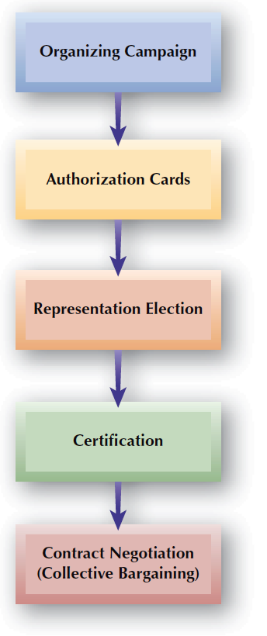
FIGURE 16–6
Typical Unionization Process

Slide 23




Organizing Campaign
Holding mandatory employee meetings.
Employers’ Union Prevention Efforts
Distributing anti-union leaflets and letters
Anti-union videos, e-mails, and other electronic means.

Slide 24
Unionization Do’s and Don’ts for Managers
Refer to page 559 in text – HR on-the-job
What do you think are the two most effective things that employers can do to prevent unionization? Why?
What do you think are the reasons that most employees join a union? Explain.
Do you think it is a good idea for an employer to hire an outside consultant if employees try to unionize?

Slide 25
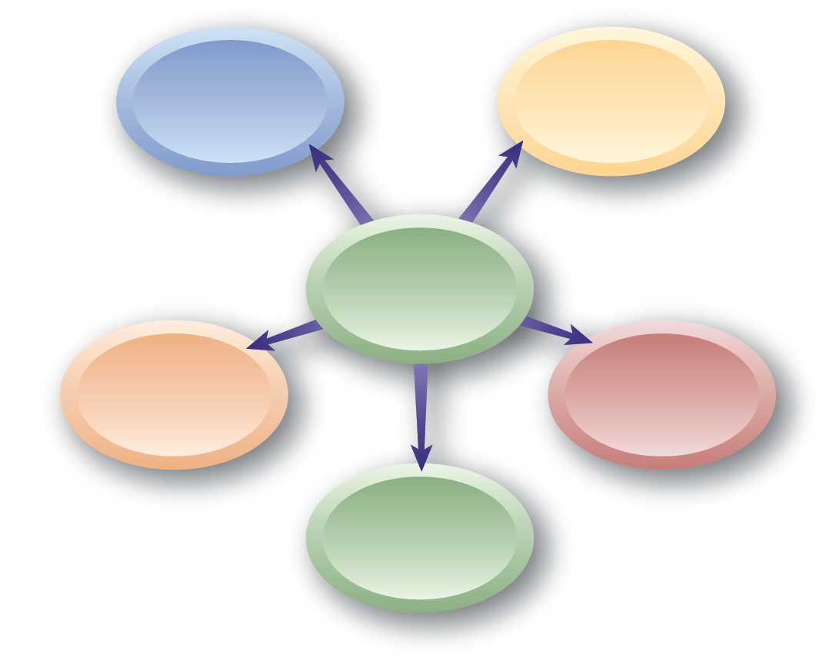
Unions’ Organizing Efforts
Salting
Authorization Cards
Unionization Efforts
Contract Negotiation
Bargaining Unit Composition
Certification
and
Decertification

Slide 26
Bargaining Unit Composition
“Community of Interest”
  Wages, hours, and working conditions
  Traditional industry groupings for bargaining purposes
  Physical location and amount of interaction and working relationships among employee groups
  Supervision by similar levels of management
Supervisors and Union Ineligibility
  Supervisors are excluded from bargaining units.

Slide 27
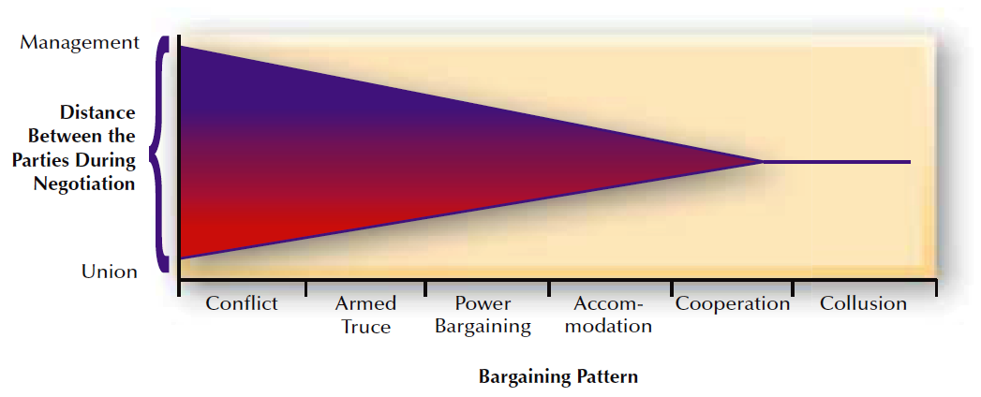
FIGURE 16–7
Continuum of Collective Bargaining Relations

Slide 28
Collective Bargaining Issues
Management Rights
Bargaining
Issues
Union Security
(dues checkoff)
Classification of
Bargaining Issues

Slide 29
Classification of Bargaining Issues
Mandatory Issues
Collective Bargaining
Issues
Permissive Issues
Illegal Issues

Slide 30







Collective Bargaining Process
Preparation and
Initial Demands
Continuing Negotiations in Good Faith
Ratification
Bargaining
Impasse
Conciliation
Mediation
Arbitration
Settlement and
Contract Agreement
Strikes and Lockouts

Slide 31

FIGURE 16–9
Typical Items in a Labor Agreement
Purpose of agreement
Non-discrimination clause
Management rights
Recognition of the union
Wages
Incentives
Hours of work
Vacations
Sick leave and leaves of absence
Discipline
Separation allowance
Seniority
Bulletin boards
Pension and insurance
Safety
Grievance procedure
No-strike or lockout clause
Definitions
Terms of contract (dates)
Appendices

Slide 32
Strikes and Lockouts
Strike
  A work stoppage in which union members refuse to work in order to put pressure on an employer.
Lockout
  Shutdown of company operations undertaken by management to prevent union members from working.
Striker Replacements

Slide 33
Strikes
Economic
Strikes
Unfair
Labor Practice
Strikes
Types of Strikes
Sympathy
Strikes
Wildcat
Strikes
Jurisdictional
Strikes

Slide 34
Union-Management Cooperation Issues
Cooperation and
Joint Efforts
Union—Management Cooperation
Employee Involvement Programs (Teams)
Unions and Employee Ownership

Slide 35
Grievance Management
Complaint
  Indication of employee dissatisfaction
Grievance
  A complaint formally stated in writing
Grievance Procedures
  Formal channels used to resolve grievances
    Union representation (Weingarten) rights
Grievance Arbitration
  Means by which a third party settles disputes arising from different interpretations of a labor contract.

Slide 36
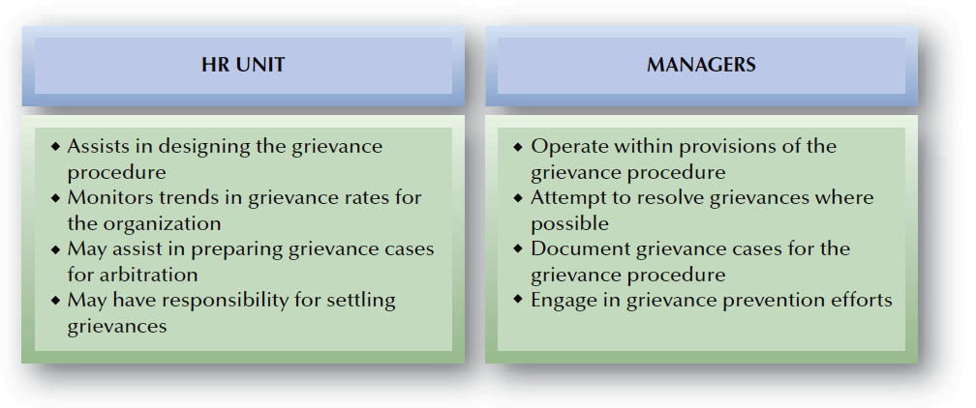
FIGURE 16–10
Typical Division of HR Responsibilities: Grievance Management

Slide 37
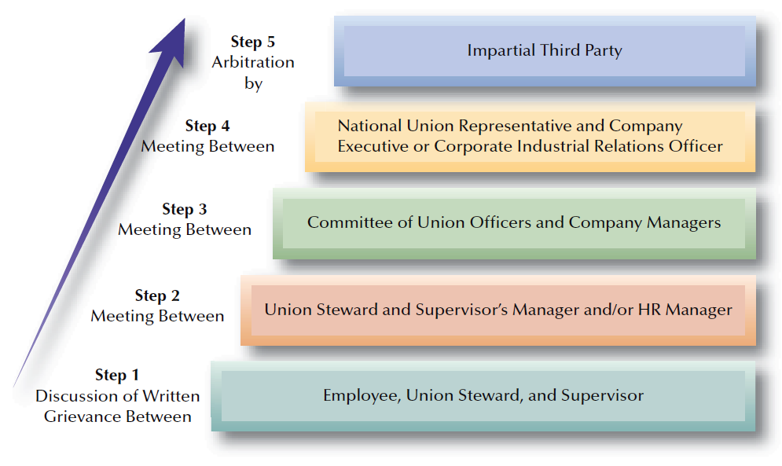
FIGURE 16–11
Steps in a Typical Grievance Procedure

