Slide 1
CHAPTER 15
Employee Rights and Responsibilities

Slide 2
Employee Rights and Responsibilities
Rights
  That which belongs to a person by law, nature, or tradition.
Responsibilities
  Obligations to perform certain tasks and duties.
Statutory Rights
  Rights based on specific laws and statutes passed by federal, state, and local governments.
    Equal employment opportunity
    Collective bargaining
    Workplace safety

Slide 3
Contractual Rights
Contractual Rights
  Rights based on a specific contract between employer and employee.
Employment Contract
  An agreement that formally outlines the details of employment.
Implied Contract
  The idea that a contract exists between the employer and the employee based on the implied promises of the employer.

Slide 4
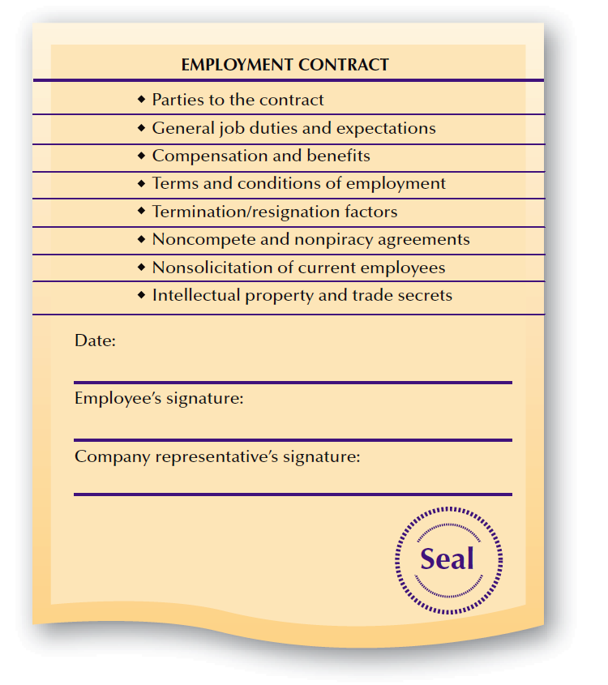
FIGURE 15–1
Provisions in Employment Contracts

Slide 5

Contractual Rights (cont’d)
Non-Compete Agreements
  Prohibit individuals who quit from competing with an employer in the same line of business for a specified period of time.
Employment Contract Clauses
Non-piracy agreements
Non-solicitation of current employees
Intellectual property and trade secrets

Slide 6
Contractual Rights (cont’d)
Employer’s Intellectual Property Rights:
  The right to keep trade secrets confidential
  The right to have employees bring business opportunities to the employer first before pursuing them elsewhere
  A common-law copyright for works and other documents prepared by employees for their employers

Slide 7
Contractual Rights (cont’d)
Employment Practices Liability Insurance (EPLI)
  Covers employer’s costs for legal fees, settlements, and judgments associated with employment-related actions.

Slide 8

Rights Affecting the Employment Relationship
Employment-at-Will (EAW)
Wrongful and Constructive
Discharge
The Employment Relationship
Just Cause
Due Process
Distributive and Procedural Justice

Slide 9

Employment-at-Will (EAW)
Employers
Employees
Employers have the right to hire, fire, demote, or promote as they choose, unless there is a law or contract to the contrary.
Employees have the right to quit and got another job under the same constraints.

Slide 10
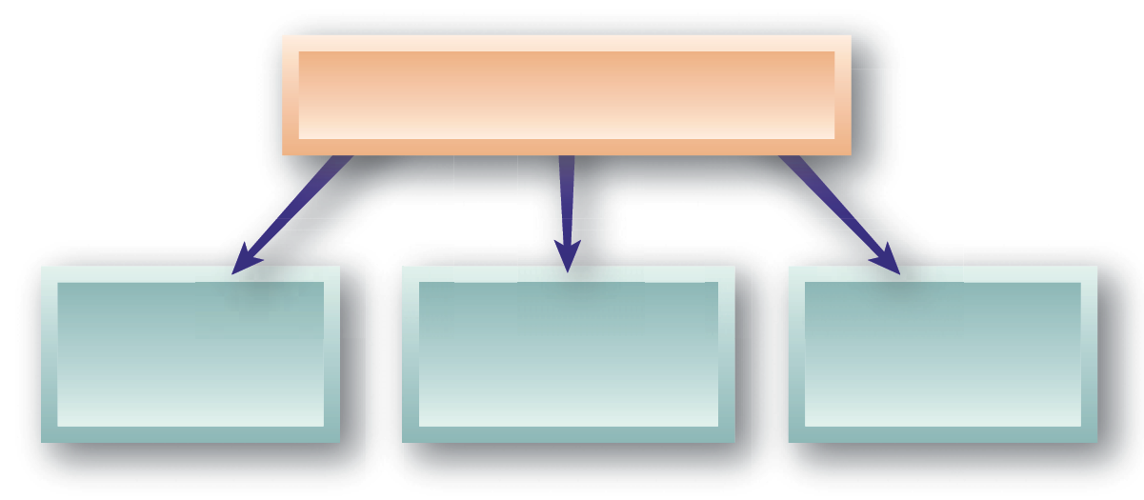
Employment-at-Will (cont’d)
Exceptions to EAW
Implied Contract of Continuing Employment
Covenant of Good-faith and Fair-dealing
Violation of Public Policy

Slide 11
Employment-at-Will Restrictions
Wrongful Discharge
  Termination of an individual’s employment for reasons that are improper or illegal.
    Fortune v. National Cash Register Company
Constructive Discharge
  An employer deliberately makes working conditions intolerable for an employee in an attempt to get (to force) that employee to resign or quit.

Slide 12
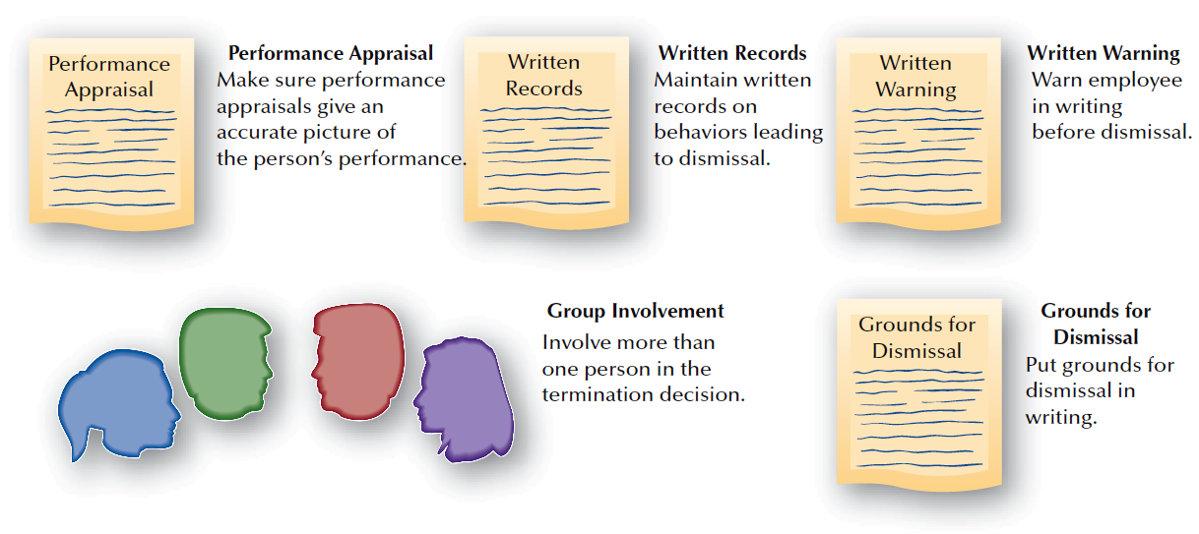
FIGURE 15–2
Keys for Preparing a Defense against Wrongful Discharge

Slide 13
Employment-at-Will: Fairness
Just Cause
  Reasonable justification for taking an employment-related action.
Due Process
  The means used for individuals to explain and defend their actions against charges or discipline.
    Distributive Justice
      Perceived fairness in the distribution of outcomes
    Procedural Justice
      Perceived fairness of the process used to make decision
    Interactional Justice
      Perceived fairness about how a person interacts with others

Slide 14
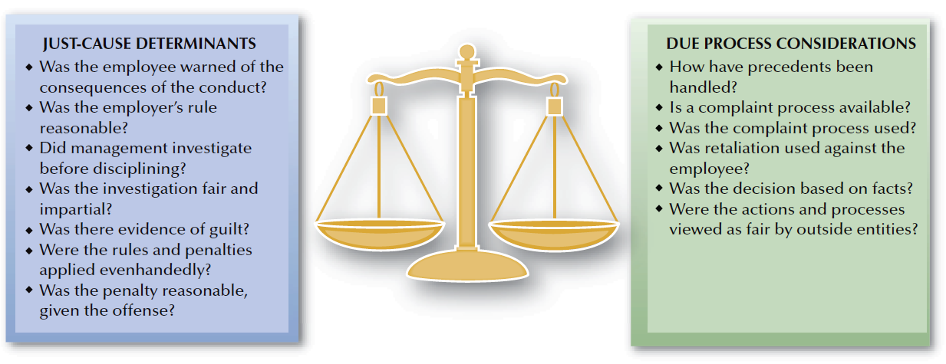
FIGURE 15–3
Criteria for Evaluating Just Cause and Due Process

Slide 15
Work-Related Alternative Dispute Resolution (ADR)
Alternative Dispute Resolution Methods
Arbitration
Peer Review Panels
Ombuds

Slide 16
Managing Individual Employee and Employer Rights Issues
Right to Privacy
  An individual’s freedom from unauthorized and unreasonable intrusion into personal affairs.
Privacy Rights and Employee Records:
  Access to personal information held by employer
  Response to unfavorable information in records
  Correction of erroneous information
  Notification when information is given to a third party

Slide 17
Privacy Rights and Employee Records
ADA Provisions
  Employee medical records are to be kept as separate confidential files available under limited conditions specified in the ADA.
Security of Employee Records
  Restrict access to all records
  Set confidential passwords to HR databases
  Keep sensitive information in separate files and restricted databases
  Inform employees about data retained
  Purge outdated data from records
  Release information only with employee’s consent

Slide 18
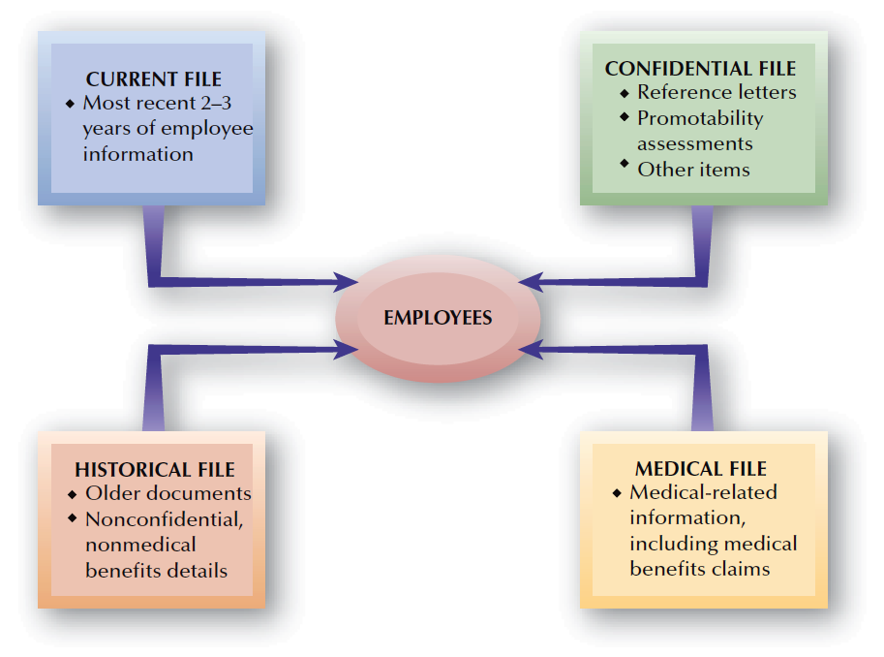
FIGURE 15–4
Employee Record Files

Slide 19
Employees’ Free Speech Rights
Employers’ Restrictions on Employees’ Free Speech Rights
Advocacy of Controversial Views
Publication of Blogs and Wikis
Engaging in Whistle-Blowing

Slide 20
Employee Rights and Personal Behavior
Body Appearance
Off-Duty Behavior
An employer can place legitimate job-related limits on an employee’s personal at-work appearance such as tattoos and body piercings.
An employer can discipline an employee if the employee’s off-the-job behavior puts the company in legal or financial jeopardy.

Slide 21
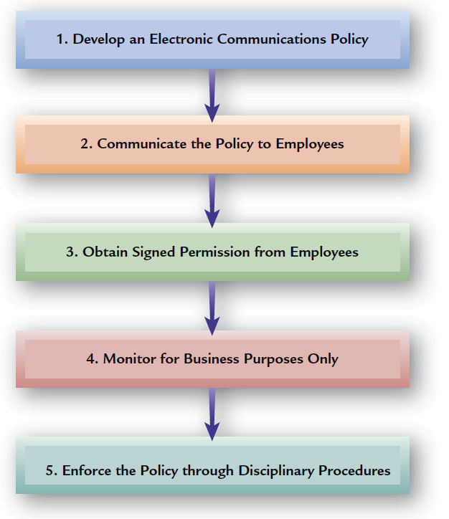
FIGURE 15–5
Recommended Employer Actions Regarding Electronic Communications

Slide 22
E-mail and Voice Mail
Electronic Communications Policy Elements
  Voice mail, e-mail, and computer files are provided by the employer and are for business use only.
  Use of these media for personal reasons is restricted and subject to employer review.
  All computer passwords and codes must be available to the employer.
  The employer reserves right to monitor or search any of the media, without notice, for business purposes.

Slide 23


Employee Misconduct
Sample
Illegal Drug
Use
Sample
Employee
Theft
Falsification of Documents
Sample
Types of
Employee
Misconduct
Sample
Sample
Employment Harassment
Misuse of Company Funds
Sample
Sample
Workplace
Violence
Disclosure of Organizational Secrets

Slide 24
Balancing Employer Security and Employee Rights
Workplace Monitoring
Employer Investigations
Monitoring e-mail and voicemail
Conducting video surveillance at work
Monitoring employee performance
Conducting work-related investigations
Employee theft
Honest and polygraph tests

Slide 25
Substance Abuse and Drug Testing
Drug-Free Workplace Act of 1988
  Requires government contractors to take steps to eliminate employee drug use.
    Failure to comply can lead to contract termination.
    Act does not cover tobacco and alcohol.
    Off-the-job drug use is not included.
U.S. Department of Transportation (DOT)
  Requires regular testing of truck and bus drivers, train crews, mass-transit employees, airline pilots and mechanics, pipeline workers, and licensed sailors.

Slide 26
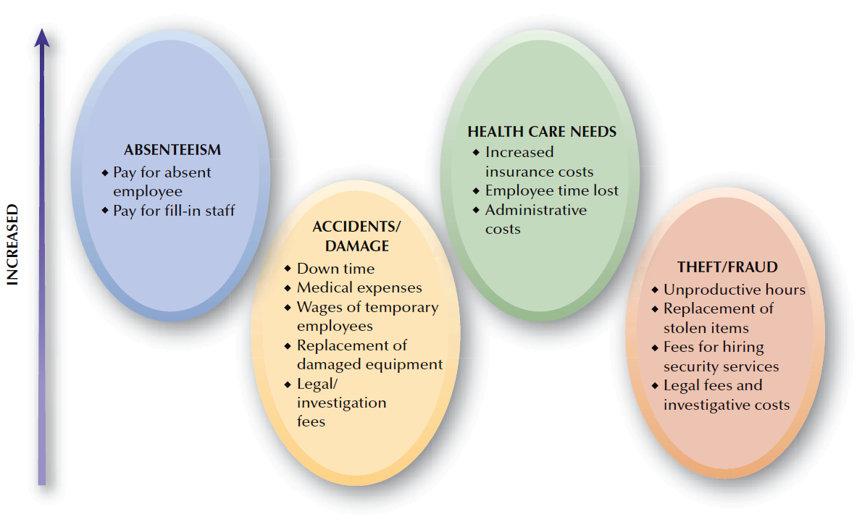
FIGURE 15–6
How Substance Abuse Affects Employers Financially

Slide 27
Drug Testing and Employee Rights
Policies for Conducting Drug Tests
  Random testing of all employees at periodic intervals IS NOT permitted in California except under DOT.
  Testing only in cases of probable cause
  Testing after accidents (if probably cause)
When to Test (Conditions)
  Job consequences outweigh privacy concerns.
  Accurate test procedures are available.
  Written consent of the employee is obtained.
  Results are treated confidentially.
  Employer has drug program, including an EAP.

Slide 28
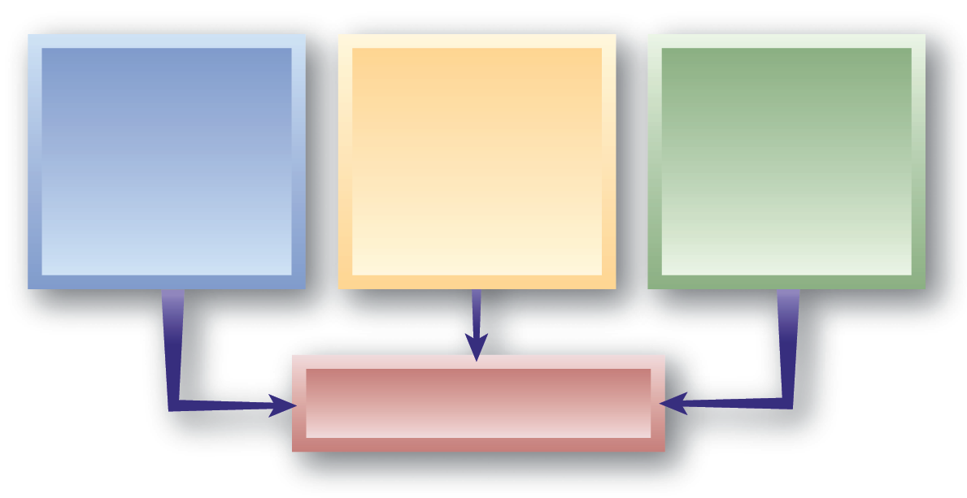
HR Policies, Procedures, and Rules
Policies
General guidelines that focus organizational actions.
“Why we do it”
Procedures
Customary methods of handling activities
“How we do it”
Rules
Specific guidelines that regulate and restrict the behavior of individuals.
“The limits on what
we do”
Employee Rights

Slide 29
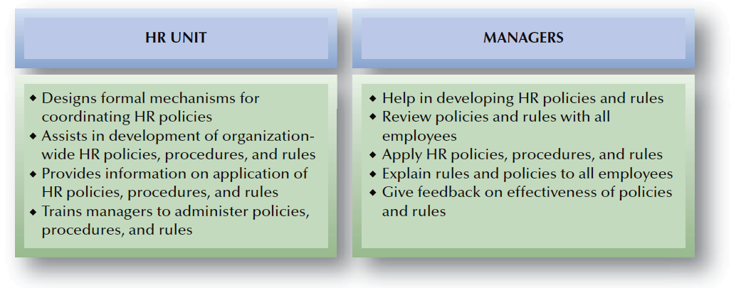
FIGURE 15–7
Typical Division of HR Responsibilities:
Policies, Procedures, and Rules

Slide 30
Employee Handbooks
At-will
Prerogatives
Hours worked
Harassment
Policies in Handbooks
Discipline
Electronic communication
Pay/benefits

Slide 31
Employee Handbooks
Legal Review of Language
  Eliminate controversial phrases in wording.
  Use disclaimers disavowing handbook as a contract.
  Keep handbook content current.
Readability
  Adjust reading level of handbook for intended audience of employees.
Use
  Communicate and discuss handbook.
  Notify all employees of changes in the handbook.

Slide 32



Communicating HR Information
Downward and Upward Internal Communications
Internal
Publications
and Media
Electronic Communication

Slide 33
Employee Absenteeism
Absenteeism
  Any failure to report for work as scheduled or to stay at work when scheduled.
  Involuntary absenteeism
    Unavoidable with understandable cause (e.g., actual illness)
  Voluntary absenteeism
    Avoidable without justifiable
    cause (e.g., feigning illness)

Slide 34
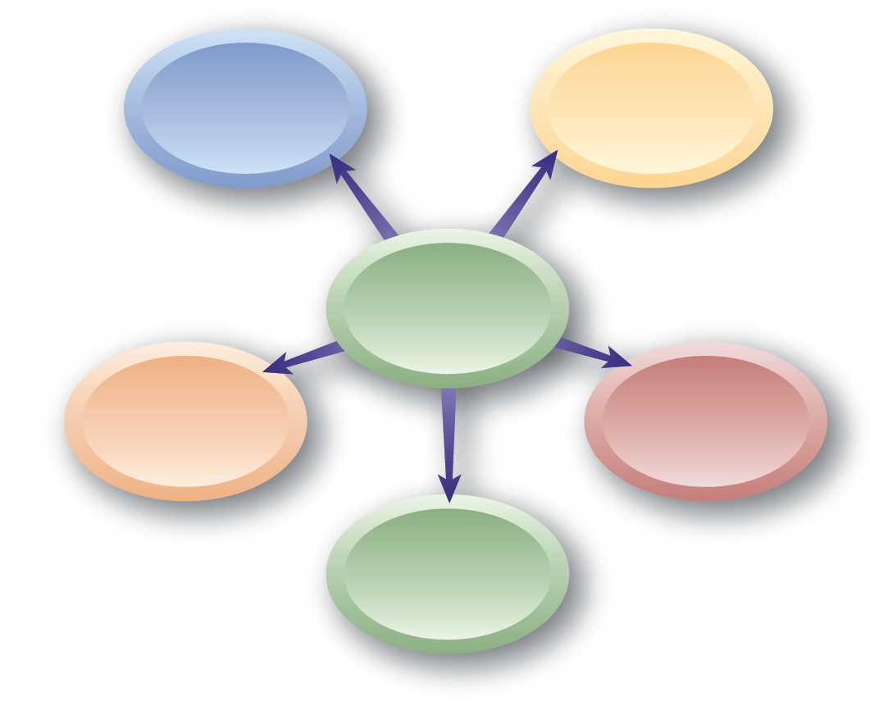
Controlling Absenteeism
Disciplinary approach
Positive reinforcement
Controlling Absenteeism
Paid time-off (PTO)
Combination approach
“No fault” policy

Slide 35
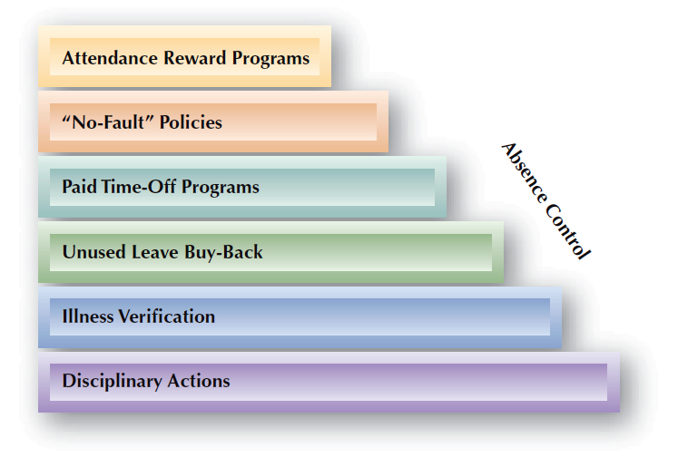
FIGURE 15–8
Employee Absenteeism Control Actions

Slide 36
HR Metrics: Measuring Absenteeism
Measuring Absenteeism
  U.S. Department of Labor formula:
Other Measures of Absenteeism:
  Incidence rate—absences per 100 employees each day
  Inactivity rate—percentage of time lost to absenteeism
  Severity rate—average time lost per absent employee during a specified period of time

Slide 37
HR Metrics: Measuring Absenteeism (cont’d)
Calculations of the costs of absenteeism should usually include:
  Lost wages and benefits
  Overtime for replacements
  Fees for temporary employees, if incurred
  Supervisor’s and manager’s time
  Substandard production and performance
  Overstaffing necessary to cover anticipated absences

Slide 38
Employee Discipline
Discipline
  A form of training that enforces organizational rules.
Effective Discipline:
  Focuses on problem behaviors, not at the employees personally.
  Supports distributive and procedural justice in the organizations
  Relies on supervisors and manager who are properly trained on when and how to use discipline.

Slide 39
Organizational culture of
avoiding discipline
Fear of
lawsuits
Lack of support by higher management
Reasons Why Managers Might Not Use
Discipline
Avoidance of
time loss
Guilt about
past behavior
Fear of loss of friendship

Slide 40
Employee Discipline (cont’d)
Approaches to Discipline
Positive Discipline
Progressive Discipline
Counseling
Written Documentation
Final Warning (decision day-off)
Discharge
Verbal Caution
Written Reprimand
Suspension
Discharge

Slide 41
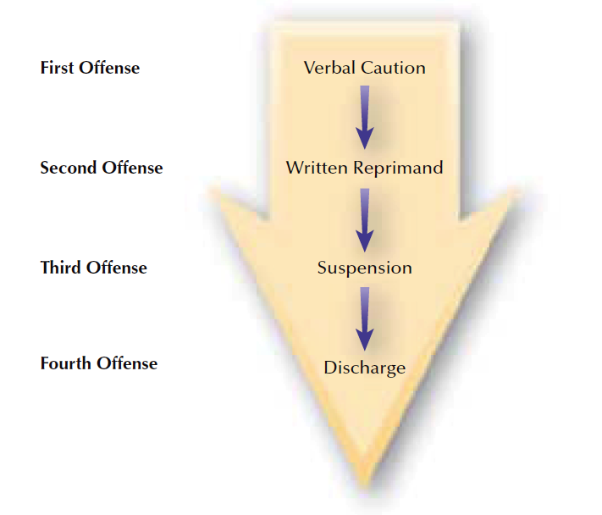
FIGURE 15–9
Progressive Discipline Process

Slide 42
Discharge: The Final Disciplinary Step
Termination Process
  Coordinate manager and HR review
  Select a neutral location
  Conduct the termination meeting
  Have HR discuss termination benefits
  Escort the employee from the building
  Notify the department staff
Separation Agreement
  An agreement in which a terminated employee agrees not to sue the employer, in exchange for specified benefits.

