Slide 1
CHAPTER 14
Risk Management and
Worker Protection

Slide 2

Effective Risk Management
Risk Management
  Involves responsibilities to consider physical, human, and financial factors to protect organizational and individual interests.
Focus of Risk Management
Health
(Individual)
Safety
(Physical)
Security
(Organizational)

Slide 3


Risk Management
Preventing accidents and health problems at work
Preparing for natural disasters
Planning for terrorism attack
Risk
Management
Concerns
Anticipating global disease outbreaks
Protecting against workplace violence
Ensuring HR data are secure

Slide 4
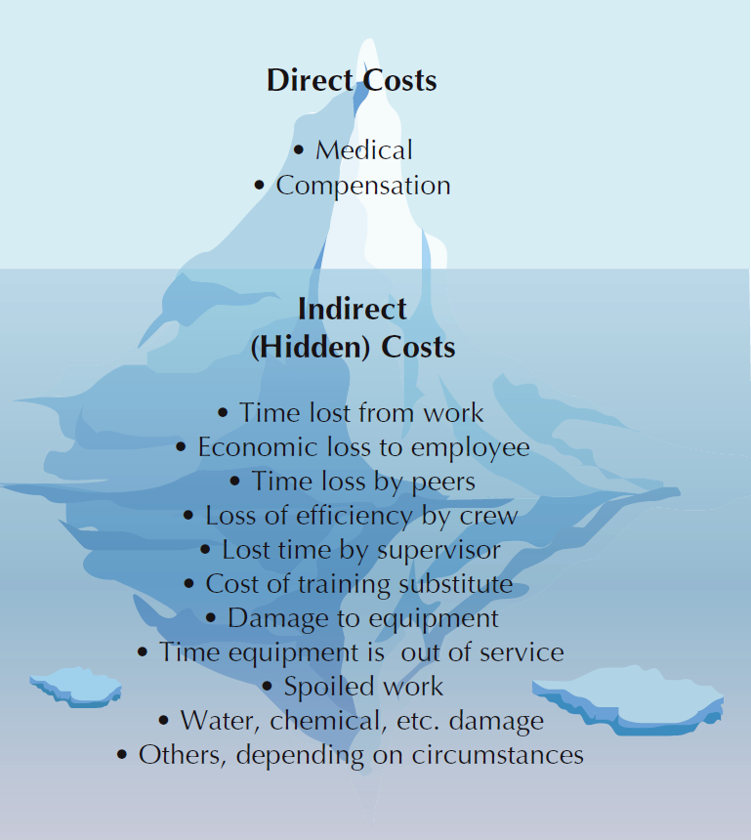
FIGURE 14–1
Hidden Costs of Accidents

Slide 5
Risk Management
Size and location
of organizations
Involvement and capabilities of HR professionals
Industry characteristics
and demands
Factors
Affecting
Risk
Management
Strategic priorities of each
organization
Geographic and global location factors
Government-mandated programs and requirements

Slide 6
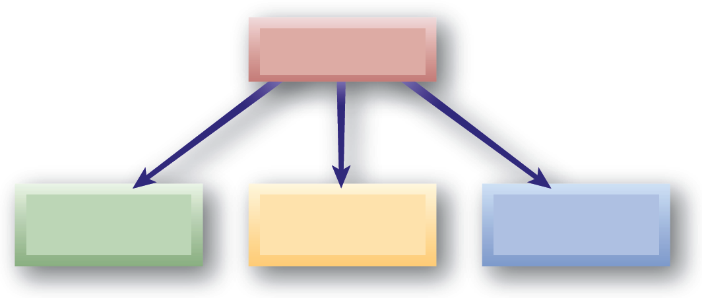
Global Health, Safety, and Security
Health and Safety in High-Risk International Environments
International Emergency Health Services
International Security and Terrorism
Kidnapping and Other Acts of Violence

Slide 7
Legal Requirements for Safety and Health
Major Legal Areas
Americans with Disabilities Act and Safety Issues
Workers’ Compensation
Child Labor
Laws

Slide 8
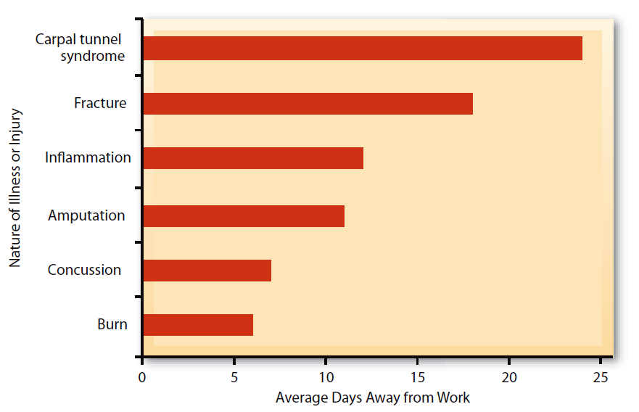
FIGURE 14–2
Sample of Worker’s Comp Covered Injuries
Source: Adapted from Nicole Nestoriak and Brooks Pierce, “Comparing Workers Compensation Claims with Establishments Responses to the 5011,” Monthly Labor Review, May 2009, 63.

Slide 9
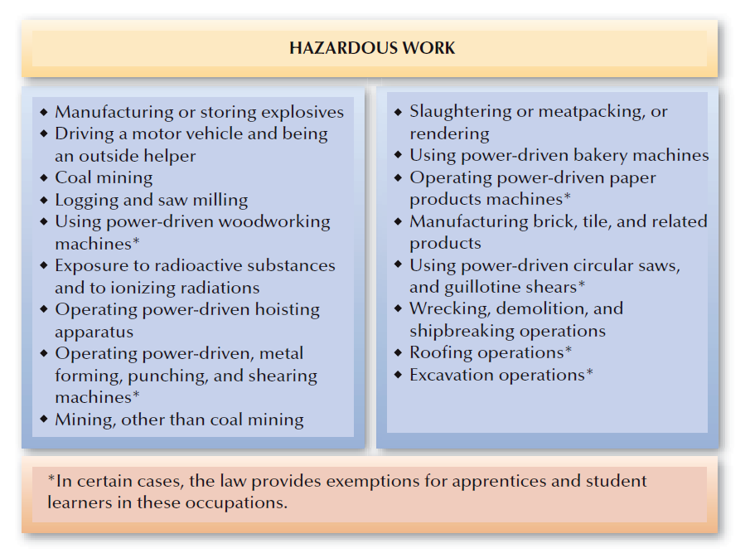
FIGURE 14–3
Selected Child Labor Hazardous Occupations
(minimum age: 18 years)

Slide 10
Occupational Safety and Health Act
Occupational Safety and Health Act of 1970
  Passed to assure safe and healthful working conditions.
  Occupational Safety and Health Administration (OSHA) administers provisions of the Act.
  OSHA Enforcement Standards regulate equipment and working environments:
    The “general duty” of employers to provide safe and healthy working conditions.
    Notification and posters are required of employers to inform employees of OSHA’s safety and health standards.
  California has its own OSHA enforcement and consultation units (Cal/OSHA).

Slide 11
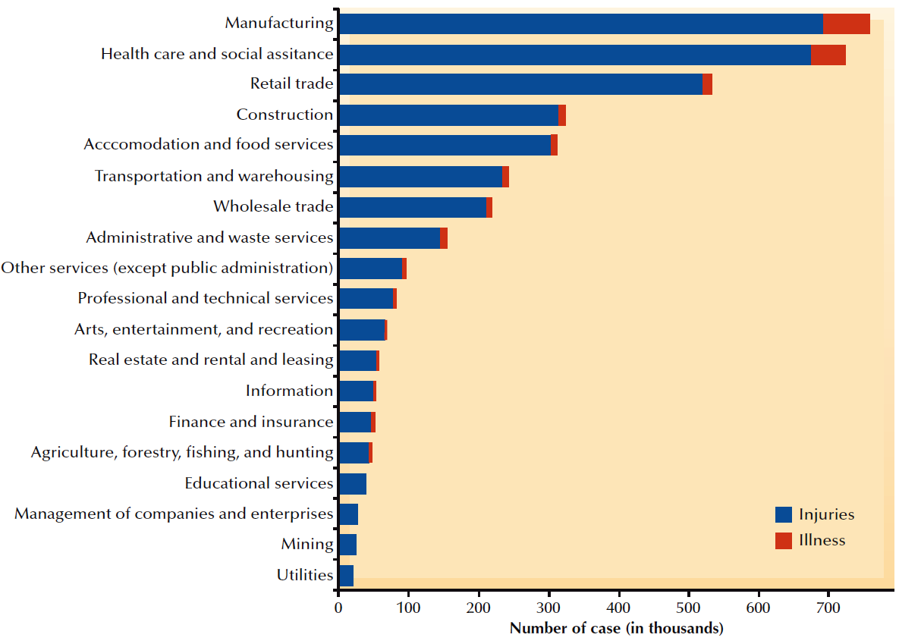
FIGURE 14–4
Distribution of Nonfatal Occupational Injuries versus Illnesses by Private Industry Sector, 2008

Slide 12
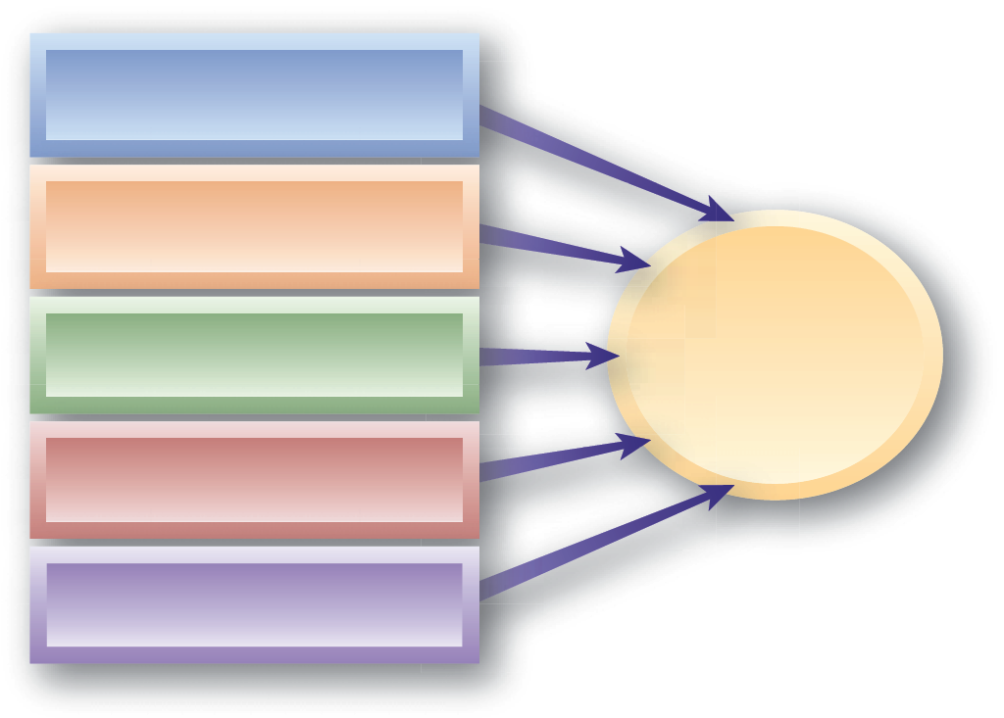
Occupational Safety and Health Act (cont’d)
Hazard Communication
Bloodborne Pathogens
OSHA Enforcement Standards
Personal Protective Equipment (PPE)
Cumulative Stress Disorders
Work Assignments

Slide 13


Occupational Safety and Health Act (cont’d)
Work Assignments and OSHA:
Employer Obligations and Employee Rights
Reproductive Health
Refusing Unsafe Work
Maintain safe workplace by seeking safest working methods.
Comply with state and federal safety laws.
Inform employees of known risks.
Document employee acceptance
of any risks.
The employee’s fear is objectively reasonable.
The employee has tried to have the dangerous condition corrected.
Using normal procedures to solve the problem has not worked.

Slide 14
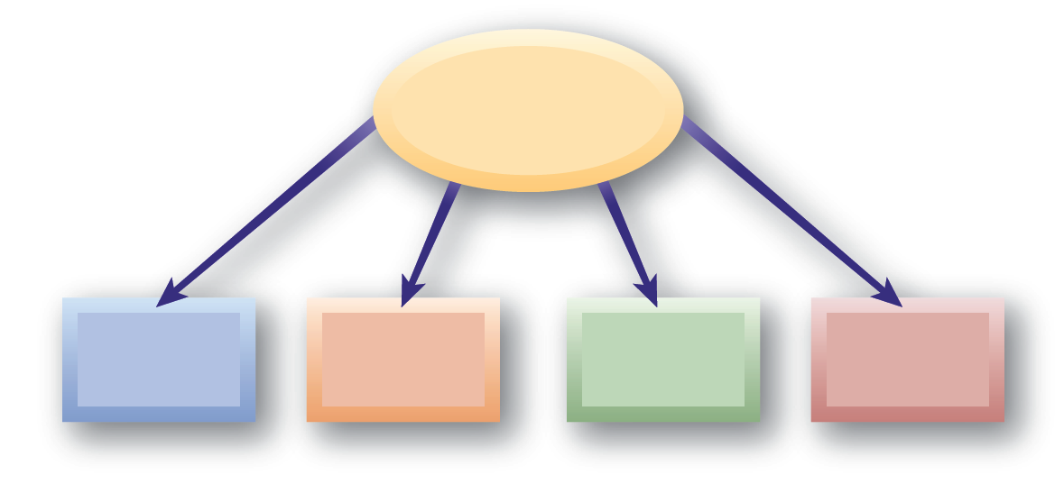
OSHA Recordkeeping Requirements
Types of Injuries
Injury- or illness-related death
Lost-time
or disability injuries
Medical care injuries
Minor
injuries

Slide 15
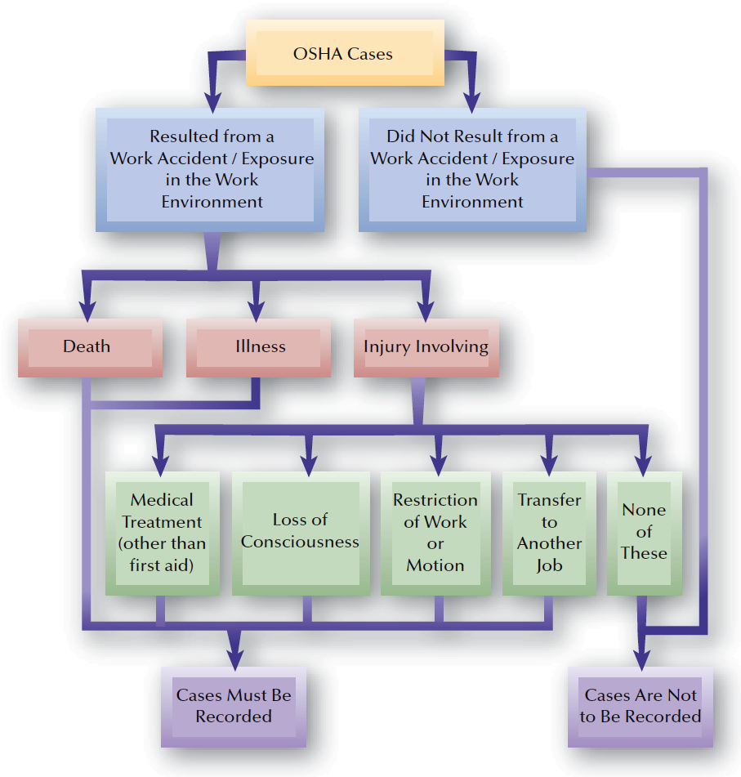
FIGURE 14–5
Guide to Recordability of Cases under the Occupational Safety and Health Act

Slide 16
OSHA Inspections
On-the-Spot Inspections
  Compliance officers
    Marshall v. Barlow’s, Inc.
Dealing with an Inspection
  Check credentials
  Opening conference
  Safety record check
  On-the-spot inspection
Citations and Violations
  Imminent danger
  Serious
  Other than serious
  De minimis
  Willful and repeated

Slide 17
Cal-OSHA Citations and Violations
Citations and Violations
  Regulatory Violation
  General Violation
  Serious Violation (newly defined - stricter)
    There is a realistic probability that death or serious physical harm could result from the actual hazard created by the violation.
  Failure to Abate Regulatory, General, or Serious Violation
  Repeated Violation
    Regulatory, General, or Serious
  Willful Violation
    Regulatory, General, or Serious
    Causing Death or Serious Injury, Illness, or Exposure
  Serious Repeated or Willful Repeated
  Multiple Violations Pertaining to a Single Hazard

Slide 18
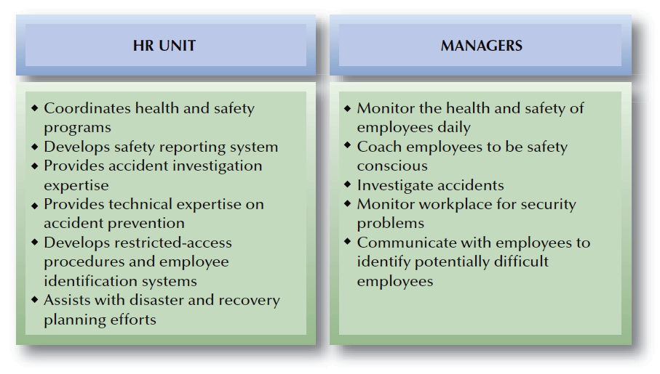
FIGURE 14–6
Typical Division of HR Responsibilities: Health, Safety, and Security

Slide 19
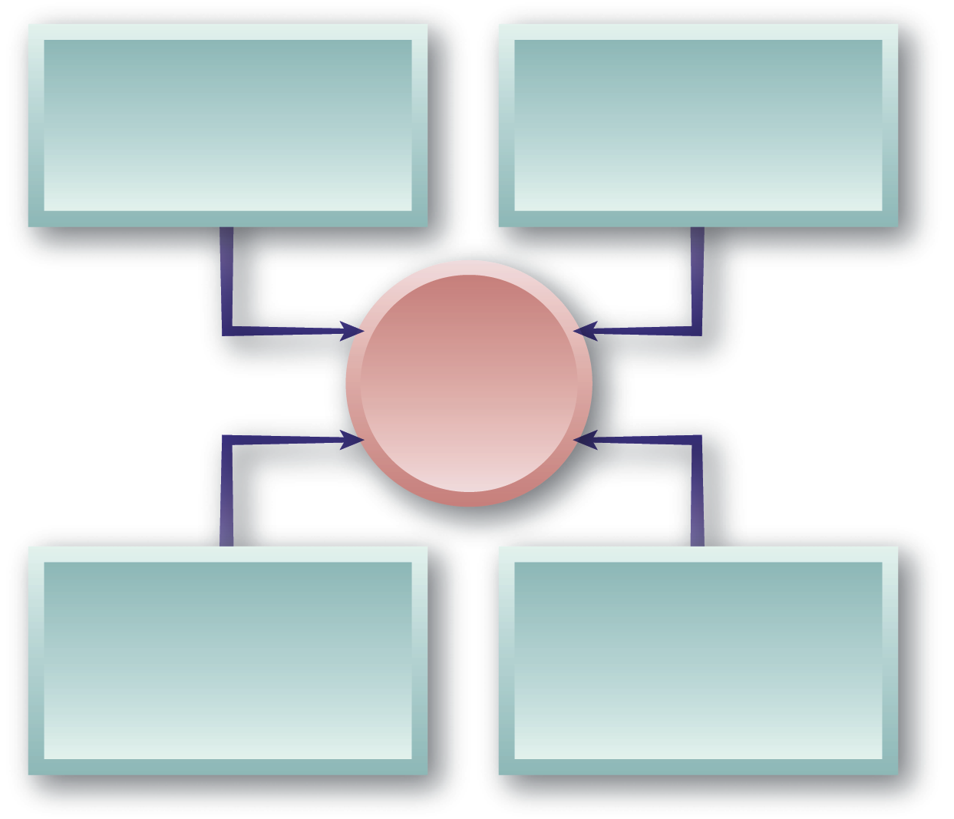
Safety Management
Organizational Commitment and
a Safety Culture
Safety Policies, Discipline, and Recordkeeping
Managing Safety Effectively
Safety Planning through
Safety Committees
Safety Training
and
Communication

Slide 20
Safety Management
Organizational commitment
Policies, discipline, and recordkeeping
Effective Safety Management
Training and communication
Participation
(safety committees)
Inspection, investigation, and evaluation

Slide 21
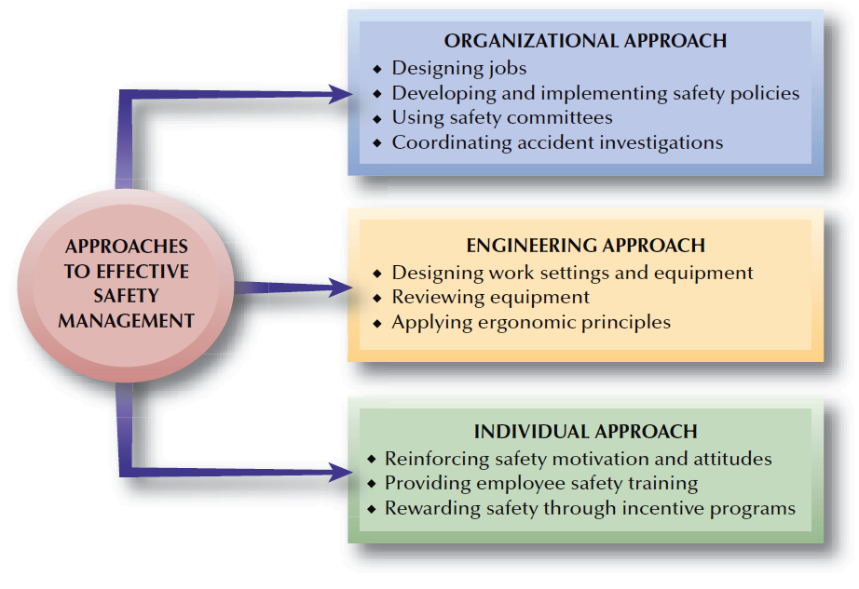
FIGURE 14–7
Approaches to Effective Safety Management

Slide 22
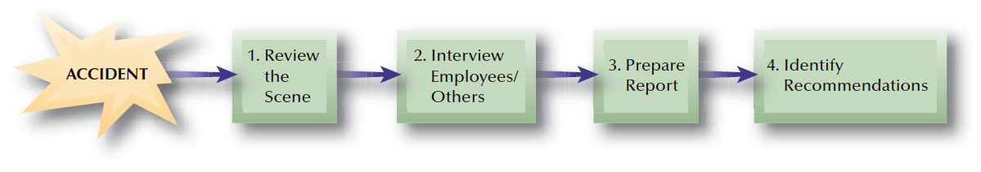
FIGURE 14–8
Phases of Accident Investigation

Slide 23
Inspection, Investigation, and Evaluation
Measuring Safety Efforts
Accident
and Injury
Statistics
Worker Compensation Costs
Illness/Injuries by Areas, Shifts, and Jobs
Incident Rate and Benchmark Comparisons

Slide 24
Other Employee Health Concerns
Employee Health
Emotional/Mental Health
Health and
Older Employees
Smoking
at Work

Slide 25
Health Promotion
Health Promotion
  A supportive approach of facilitating and encouraging healthy actions and lifestyles among employees.
Wellness Programs
  Programs designed to maintain or improve employee health before problems arise.
Employee Assistance Program (EAP)
  A program that provides counseling and other help to employees having emotional, physical, or other personal problems.

Slide 26
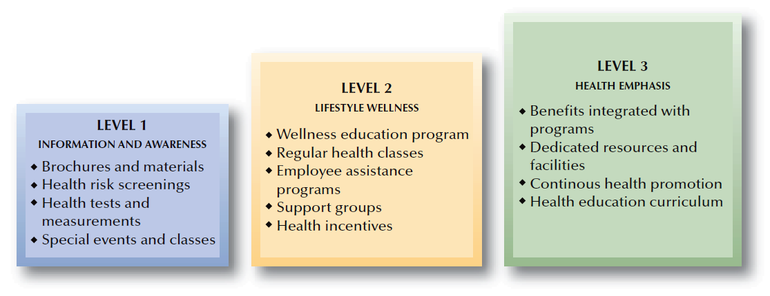
FIGURE 14–10
Health Promotion Levels

Slide 27
Security Concerns at Work
Security Concerns
Workplace Violence
Security Management
Employee Screening and Selection
Security Personnel

Slide 28
Workplace Violence
Workplace Violence Issues
Workplace Violence Warning Signs
Training in Detection and Prevention
Post-Violence Management Responses

Slide 29
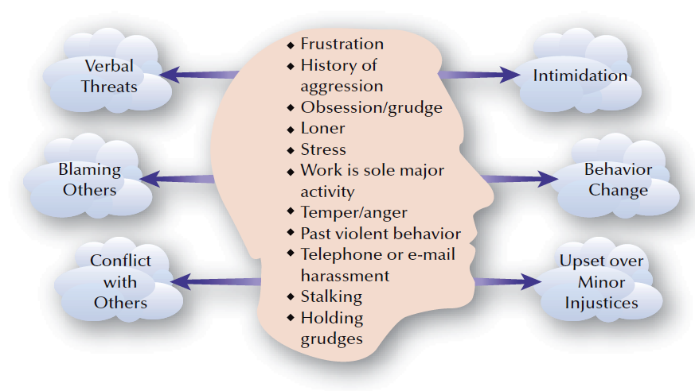
FIGURE 14–11
Profile of a Potentially Violent Employee

Slide 30




Security Management
Security Audit
Security
Management
Programs
Controlled Access
Computer Security

Slide 31
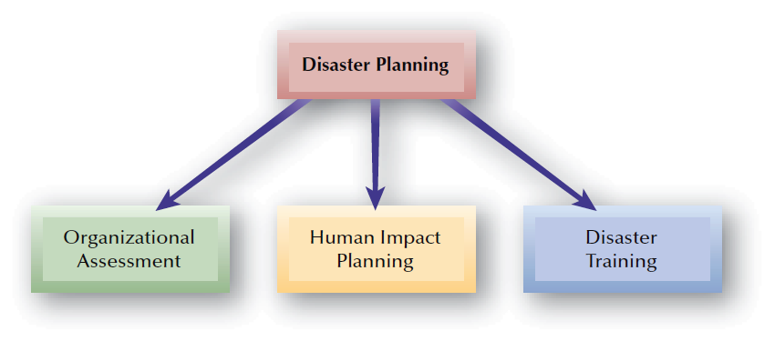
FIGURE 14–12
Disaster Planning Components

Slide 32
Disaster Preparation And Recovery Planning
First Aid/CPR
Hazardous Materials Containment
Disaster Training Topics
Disaster Escape Means
Employee Contact Methods
Organizational Restoration Efforts

