Slide 1
CHAPTER 13
Managing Employee Benefits

Slide 2

Benefits and HR Strategy
Benefit
  An indirect reward given to an employee or group of employees for organizational membership.
Employer-Provided Benefits
Absorb social costs for health care and retirement
Influence employee decisions about employers
Are increasingly seen as entitlements
Average over 40% of total payroll costs

Slide 3
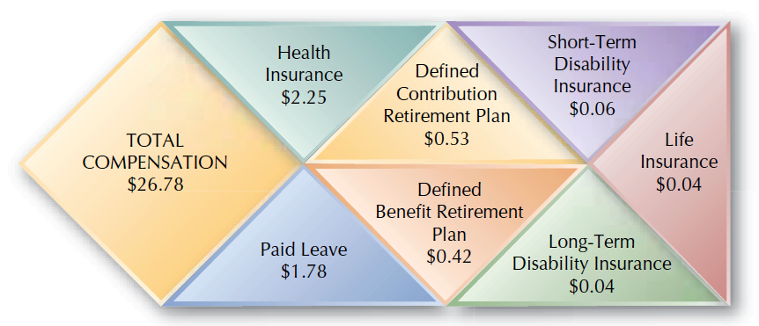
FIGURE 13–1
Employer Compensation and Benefits Costs per Hour
Source: U.S. Bureau of Labor Statistics, 2008.

Slide 4
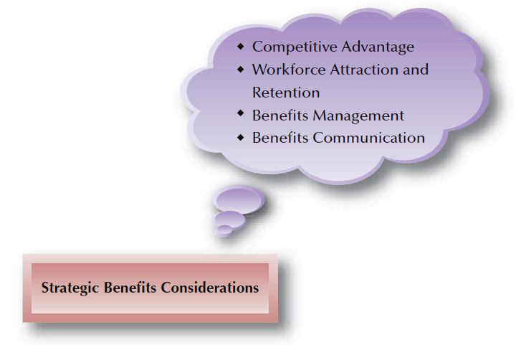
FIGURE 13–2
Strategic Benefits Considerations

Slide 5
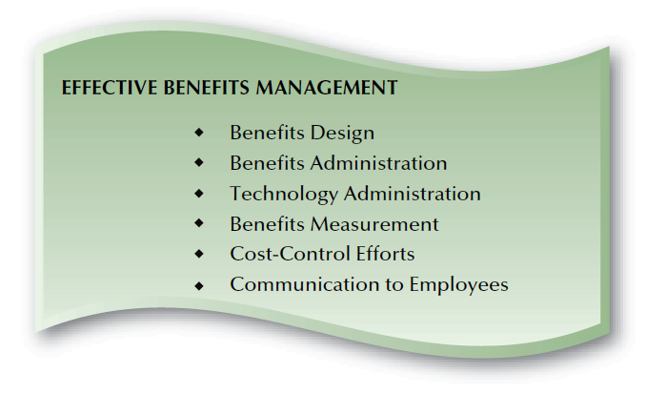
FIGURE 13–3
Benefits Management Components

Slide 6
Benefits Design
Decisions Affecting Benefit Design:
  How much total compensation, including benefits,
  can be provided?
  What part of total compensation of individuals should benefits comprise?
  Which employees should get which benefits?
  What expense levels are acceptable for each benefit?
  What are we getting in return for the benefit?
  How flexible should the benefits package be?

Slide 7
Flexible Benefits
Flexible Benefits Plan
  A program that allows employees to select the benefits they prefer from groups of benefits established by the employer.
The Challenge of Providing Choices
  Inappropriate benefits package
    Requiring selection of core benefits
  Adverse selection
    Situation in which only higher-risk employees select and use certain benefits
  Administrative time and plan complexity

Slide 8
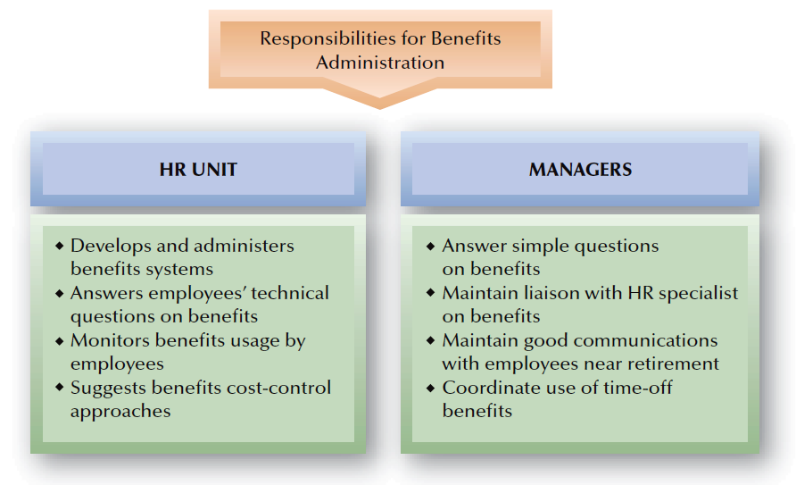
FIGURE 13–4
Typical Division of HR Responsibilities: Benefits Administration

Slide 9

HR Technology and Benefits Administration
Benefits Administration
Issues and Trends
Outsourcing of Benefits Administration
Internet-Based Administration Systems
Benefits Measurement (Return vs. Costs)

Slide 10
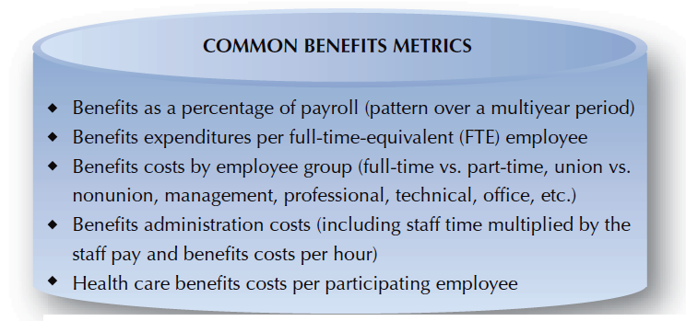
FIGURE 13–5
Common Benefits Metrics

Slide 11

Benefits Cost Control
Reducing or dropping benefits
Cost sharing with employees
Sponsoring wellness programs
Fostering employee health education
Direct purchase of benefits by employees
Negotiating reduced-rate benefit contracts
Consolidating of benefits packages

Slide 12
Benefits Communication
Summary Plan Description
  Details the rights and benefits associated with a particular plan
  Is required by the Employee Retirement Income Security Act (ERISA)
Benefits Statement
  A “personal statement of benefits” that translates benefits into dollar amounts that is given to employees as part of a total rewards education and communication effort.
  ERISA also requires that employees receive an annual pension-reporting statement.

Slide 13
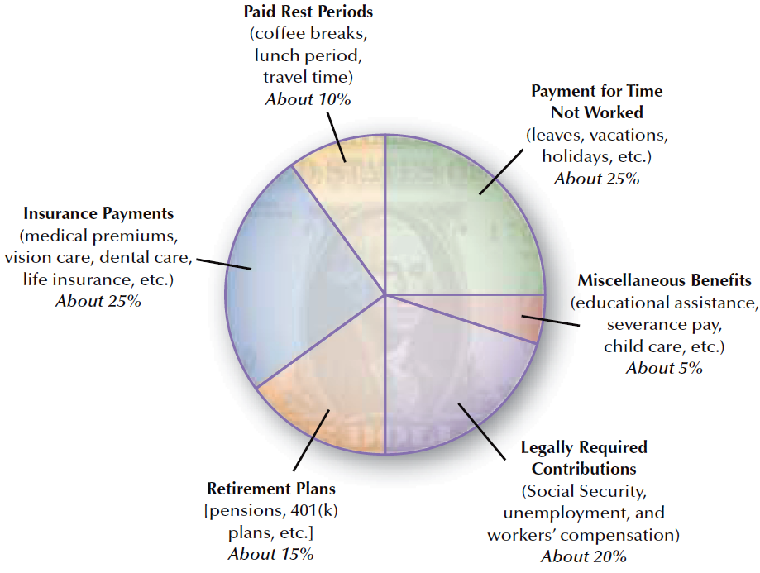
FIGURE 13–6
How the Typical Benefits Dollar Is Spent

Slide 14
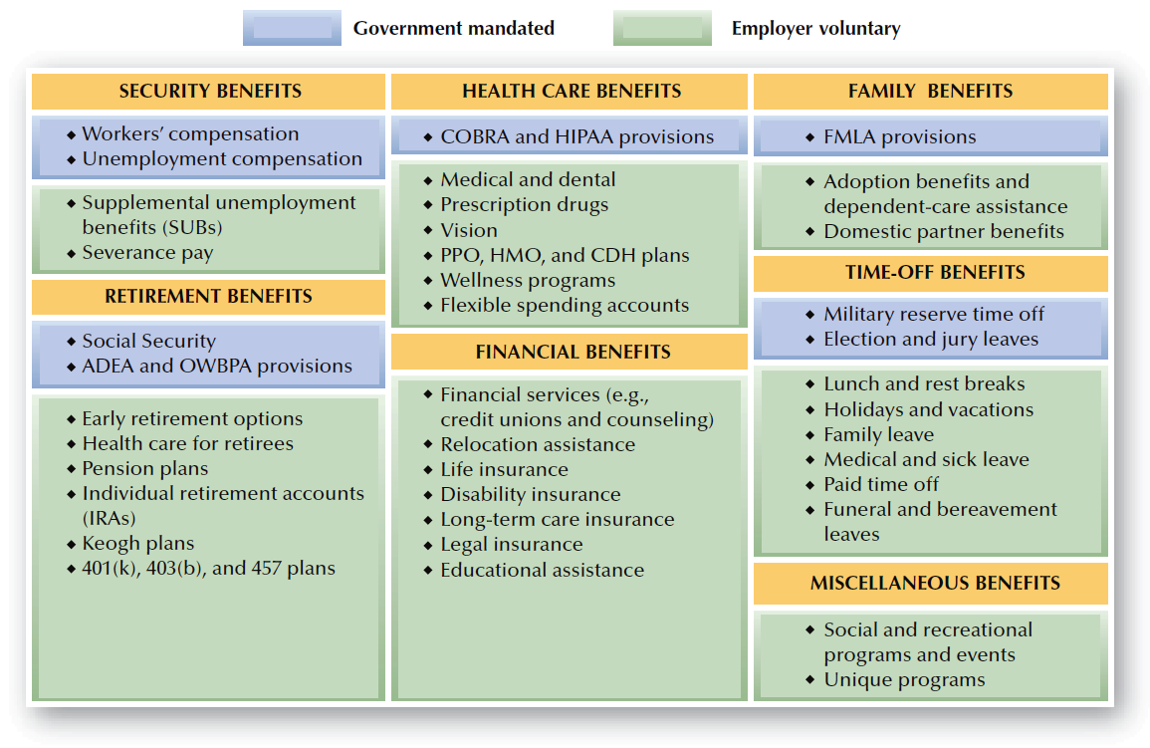
FIGURE 13–7
Types of Benefits

Slide 15
Security Benefits
Types of Security Benefits
Workers’ Compensation
Unemployment Compensation
Severance
Pay

Slide 16
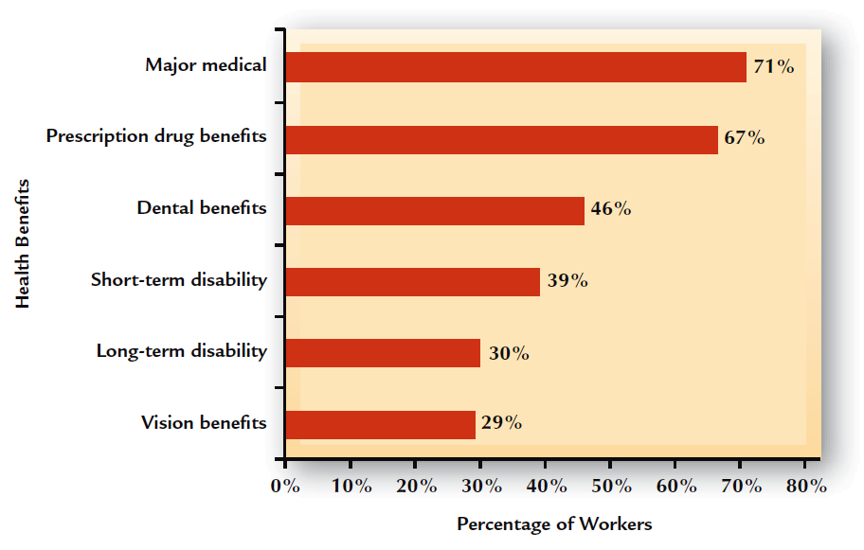
FIGURE 13–8
Private Industry Workers with Health Benefits
Source: U.S. Bureau of Labor Statistics, www.bls.gov/ncs/home.htm.

Slide 17
Health-Care Benefits
Controlling Health-Care Benefits Costs
Co-Payments and Employee Contributions
Managed Care
(PPOs and HMOs,
Utilization Reviews)
Mini-Medical
Plans

Slide 18
Consumer-Driven Health (CDH) Plans
Employee-Focused Health Benefits Plans
Defined-Contribution Health Plans
Health Savings Accounts
(HSAs)
Health Reimbursement Arrangements (HRA)

Slide 19
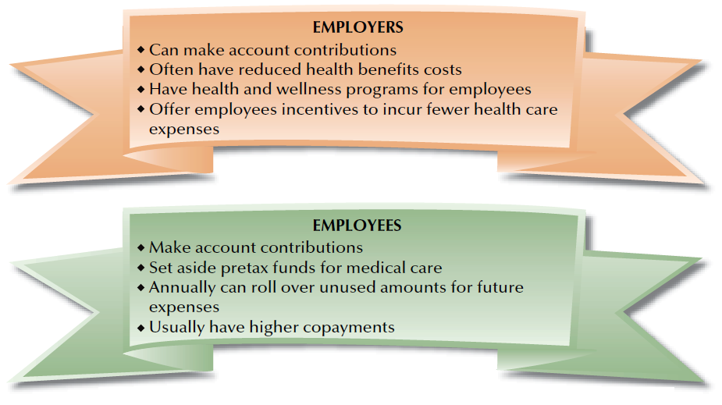
FIGURE 13–9
Components of Consumer-Driven Health Plans

Slide 20
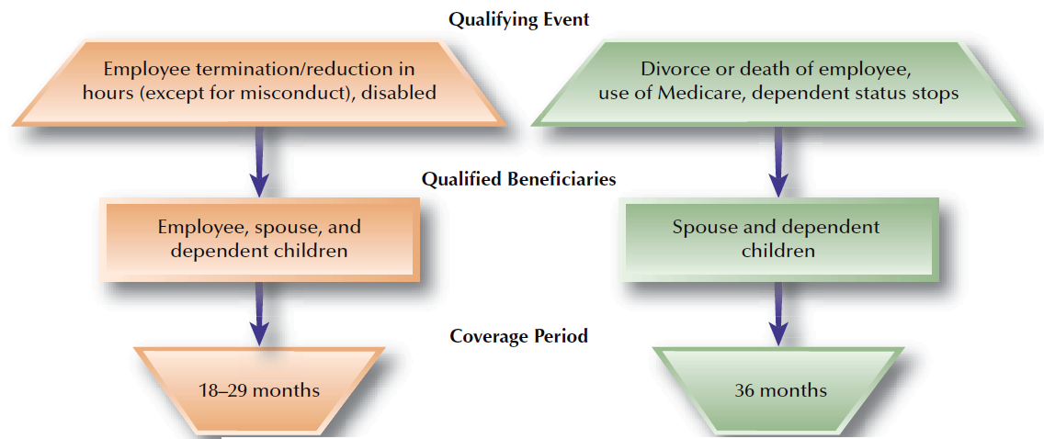
FIGURE 13–10
Overview of COBRA Provisions

Slide 21
Health-Care Legislation
Health Insurance Portability and Accountability Act (HIPAA) of 1996
  Allows employees to switch their health insurance plan from one company to another, regardless of pre-existing health conditions.
  Requires employers to provide privacy notices to employees and to not disclose of health information without authorization.
Flexible Spending Accounts
  Benefits plans that allow employees to contribute pre-tax dollars to fund certain additional benefits.

Slide 22
Other Important Health Care Legislation
Mental Health Parity and Addiction Equity Act
  Requires employers to provide “equal and fair” health care coverage to those individuals adversely affected by mental disorders and substance abuse problems.
Children’s Health Insurance Program Reauthorization Act of 2009
  Gives states the opportunity to provide financial assistance for the defraying of costs associated with employer-based health care programs to (1) children of low-income families or (2) individuals below the age of 19 who are entitled to receive Medicare.

Slide 23
Patient Protection and Affordable Care Act
Aka Healthcare Reform or Obama Care –
March 23, 2010
  Represents the most significant government expansion and regulatory overhaul of the U.S. healthcare system since the passage of Medicare and Medicaid in 1965.
  Aims to increase the rate of health insurance coverage for Americans and reduce the overall costs of health care.
  Provides mechanisms - including mandates, subsidies, and tax credits - to employers and individuals to increase the coverage rate.

Slide 24
Retirement Benefits
Social Security Act of 1935
  Provides old age, survivor’s, disability, and retirement benefits.
    Federal payroll tax (6.2%) on both
    the employer and the employee – max compensation taxed is $113,700.
    Medicare taxes are 1.49% on both
    the employer and the employee.
    Benefit payments are based on
    an employee’s lifetime earnings.
  Administered by the Social
  Security Administration.

Slide 25
Pension Plans
Types of Pension Plans
Defined-
Benefit Plan
Defined-Contribution Plan
Cash
Balance Plan

Slide 26

Pension Plan Concepts
Contributory
Plan
Non-Contributory
Plan
Pension
Plan
Formats
Vesting of
Pension Rights
Portability of Pension Benefits

Slide 27
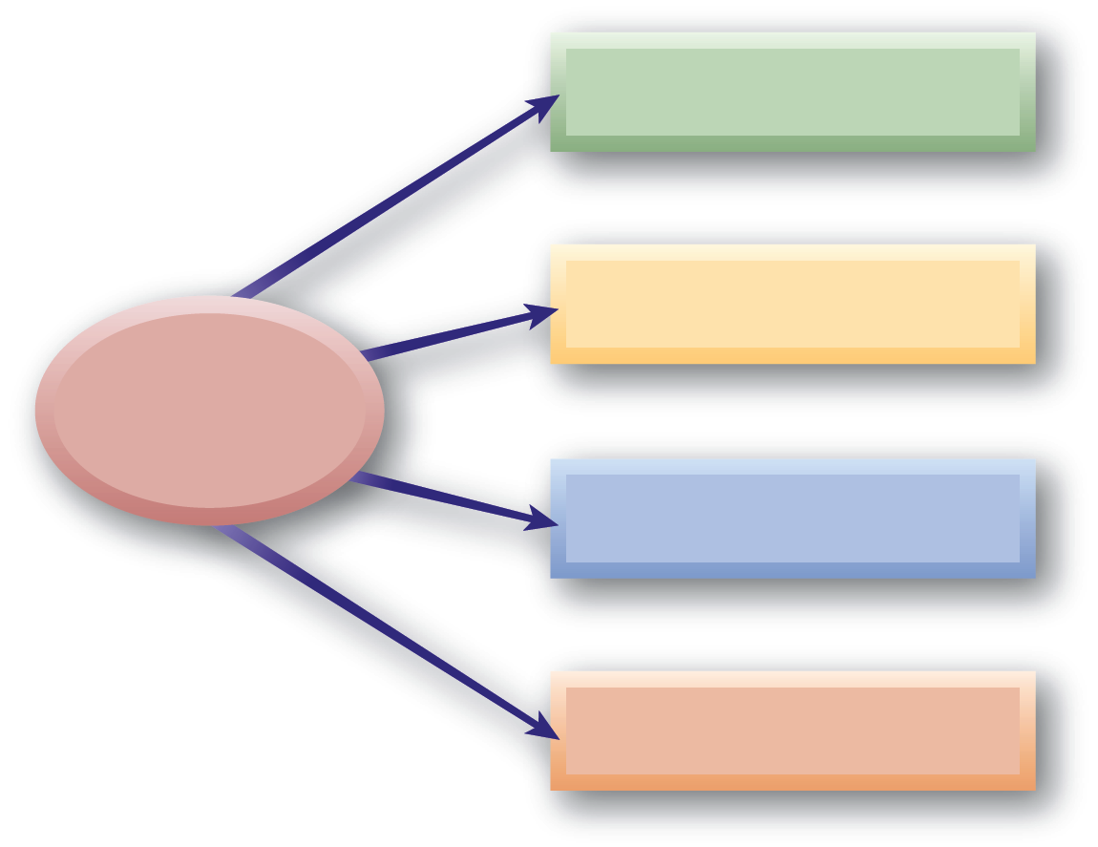
Individual Retirement Options
Individual Retirement Account (IRA)
401(k) and Roth IRA
Individual Retirement
Options
403(b)
Keogh

Slide 28
Legal Requirements for Retirement Benefits
Employee Retirement Security
Employee Retirement Income Security Act (ERISA) 1974
Retirement Equity Act (amended ERISA in 1984)
Qualified Domestic Relations Order (QDRO)

Slide 29
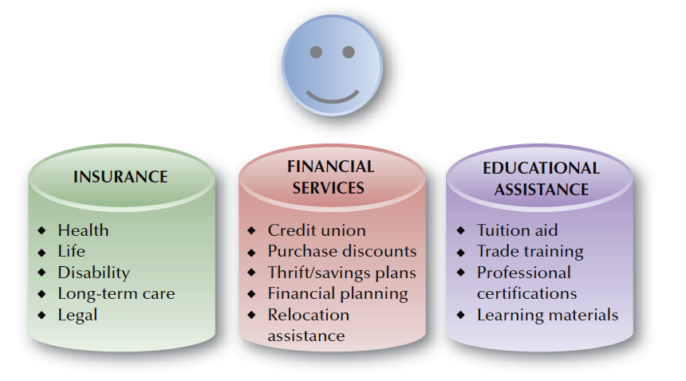
FIGURE 13–12
Common Types of Financial Benefits

Slide 30
Family Medical Leave Act (FMLA)
Coverage
  Employers with 50 or more employees
  Employees who have worked at least 12 months and 1,250 hours in the previous year.
Requirements
  Eligible employees can take up to a total of 12 weeks of unpaid leave in a 12-month period to attend to a family or serious medical condition.
  Employees must exhaust all other forms of leave.
  Employees have rights to continued health benefits and to return to their job.
  Domestic partners are not included.

Slide 31
California Leaves
Pregnancy Disability Leave (PDL) –
  Requires that any employer with 5 or more employees be given up to 4 months (693 hours if normally works 40 hours weekly) of leave without pay due to pregnancy or related disability.
  January 2012 – employer must maintain coverage under group health plans for up to 4 months, at the level and under the conditions that would have been provided if employee was not on leave.
  Runs concurrent with FMLA if employee is eligible

Slide 32
California Leaves
California Family Rights Act (CFRA)
  Employers with 50 or more employees
  Employees who have worked at least 12 months and 1,250 hours in the previous year.
Requirements
  Eligible employees can take up to a total of 12 weeks of unpaid leave in a 12-month period to attend to a family or serious medical condition or baby bonding.
  Employees must exhaust all other forms of leave.
  Employees have rights to continued health benefits and to return to their job.
  Domestic partners are included.

Slide 33
Family-Care Benefits
Family-Based Benefits
Adoption Benefits
Child-Care Assistance
Elder-Care Benefits

Slide 34
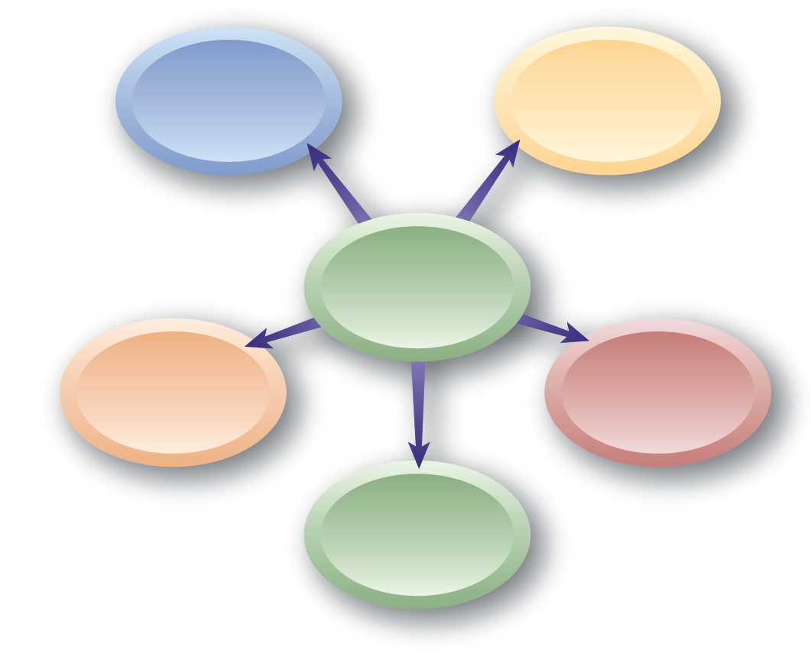
Time-Off and Other Benefits
Holiday
Pay
Vacation
Pay
Time-Off
and Other Benefits
Miscellaneous Benefits
Leaves of Absence
Paid-Time-Off (PTO) Plans

Slide 35
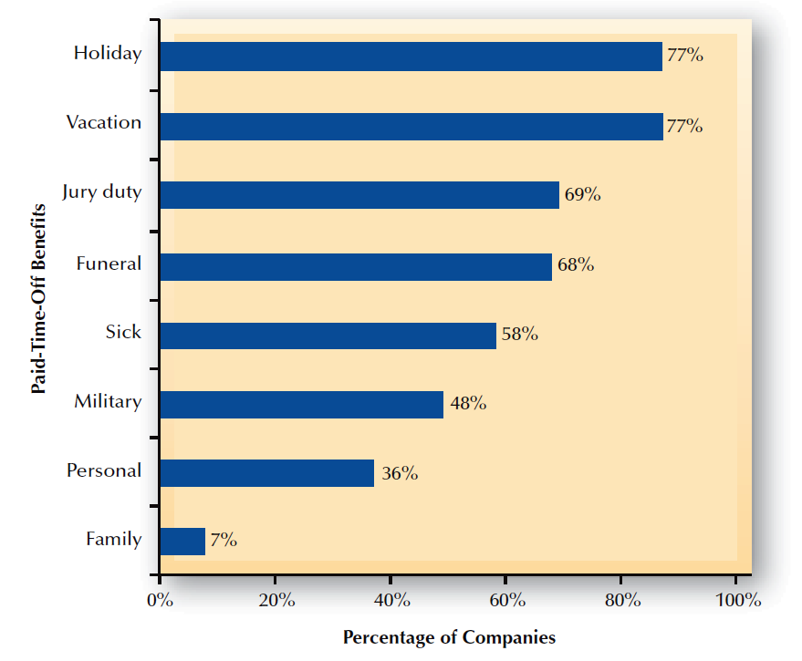
FIGURE 13–13
Percentage of Companies with Various Paid-Time-Off Plans
Source: U.S. Bureau of Labor Statistics, www.bls.gov.

