Slide 1
CHAPTER 12
Incentive Plans and Executive Compensation

Slide 2
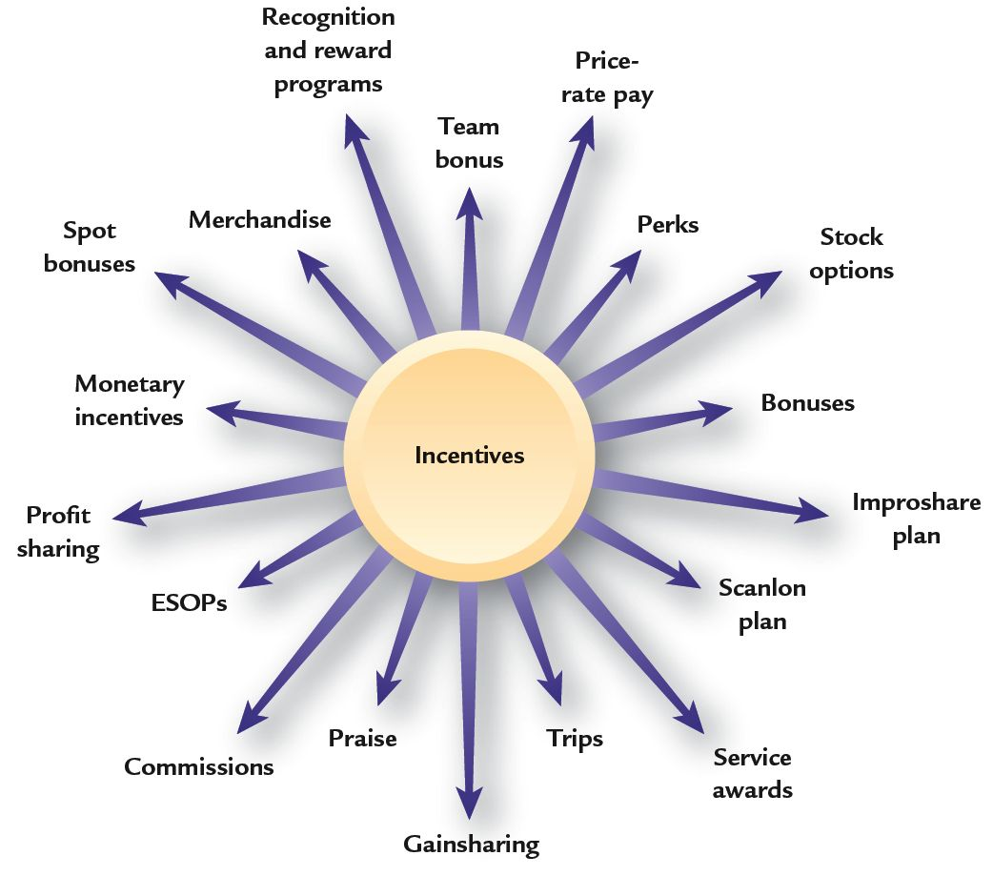
Variable: Incentives for Performance
Variable Pay
  Compensation linked to individual, group/ team, and/or organizational performance.

Slide 3

Why Use Variable Pay?
Some people perform better and are more productive than others
Better performing employees should receive more compensation
Variable
Pay Assumptions
Total compensation should be tied directly to performance and results
Some jobs contribute more to organizational success than others

Slide 4
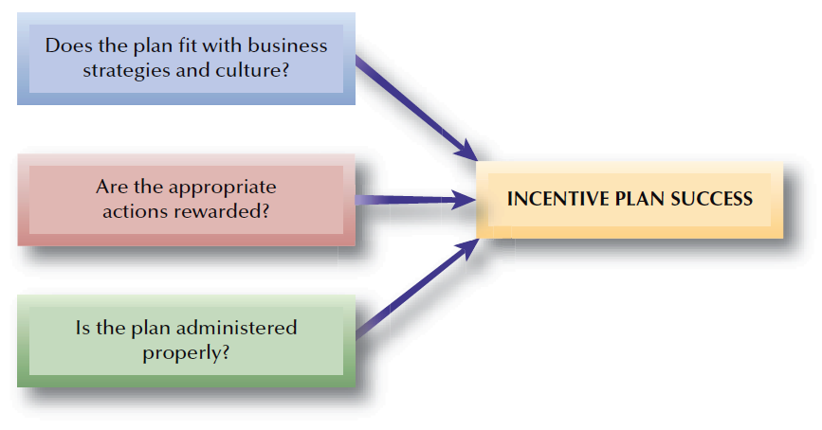
FIGURE 12–1
Effective Variable Pay Plans

Slide 5




Developing Successful
Pay-for-Performance Plans
Link strategic goals and employee performance
Reasons for
Pay-for-Performance Plans
Enhance results and reward employees financially
Reward and recognize employee performance
Promote
achievement of
HR objectives

Slide 6
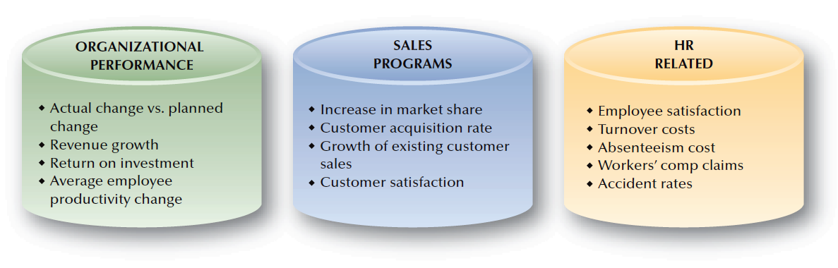
FIGURE 12–2
Metric Options for Variable Pay Plans

Slide 7
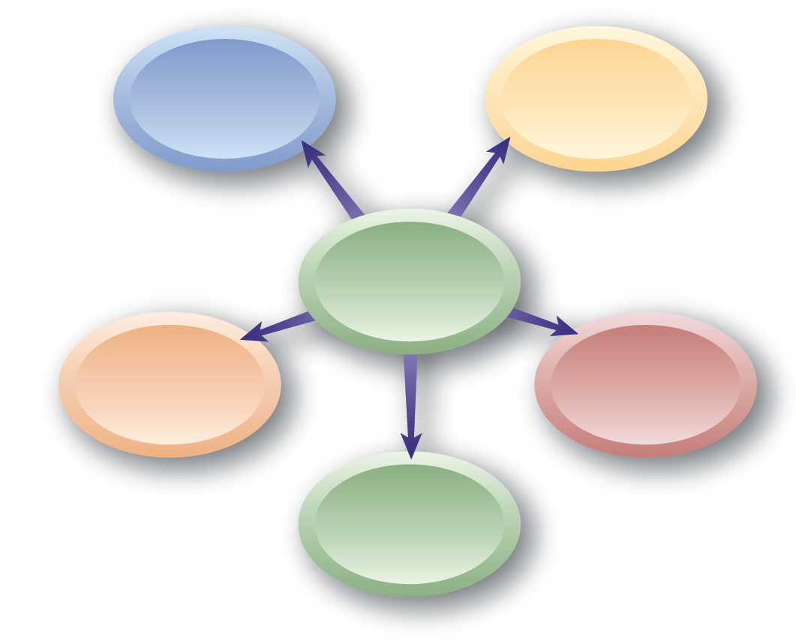
Why Variable Pay Plans Fail
Plan incentives are not seen as desirable
Plan doesn’t reward doing a good job
Employees’
View of Variable Pay Plan
Plan rewards teams/groups rather than individuals
Plan doesn’t motivate
Plan doesn’t increase base pay

Slide 8

Developing Successful Incentive Plans
Develop clear, understandable plans that are continually communicated
Use realistic performance measures
Successful Incentive Plans
Keep plans current and linked to organizational objectives
Link results to payouts that recognize differences
Identify variable pay incentives separately from base pay

Slide 9
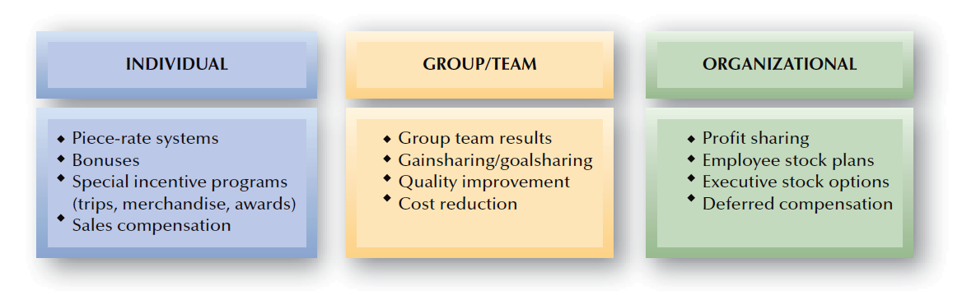
FIGURE 12–3
Categories of Variable Pay Plans

Slide 10

Individual Incentives
Necessary Conditions For Individual Incentive Plans
Individual performance must be identified
Individual competitiveness must be desired
Individualism must be stressed in the organizational culture

Slide 11
Individual Incentives
Piece-Rate Systems
  Straight piece-rate system
  Differential piece-rate system
Bonus
“Spot” Bonuses
Special Incentive Programs
  Performance awards
  Recognition awards
  Service awards
In California must comply with IWC Wage Orders

Slide 12
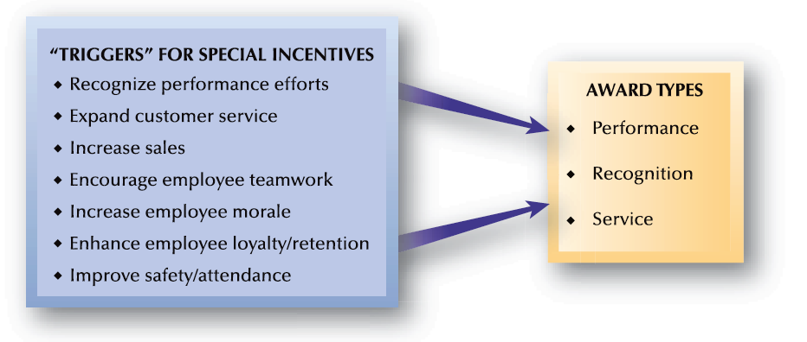
FIGURE 12–4
Purposes of Special Incentives

Slide 13

Why Organizations Establish Variable Pay Plans for Groups/Teams
Group/Team-Based Variable Pay Plans
Improve customer service or production quality
Increase employee retention
Improve productivity
Tie pay to team performance

Slide 14
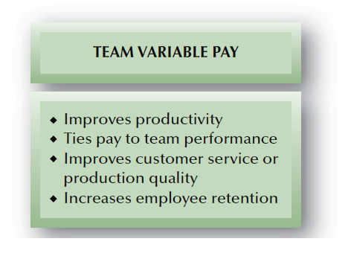
FIGURE 12–5
Teams and Variable Pay Plan Results

Slide 15
Design of Group/Team Incentive Plans
Group/Team Incentive Plan Issues
Distribution of Group/Team Incentives
Timing of Group/Team Incentives
Decisions About Group/Team Incentive Amounts

Slide 16
Group/Team Incentives (cont’d)
Distributing Rewards
  Same-size reward for each member
  Different-size reward for each member
Problems with Group/Team Incentives
  Rewards in equal amounts may be perceived as “unfair” by employees who work harder, have more capabilities, or perform more difficult jobs.
  Group/team members may be unwilling to handle incentive decisions for co-workers.
  Many employees still expect to be paid according to individual performance.

Slide 17
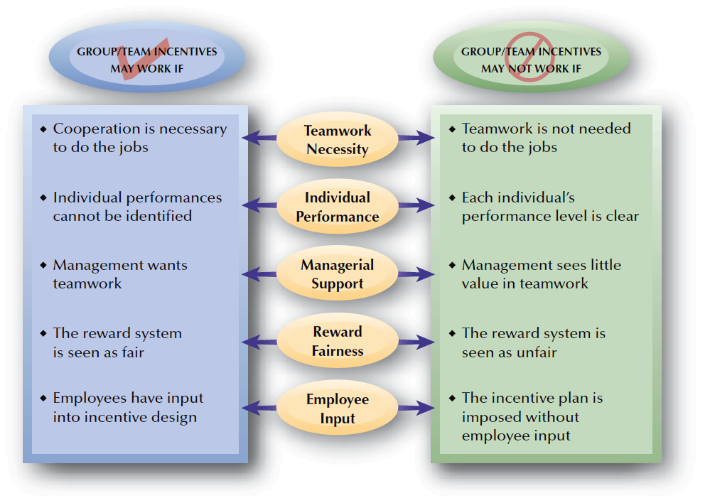
FIGURE 12–6
Conditions for Successful Group/Team Incentives

Slide 18


Organizational Incentives
Profit Sharing
Primary Objectives
Drawbacks
Increase productivity and organizational performance
Attract or retain employees
Improve product/service quality
Enhance employee morale
Disclosure of financial information
Variability of profits from year to year
Profit results not strongly tied to employee efforts

Slide 19
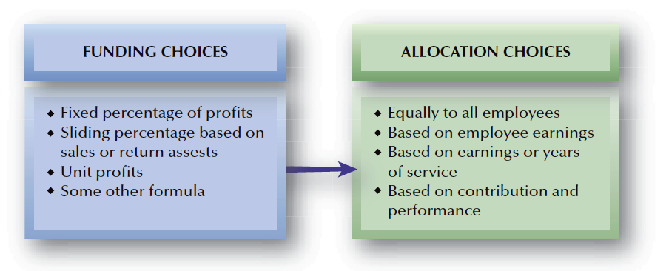
FIGURE 12–7
Framework Choices for a Profit-Sharing Plan

Slide 20
Employee Stock Plans
Stock Option Plan
  A plan that gives employees the right to purchase a fixed number of shares of company stock at a specified price for a limited period of time.
    If market price of the stock is above the specified option price, employees can purchase the stock and sell it for a profit.
    If the market price of the stock is below the specified option price, the stock option is “underwater” and is worthless to employees.

Slide 21
Employee Stock Plans
Employee Stock Ownership Plan (ESOP)
  A plan whereby employees gain significant stock ownership in the organization for which they work.
  Advantages
    Favorable tax treatment for ESOP earnings
    Employees motivated by their ownership stake in the firm
  Disadvantages
    Retirement benefit tied to the firm’s future performance
    Management tool to fend off hostile takeover attempts.

Slide 22
Types of Sales Compensation Plans
In California must comply with IWC Wage Orders
Salary-Only
  All compensation is paid as a base wage with no incentives.
Commission
  Straight Commission
    Compensation is computed as a percentage of sales in units or dollars.
    The draw system makes advance payments against future commissions to the salesperson.
  Salary-Plus-Commission or Bonuses
    Compensation is part salary for income stability and part commission for incentive.

Slide 23
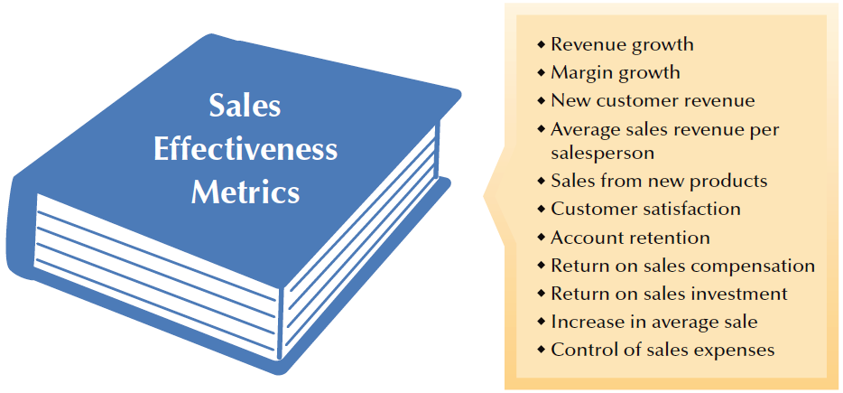
FIGURE 12–8
Sales Metric Possibilities

Slide 24
Effectiveness of Sales Incentive Plans
Frequent changes in sales plans
An “entitlement” culture
Causes of Ineffectiveness in Incentive
Plans
Pay without performance
Poor quota setting
Small differences in pay for top and bottom performers

Slide 25
Executive Compensation
Executive Salaries
Executive Benefits
Elements of Executive Compensation
Executive Perquisites
(Perks)
Annual Executive Incentives
and Bonuses
Performance Incentives:
Long Term vs. Short Term

Slide 26
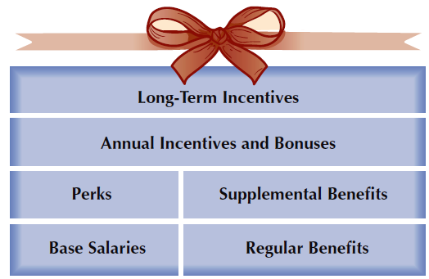
FIGURE 12–9
Components of Executive Compensation Packages

Slide 27
“Reasonableness” of Executive Compensation
Would another company hire this person as an executive?
How does the executive’s compensation compare with that for executives in similar companies?
Executive Compensation Considerations
and
Concerns
Is the executive’s pay consistent with pay for other employees within the company?
What would an investor pay for the level of performance of the executive?

Slide 28
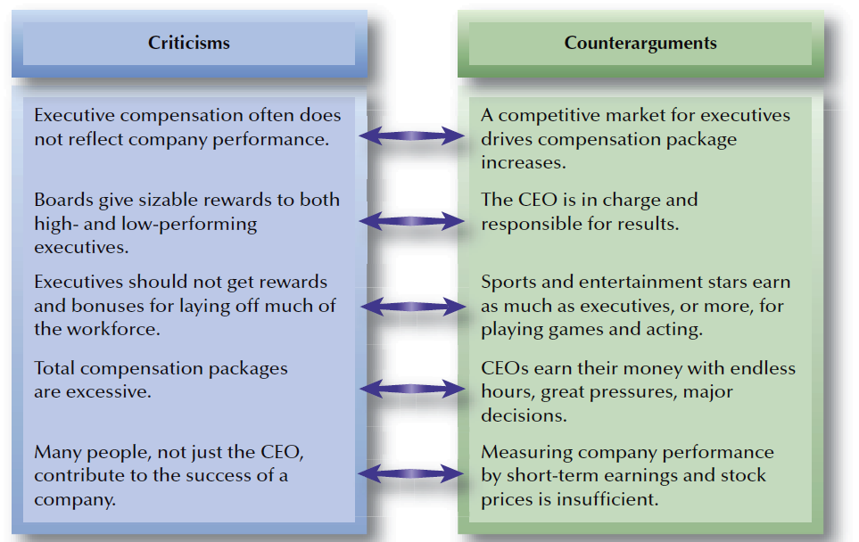
FIGURE 12–10
Common Executive Compensation Criticisms

