Slide 1
CHAPTER 11
Total Rewards and Compensation

Slide 2
Nature Of Total Rewards and Compensation
Total Rewards
  Monetary and non-monetary rewards provided to attract, motivate, and retain employees.
Rewards System Strategic Objectives:
  Legal compliance with all laws and regulations
  Cost-effectiveness for the organization
  Internal, external, and individual equity
  Performance enhancement for the organization
  Performance recognition and talent management
  Enhanced recruitment, involvement, and retention

Slide 3

Compensation Approaches
Traditional Approach
Total Rewards Approach
Compensation is primarily base pay
Bonuses are for executives only
Fixed benefits tied to long tenure
Pay grade progression is based on organizational promotions
One organization-wide pay plan for all employees
Variable pay used with base pay
Annual/long-term incentives provided to all employees
Flexible and portable benefits offered
Knowledge-based broadbands determine pay grades
Multiple pay plans consider job family, location, and business units

Slide 4
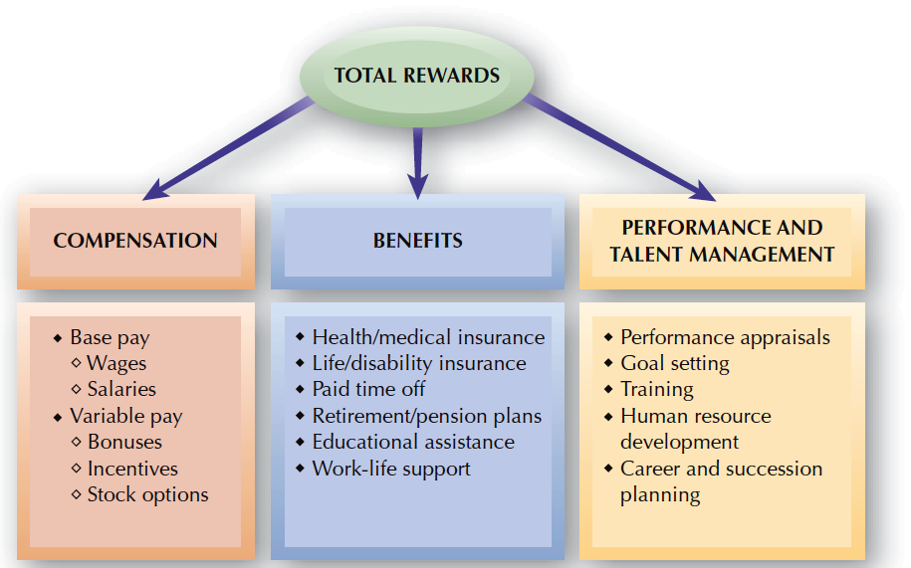
FIGURE 11–1
Total Rewards Components

Slide 5
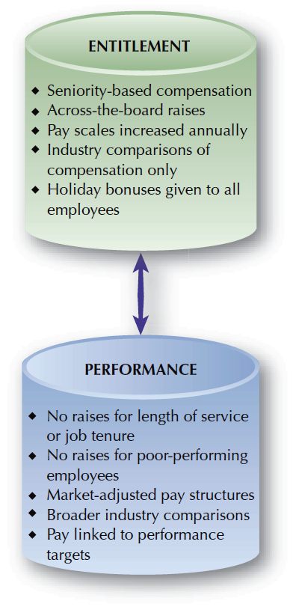
FIGURE 11–2
Continuum of Compensation Philosophies

Slide 6
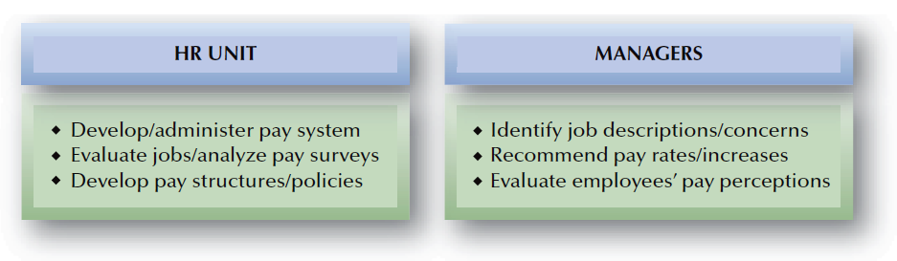
FIGURE 11–4
Typical Division of Compensation Responsibilities in HR

Slide 7

Compensation System Design Issues
Compensation Fairness
and Equity
External
Equity
Internal Equity
Procedural Justice
Distributive Justice
Pay Secrecy vs. Openness

Slide 8
Compensation System Design Issues (cont’d)
Market Competitiveness
and Compensation
“Meet the Market” Strategy
“Lag the Market”
Strategy
“Lead the Market” Strategy

Slide 9
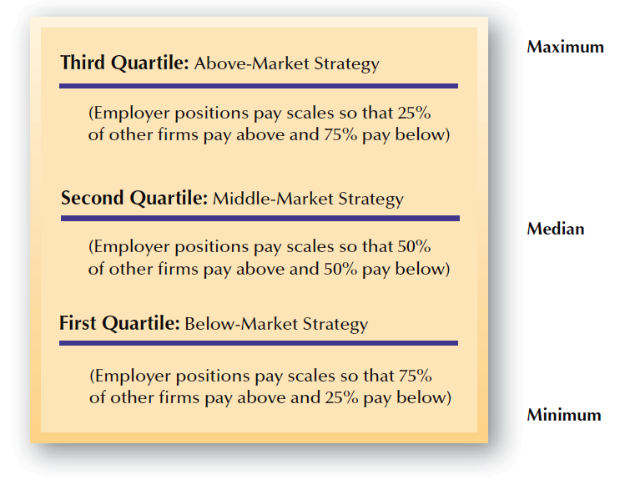
FIGURE 11–5
Compensation Quartile Strategies

Slide 10

Competency-Based Pay System Design Issues
Identification of the required competencies
Progression and compensation of employees
Competency-Based Pay Systems
KBP/SBP
Limitations on who can acquire more competencies
Training in the appropriate competencies
Certification and maintenance of competencies

Slide 11


Compensation System Design Issues (cont’d)
Individual versus Team Rewards
Team
Individual
How to develop compensation programs that build on the team concept.
How to compensate
the individuals whose performance may also be evaluated on team achievements.

Slide 12
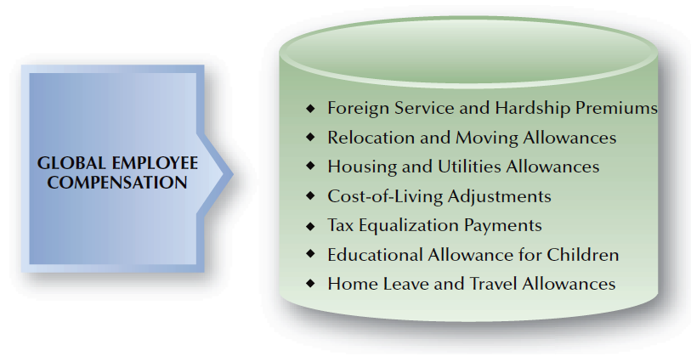
FIGURE 11–6
Possible Components of Global Employee Compensation

Slide 13
Global Compensation Issues
Compensating Expatriates
Balance-Sheet Approach
Global Market Approach
Tax Equalization Plan

Slide 14

Legal Constraints On Pay Systems
Fair Labor Standards Act (FSLA)
Minimum
Wage
Child
Labor
Provisions
Exempt and Non-Exempt Statuses
Overtime
Pay

Slide 15
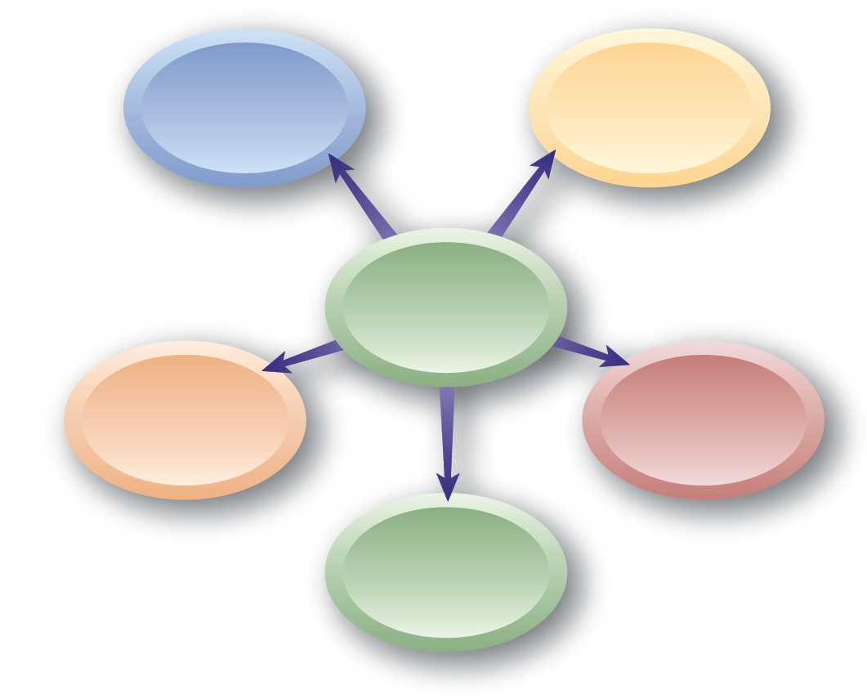
Categories of Exempt Employees
Executive
Administrative
Exempt Employees
Outside Sales
Professional
Computer Employees

Slide 16
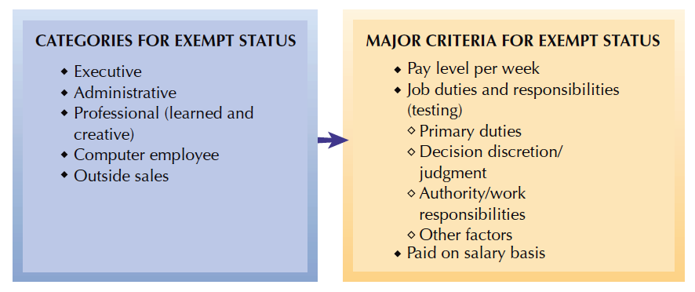
FIGURE 11–7
Determining Exempt Status under the FLSA

Slide 17
Wage/Hour Regulations
Fair Labor Standards Act (FLSA)
  To qualify for an exemption from the overtime provisions of the act:
    Employees must perform their primary duties as executive, administrative, professional, or outside sales employees.
    Primary has been interpreted to mean occurring at least 50% of the time.

Slide 18
Wage/Hour Regulations
California – Exempt from Overtime
  Administrative exemption
  Professional exemption
  Executive exemption
  Computer software employee exemption – must also earn $83,132.93 annually or $39.90 per hour (1/1/13)

Slide 19
Compensation for Overtime Work
Common Overtime Issues
Compensatory Time Off
Incentives for Non-exempts
Training
Time
Travel
Time

Slide 20
Independent Contractor Regulations
Identifying Criteria for Independent Contractors
Behavioral Control
Financial
Control
Relationship-Type Factors

Slide 21
Acts and Legislation Affecting Compensation
Compensation and the Law
Davis-Bacon Act
Walsh-Healy Act
McNamara-O’Hara Act
Equal Pay Act
of 1963 and
Pay Equity
State and
Local Laws
Garnishment Laws

Slide 22
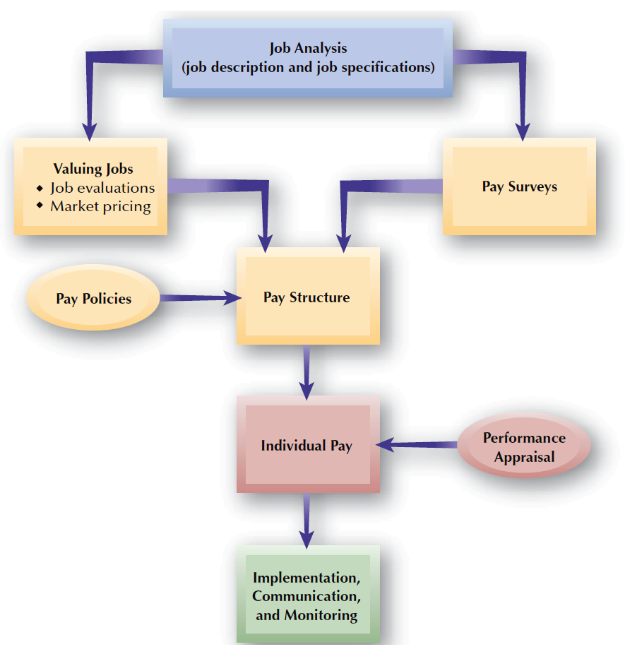
FIGURE 11–8
Compensation Administration Process

Slide 23
Valuing Jobs with Job Evaluation Methods
Job Evaluation
  The formal systematic means used to identify the relative worth of jobs within an organization.
Compensable Factor
  A job value commonly present throughout a group of jobs.
  Something for which an organization will compensate an employee.

Slide 24
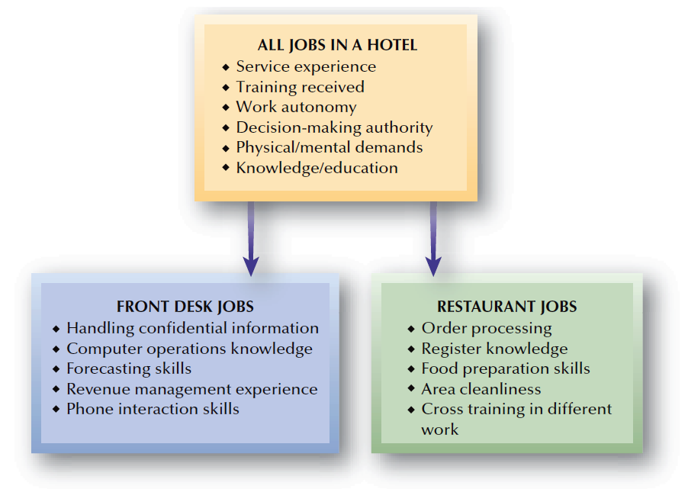
FIGURE 11–9
Examples of Compensable Factors for Different Job Families in a Hotel

Slide 25
Job Evaluation Methods
Job Evaluation Methods
Point
Method
Ranking Method
Classification Method
Factor-Comparison Method

Slide 26
Valuing Jobs Using Market Pricing
Market Pricing
  Using market pay data to identify the relative value of jobs based on what other firms pay for similar jobs.
Advantages
Disadvantages
Ties organizational pay levels to the external job market, without “internal” job evaluation distortion.
Communicates to employees that the compensation system is “market linked.”
It relies on market survey data.
A specific job may differ from a “matching” job in the survey.
The market data’s scope (range of sources) is a concern.
Tying pay levels to market data can lead to wide fluctuations.

Slide 27
Pay Surveys
Pay Survey
  Collection of data on compensation rates for workers performing similar jobs in other organizations.
Benchmark Jobs
  Jobs found in many organizations.
Internet-Based Pay Surveys
  Pay survey questionnaires are distributed electronically rather than as printed copies.

Slide 28
Using Pay Surveys
Participants
Broad-based
Survey Data Relevance and Validity
Job-matches
Timeliness
Methodology

Slide 29
Pay Structures
Job Family
  A group of jobs having common
  organizational characteristics.
Common Pay Structures
  Hourly and salaried
  Office, plant, technical, professional, managerial
  Clerical, information technology, professional, supervisory, management, and executive
Pay Grades
  Groupings of individual jobs having
  approximately the same job worth.

Slide 30
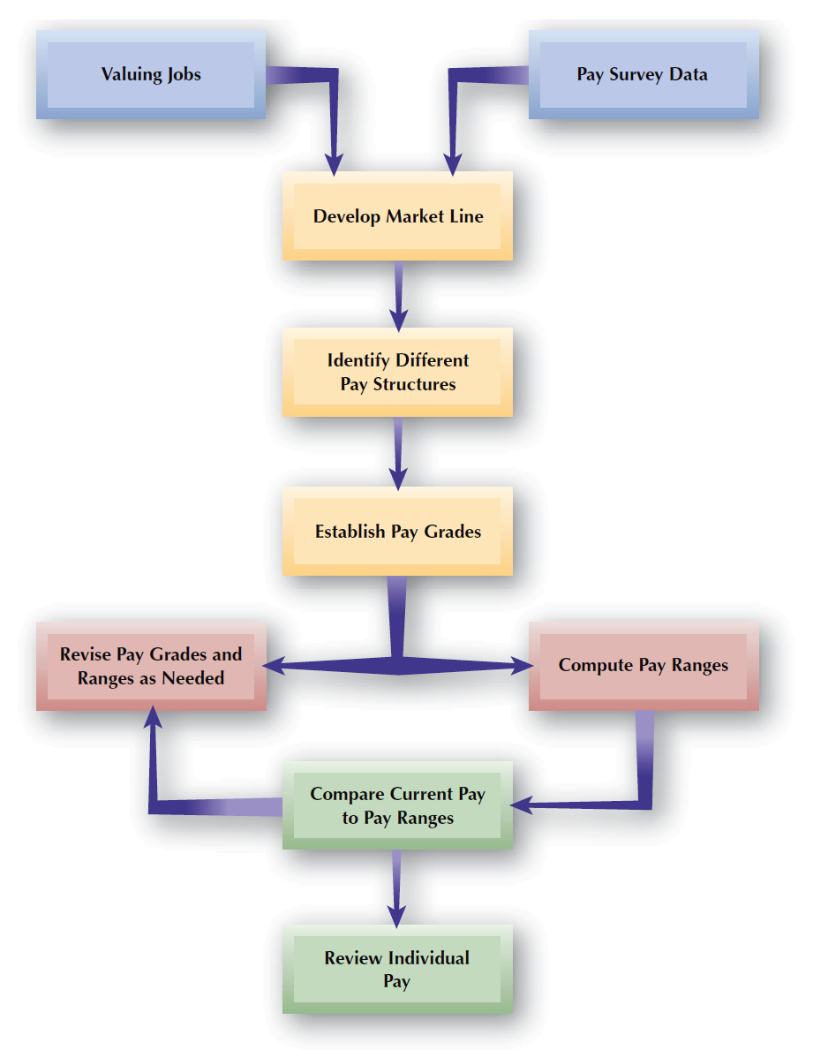
FIGURE 11–10
Establishing Pay Structures

Slide 31
Pay Structures (cont’d)
Market Line
  Shows relationship between job value as determined by job evaluation points and job value as determined by pay survey rates.
  Shows distribution of pay for the surveyed jobs, allowing a linear trend line to be developed by the least-squares regression method.
Market Banding
  Grouping jobs into pay grades based on similar market survey amounts.

Slide 32
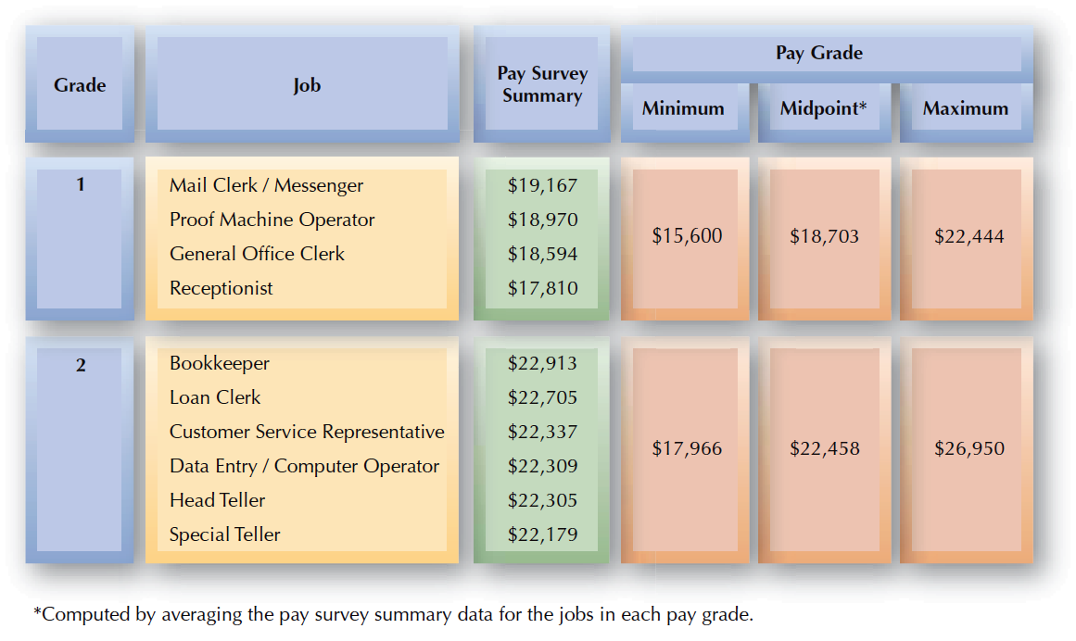
FIGURE 11–11
Market-Banded Pay Grades for Community Bank

Slide 33
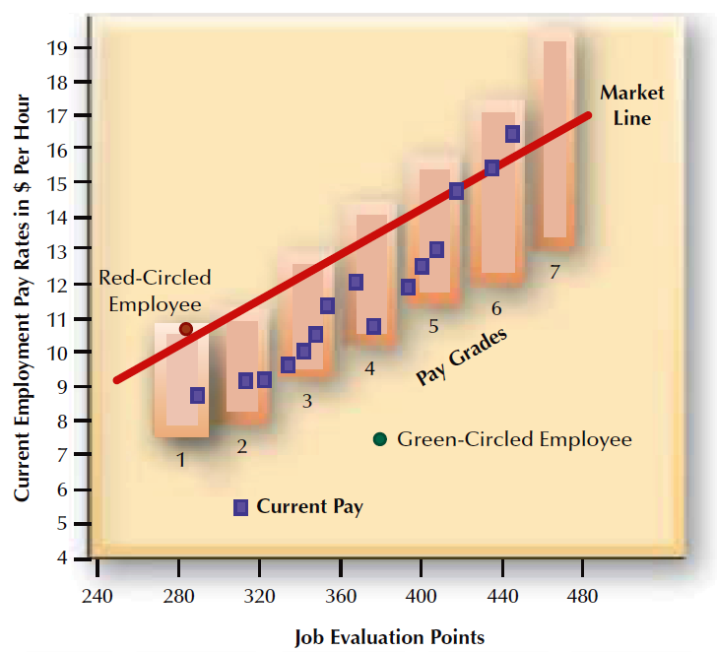
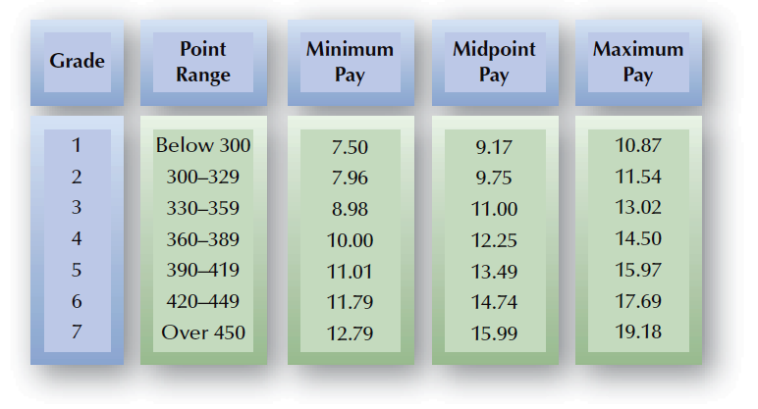
FIGURE 11–12
Example of Pay Grades and Pay Ranges

Slide 34
Pay Ranges
Broadbanding
  The practice of using fewer pay grades having broader pay ranges that in traditional systems.
  Benefits
    Encourages horizontal movement of employees
    Is consistent with trend towards flatter organizations
    Creates a more flexible organization
    Encourages competency development
    Emphasizes career development

Slide 35
Individual Pay
Rates Out of Range
  Red-Circled Employees
    An incumbent (current jobholder) who is paid above the range set for the job.
  Green-Circled Employees
    An incumbent who is paid below the range set for the job.
Pay Compression
  A situation in which pay differences among individuals with different levels of experience and performance in the organization becomes small.

Slide 36
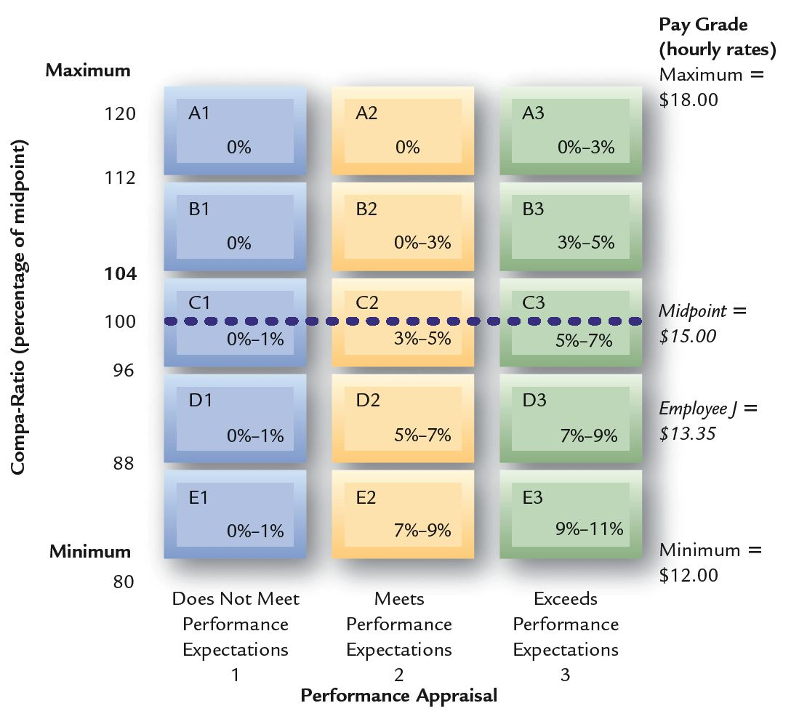
FIGURE 11–13
Pay Adjustment Matrix
89
Compa-ratio
  The pay level divided by the midpoint of the pay range.

Slide 37
Standardized Pay Adjustments
Standardized Pay Increases
Cost-of-Living Adjustments
(COLA)
Across-the-Board
Increases
Lump-Sum Increases
(LSI)
Seniority

