Slide 1
CHAPTER 10
Performance Management and Appraisal

Slide 2
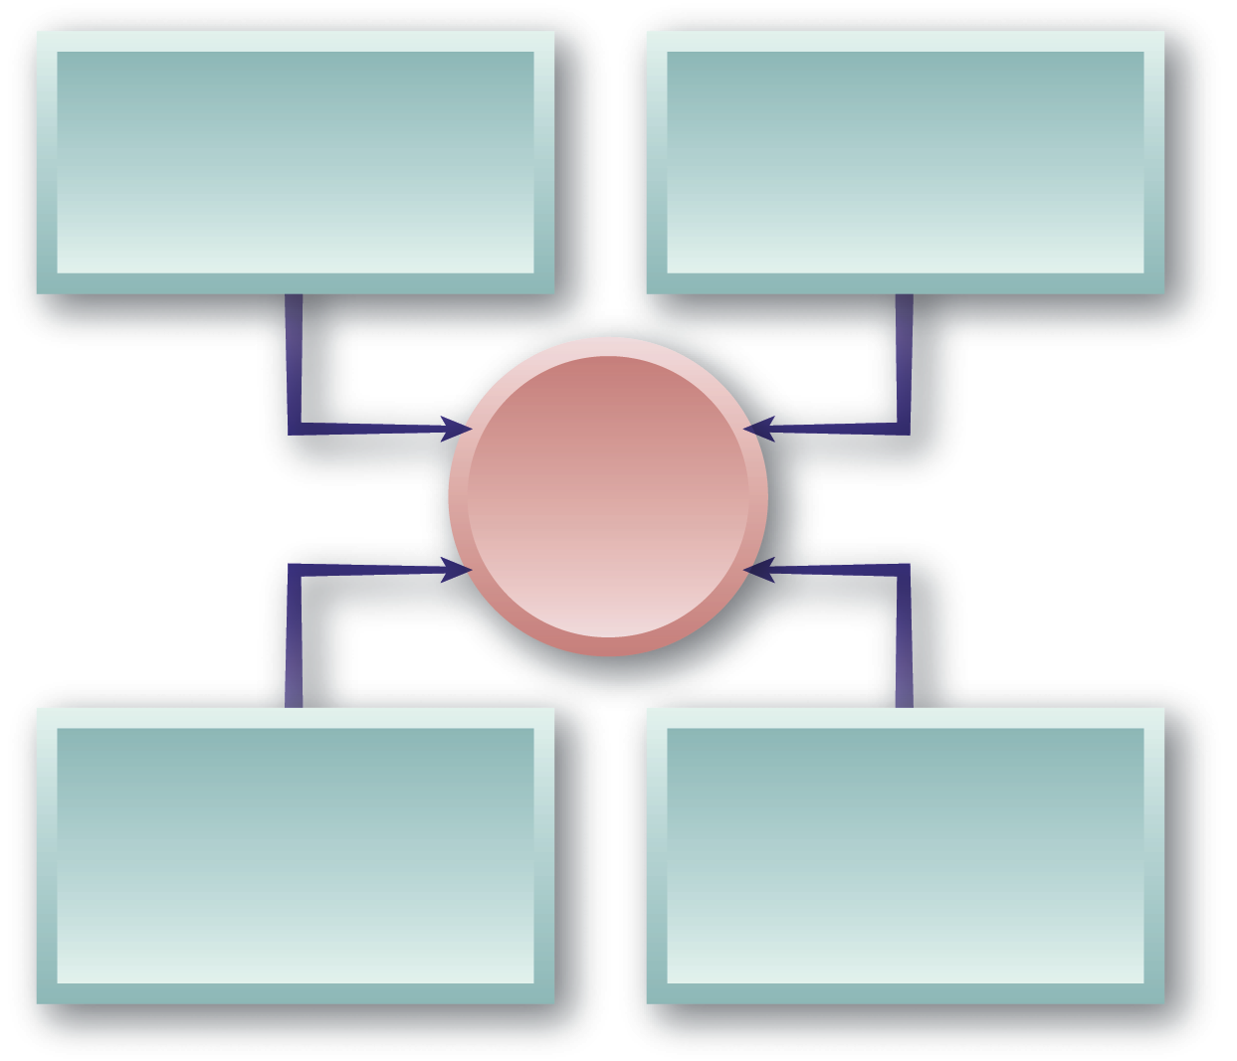
The Nature of Performance Management
Make clear what the organization expects
Provide performance information to employees
Effective Performance Management System
Identify areas of success and needed development
Document performance for personnel records

Slide 3

Performance Management versus Performance Appraisal
Performance Management
Performance Appraisal
Processes used to identify, encourage, measure, evaluate, improve, and reward employee performance
The process of evaluating how well employees perform their jobs and then communicating that information to the employees

Slide 4
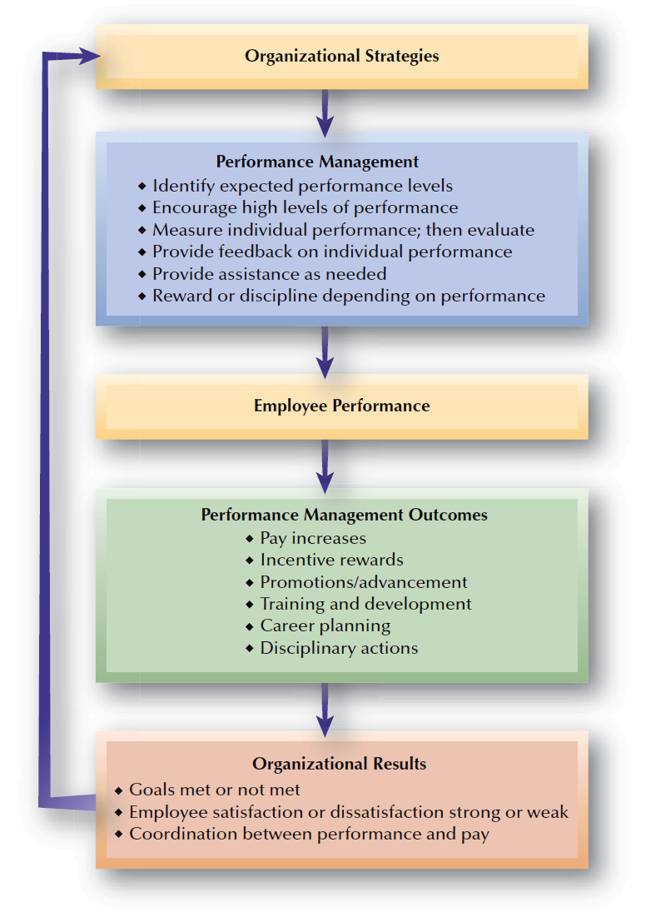
FIGURE 10–1
Performance Management Linkage

Slide 5
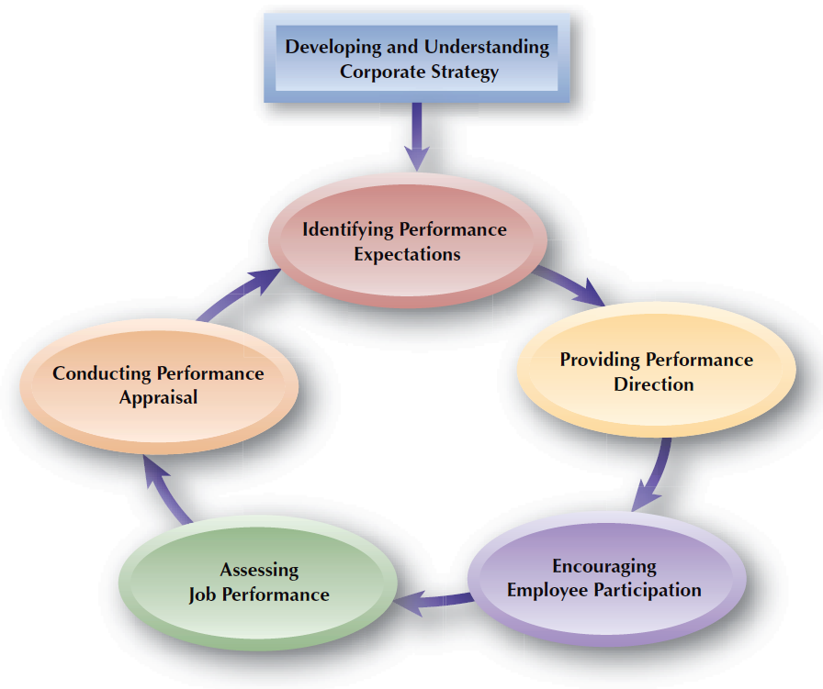
FIGURE 10–2
Components of Performance Management

Slide 6
Global Cultural Differences in Performance Management
Uncommon for managers in other cultures to rate employees or to give direct feedback.
Younger subordinates do not engage in joint discussions with their managers due their high respect for authority and age.
Criticism from superiors is viewed as personally devastating rather than as useful feedback.

Slide 7
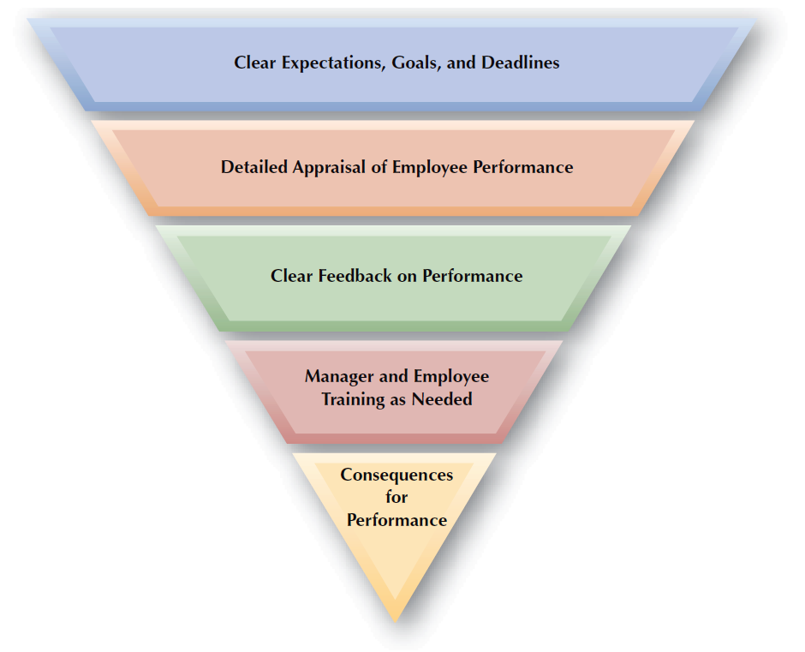
FIGURE 10–3
Components of a Performance-Focused Culture

Slide 8


Identifying and Measuring Employee Performance
Quantity
of output
Quality
of output
Timeliness
of output
Performance Criteria for Appraisals
Presence/
attendance
on the job
Efficiency of work completed
Effectiveness of work completed

Slide 9
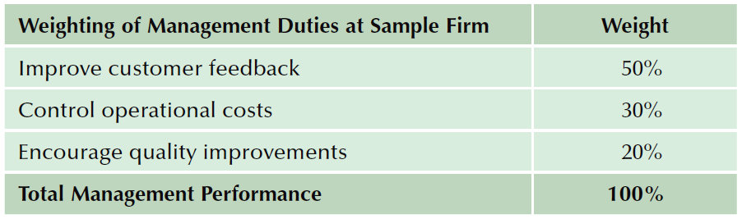
Identifying and Measuring Employee Performance (cont’d)
Job Duties
  Important elements in a given job as identified from job descriptions.
  What an organization pays an employee to do.

Slide 10
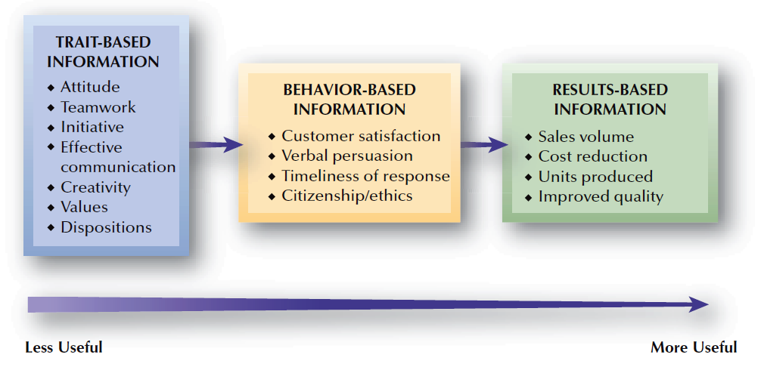
FIGURE 10–4
Types of Performance Information

Slide 11

Relevance of Performance Criteria
Factors Affecting Relevance
Deficient Measures
Contaminated Measures
Overemphasized Measures

Slide 12
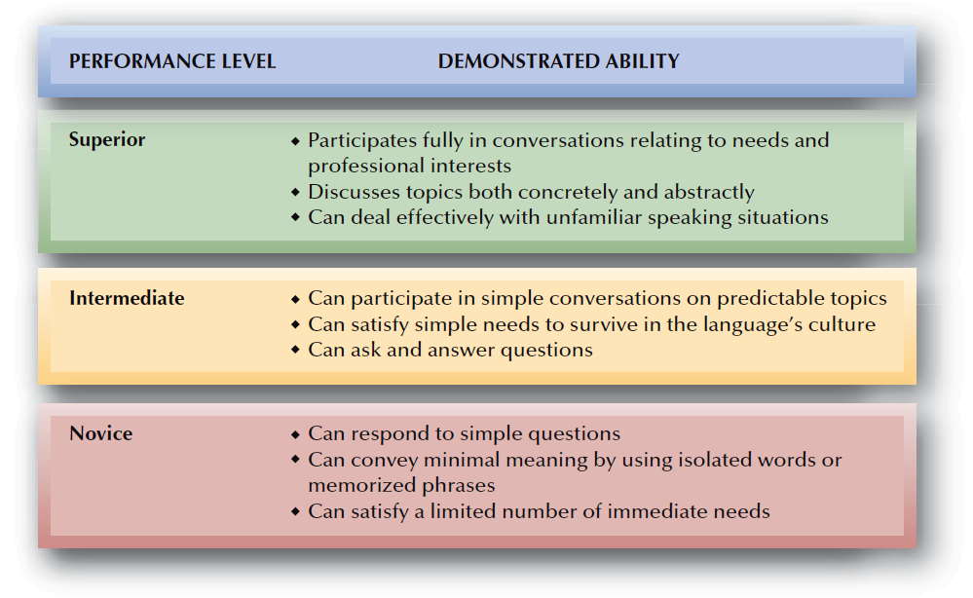
FIGURE 10–5
ACTFL Performance Standards for Speaking Proficiency

Slide 13
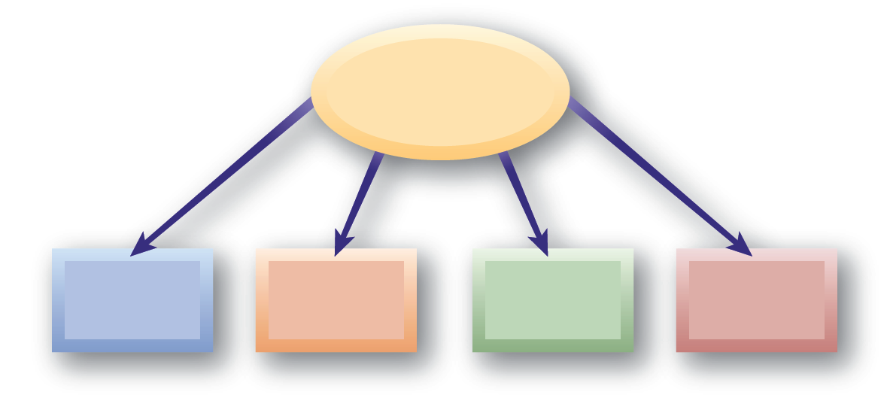
Performance Metrics in Service Businesses
Common Sources
of Performance Differences
Regional
Labor Cost Differences
Service Agreement Differences
Equipment/ Infrastructure Differences
Work
Volume
Performance that is measured can be managed.

Slide 14
Performance Appraisals
Benefits of Performance Appraisals
  Increased operational competence
  Legal compliance
  Enhanced corporate growth
  Heightened transformational processes and performance
  Provide answers to a wide array of work-related questions of how to improve job performance

Slide 15
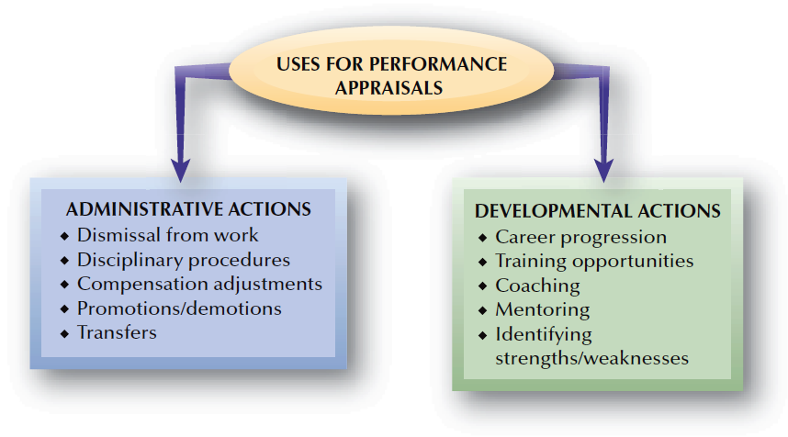
FIGURE 10–6
Uses for Performance Appraisals

Slide 16
Decisions About the Performance Appraisal Process
Designing Appraisal Systems
Informal vs. Systematic Processes
Appraisal Responsibilities
Timing of Appraisals

Slide 17
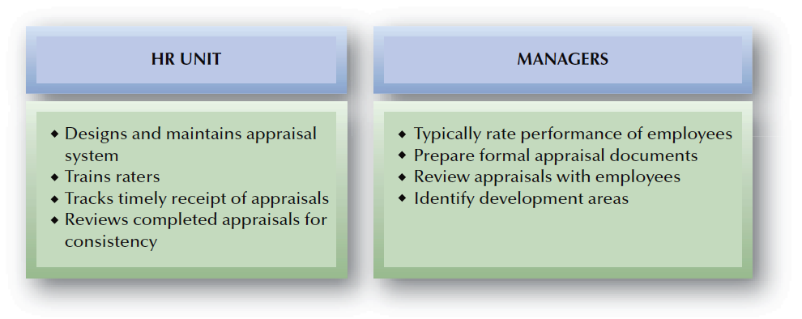
FIGURE 10–7
Typical Division of HR Responsibilities: Performance Appraisal

Slide 18

Legal Concerns and Performance Appraisals
Legally Defensible Performance Appraisal System:
Appraisal criteria based on job analysis (i.e., job-related)
Absence of disparate impact and evidence of validity
Formal evaluation criteria that limit managerial discretion
A rating instrument linked to job duties and responsibilities
Documentation of the appraisal activities
Personal knowledge of and contact with appraised individual
Training of supervisors in conducting appraisals
Review process to prevent undue control of careers
Counseling to help poor performers improve

Slide 19
Who Conducts Appraisals?
Supervisors rating their employees
Multisource or
360° feedback
Employees rating their superiors
Sources of Performance Appraisals
Outside sources rating employees
Team members rating each other
Employees rating themselves

Slide 20
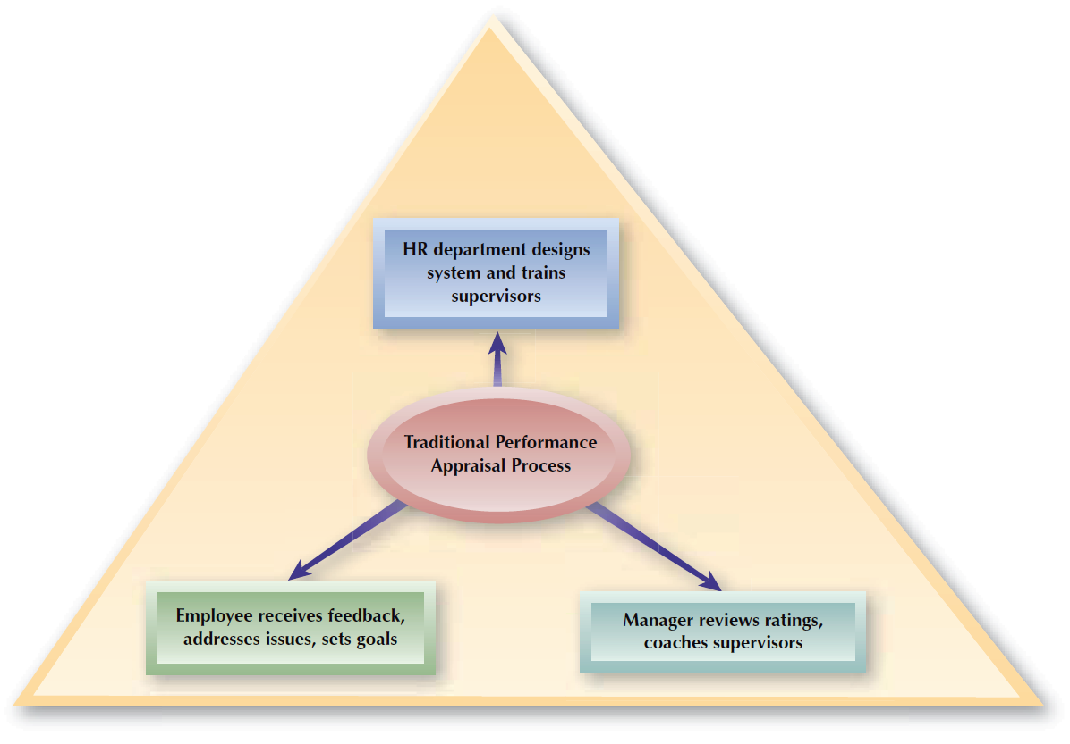
FIGURE 10–8
Traditional Performance Appraisal Process

Slide 21

Employee Rating of Managers
Advantages
Disadvantages
Helps in identifying competent managers
Serves to make managers more responsive to employees
Contributes to the career development of managers
Negative reactions by managers to ratings
Subordinates’ fear of reprisals may inhibit them from giving realistic (negative) ratings
Ratings are useful only for self-improvement purposes

Slide 22
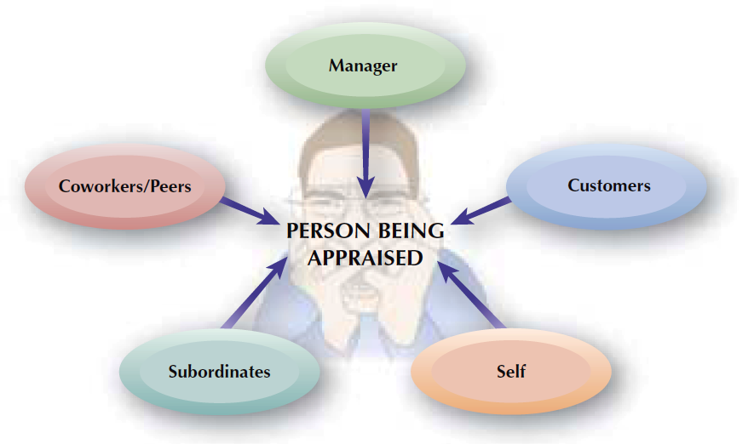
FIGURE 10–9
Multisource Appraisal

Slide 23
Team/Peer Rating
Advantages
Disadvantages
Helps improve performance of lower-rated individuals
Peers have opportunity to observe other peers
Peer appraisals focus on individual contributions to teamwork and team performance
Can negatively affect working relationships
Can create difficulties for managers in determining individual performance
Organizational use of individual performance appraisals can hinder the development of teamwork

Slide 24
Category Scaling Methods
Graphic Rating Scale
  Allows the rater to mark an employee’s performance on a continuum indicating low to high levels of a particular characteristic.
Aspects of Performance Measured
Descriptive Categories
Job
Duties
Behavioral Dimensions

Slide 25
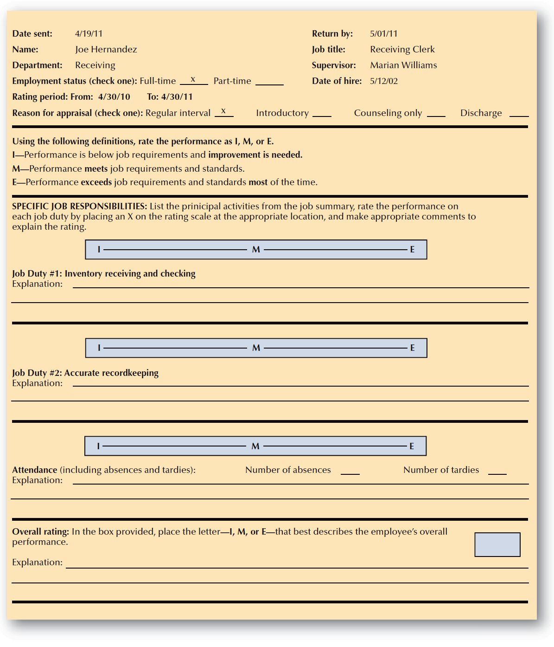
FIGURE 10–10
Sample Performance Appraisal Form

Slide 26
Concerns with Graphic Rating Scales
Restrictions on the range and type of rater responses
Differences in rater interpretations of scale item meanings and scale ranges
Graphic
Rating Scale Drawbacks
Rating form deficiencies limit effectiveness of the appraisal
Poorly designed scales that encourage rater errors

Slide 27
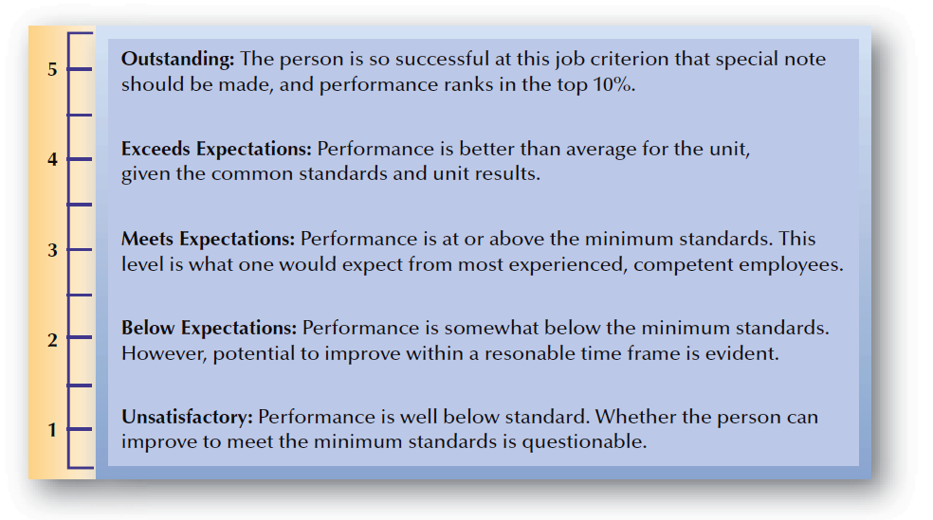
FIGURE 10–11
Sample Terms for Defining Standards

Slide 28
Category Scaling Methods (cont’d)
Behaviorally Anchored Rating Scale (BARS)
  A rating scale composed of job dimensions (specific descriptions of important job behaviors) that “anchor” performance levels on the scale.
Developing a BARS
  Identify important job dimensions
  Write short statements of job behaviors
  Assign statements (anchors) to job dimensions
  Set scales for anchors

Slide 29
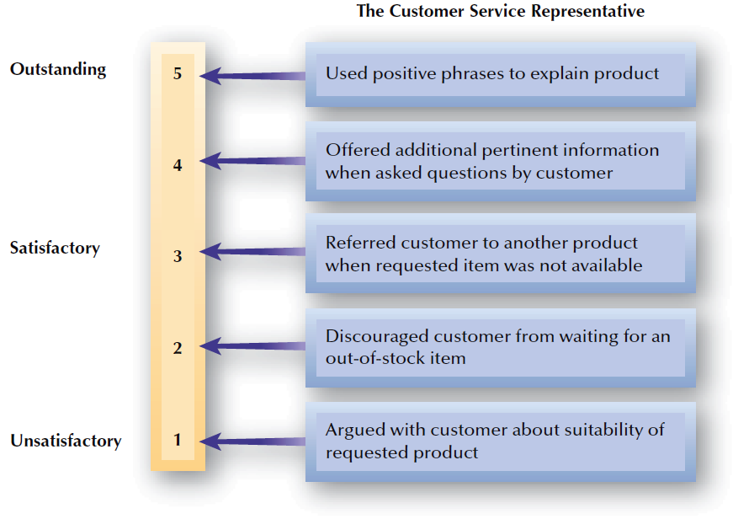
FIGURE 10–12
Behaviorally–Anchored Rating Scale for Customer Service Skills

Slide 30
Comparative Methods
Ranking
  A listing of all employees from highest to lowest in performance.
  Drawbacks:
    Does not show size of differences in performance between employees
    Implies that lowest-ranked employees are unsatisfactory performers.
    Becomes an unwieldy process if the group to be ranked is large.

Slide 31
Comparative Methods (cont’d)
Forced Distribution
  Causes ratings of employees to be distributed along a bell-shaped curve.
Advantages
Disadvantages
Helps deal with “rater inflation.”
Makes manages identify high, average, and low performers.
Ensures that compensation increases reflect performance differences among individuals.
Managers resist placing people in the lowest or highest groups.
Explanation for placement can be difficult.
Performance may not follow normal distribution.
Managers may make false distinctions between employees.

Slide 32
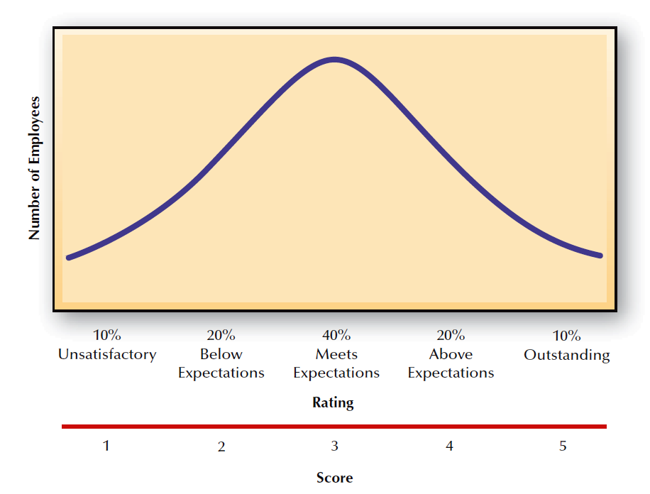
FIGURE 10–13
Forced Distribution on a Bell-Shaped Curve

Slide 33
Narrative Methods
Critical Incident
  Manager keeps a written record of highly favorable and unfavorable employee actions.
  Drawbacks:
    Variations in how managers define a “critical incident”
    Time involved in documenting employee actions
    Most employee actions are not observed and may become different if observed
    Employee concerns about manager’s “black books”

Slide 34
Narrative Methods (cont’d)
Essay
  Manager writes a short essay describing an employee’s performance.
  Drawback:
    Depends on the supervisors’ writing skills and their ability to express themselves.

Slide 35
Management by Objectives (MBO)
Management by Objectives
  Specifying the performance goals that an individual and his or her manager agree the employee will to try to attain within an appropriate length of time.
Key MBO Ideas
  Employee involvement creates higher levels of commitment and performance.
  Employees are encouraged to work effectively toward achieving desired results.
  Performance measures should be measurable and should define results.

Slide 36


Stages in the MBO Process
1. Job review and agreement
2. Development of performance standards
3. Setting of objectives
4. Continuing performance discussions

Slide 37
Training Of Managers And Employees in Performance Appraisal
Appraisal process and timing
Common rating errors
Performance criteria and job standards
Performance Appraisals Training Topics
Compensation reviews
Positive and negative feedback
Training and development goals

Slide 38
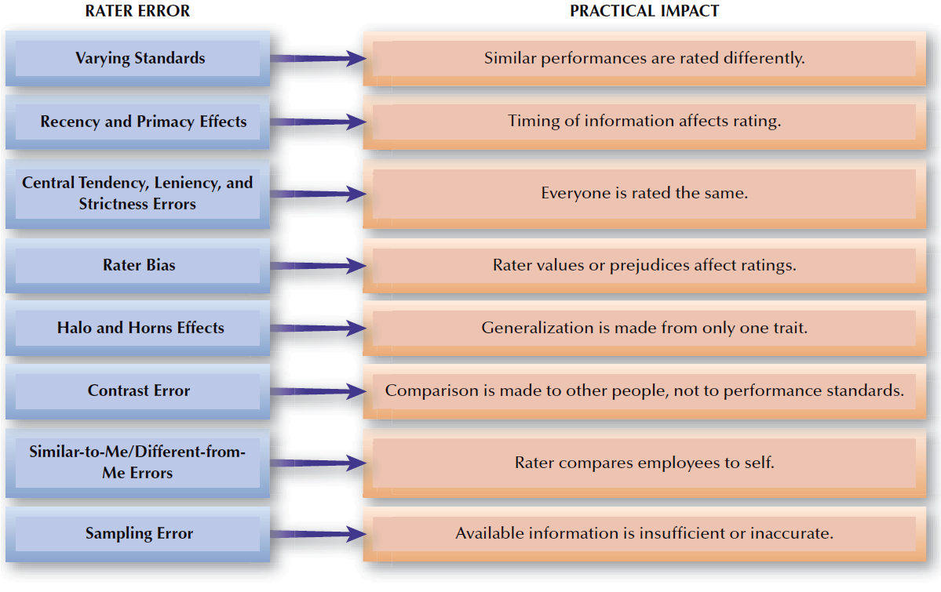
FIGURE 10–14
Common Rater Errors

Slide 39
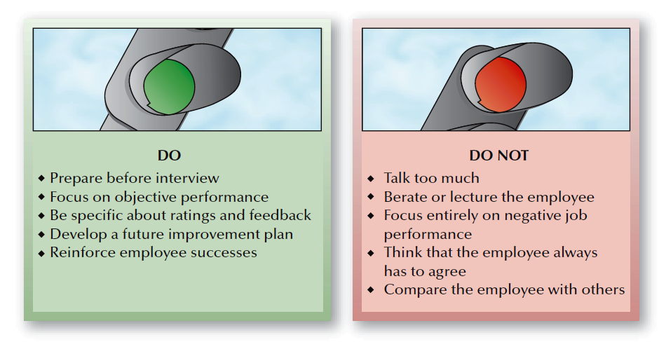
FIGURE 10–15
Appraisal Interview Hints for Appraisers

Slide 40
Feedback as a System
Components of a Feedback System
Data on
Actions
Data
Evaluation
Action Based on Evaluation

Slide 41
Performance Management System (PMS)
Consistent with the strategic mission
Effectively documents performance
Beneficial as a development tool
Effective Performance Management System
Viewed as fair by employees
Useful as an administrative tool
Is legal and job related

