Slide 1
CHAPTER 9
Talent Management

Slide 2
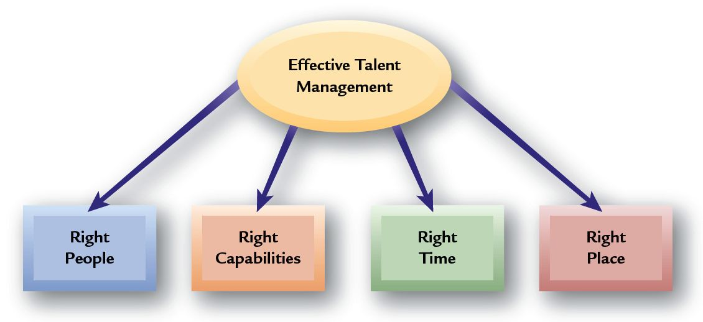
What Is Talent Management?
Talent Management
  Concerned with enhancing the attraction, long-term development, and retention of key human resources

Slide 3
Why Talent Management Is Needed
Impending retirement of experienced baby boomers
A shortage of young people entering the workforce
High school graduates who lack writing and verbal communication skills, as well as a work ethic
College graduates with weak writing, leadership, critical thinking, and creativity skills
Companies unprepared for a sudden loss of leadership
Lack of accountability for managers and executives in developing their direct reports

Slide 4
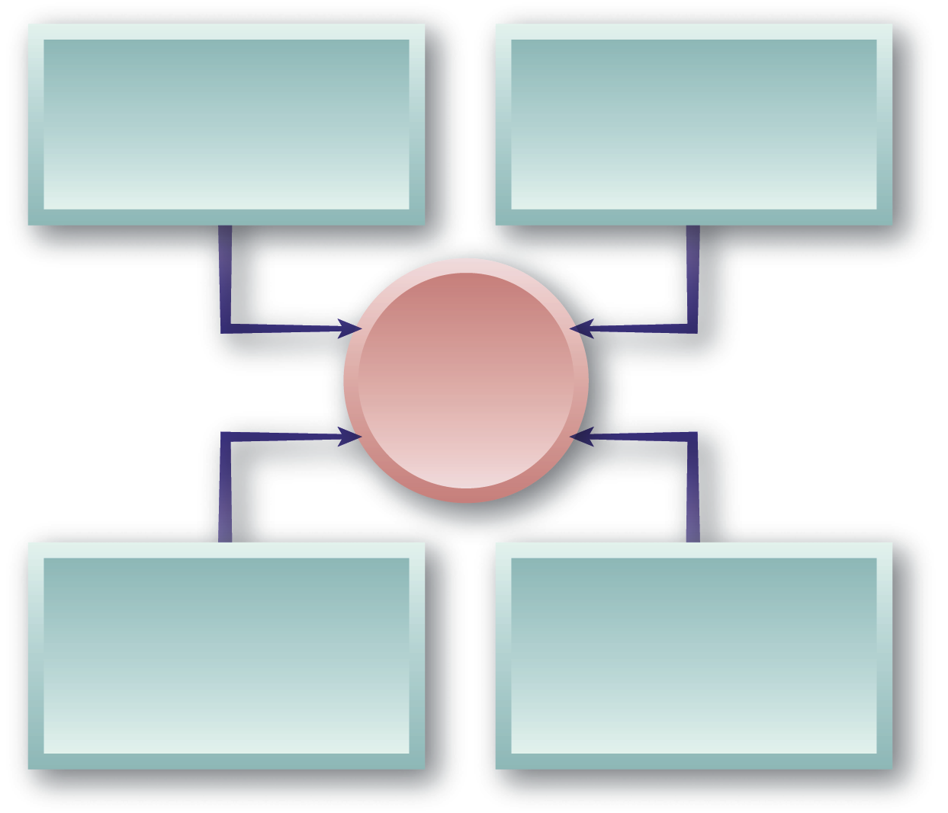
Nature Of Talent Management
Creating and maintaining an organizational culture that values people
Identifying future needs and developing individuals to fill those needs
Key Areas
of Talent Management
Establishing ways to conduct and manage activities to support talent development
Developing a pool of talented people who can supply future job needs

Slide 5


Talent Management in Perspective
Target
Jobs
High-Potential Individuals
Competency
Models
Scope of
Talent Management
Talent
Pools
Assessment and Career Tracks
Development
Risk Sharing

Slide 6
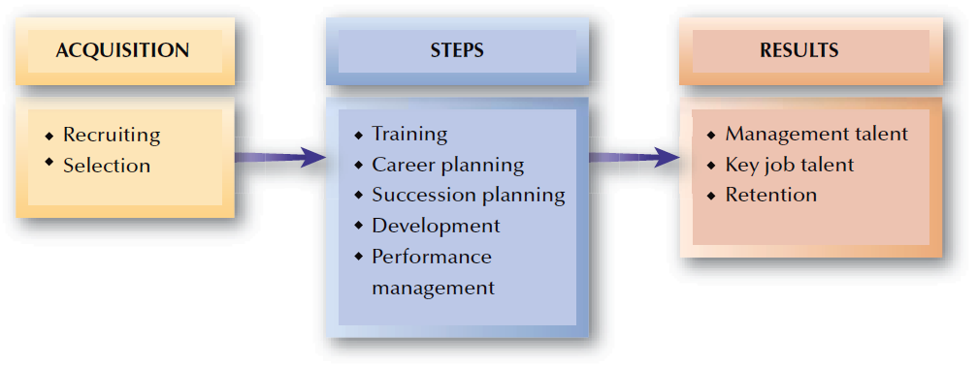
FIGURE 9–1
Talent Management

Slide 7
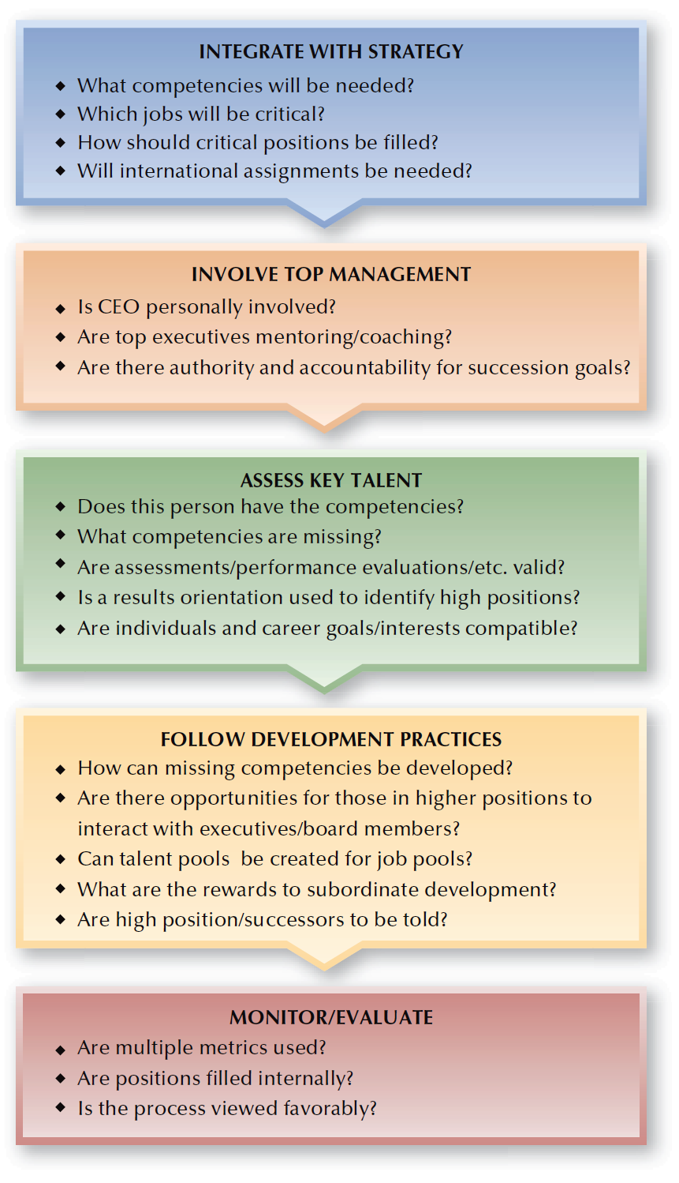
FIGURE 9–2
Succession Planning Process

Slide 8

HR’s Role in Succession Planning
Identifying development needs of the workforce
Assisting in identifying needed future job skills
Noting employees who might fill future positions
Succession Planning
Communicating the succession planning process to employees
Tracing and regularly updating succession plan efforts

Slide 9


Succession Planning Decisions
Potential versus Performance
Succession
Planning Considerations
“Make or Buy” Talent
Succession Planning Metrics
Computerized Succession
Planning Models

Slide 10
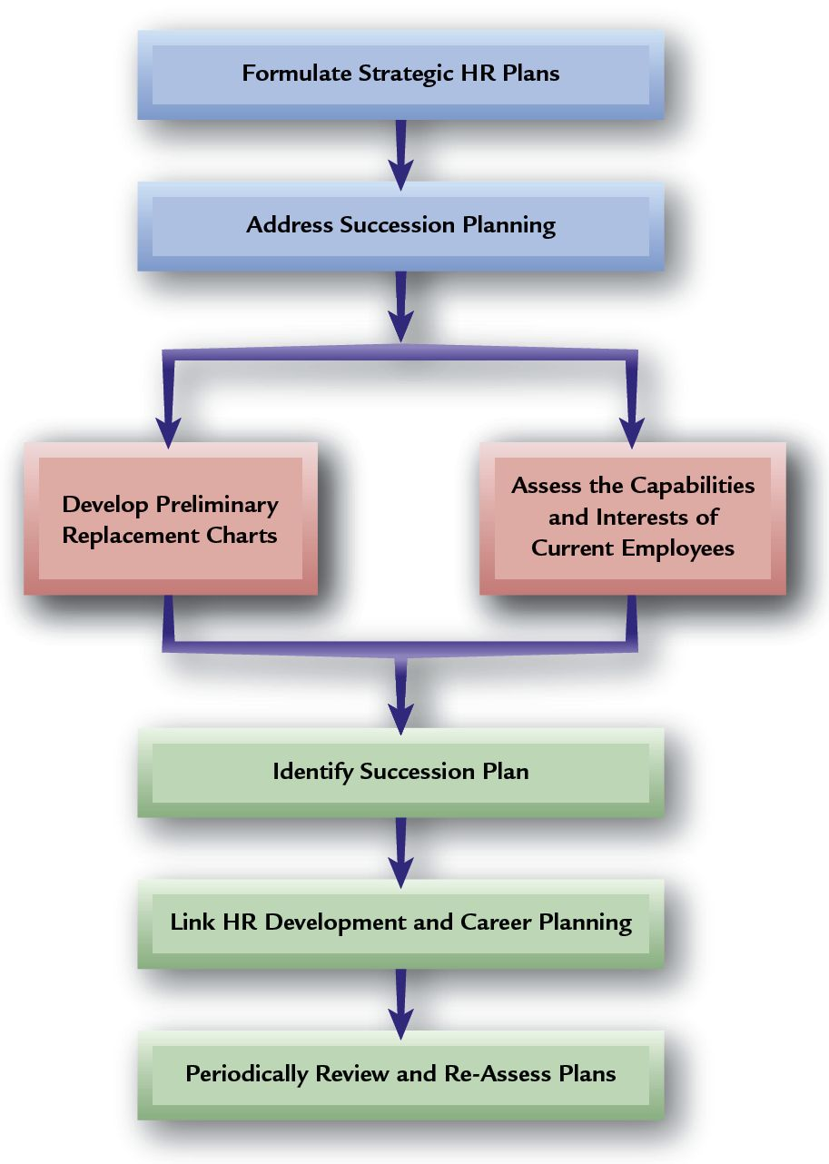
Succession Planning Process

Slide 11
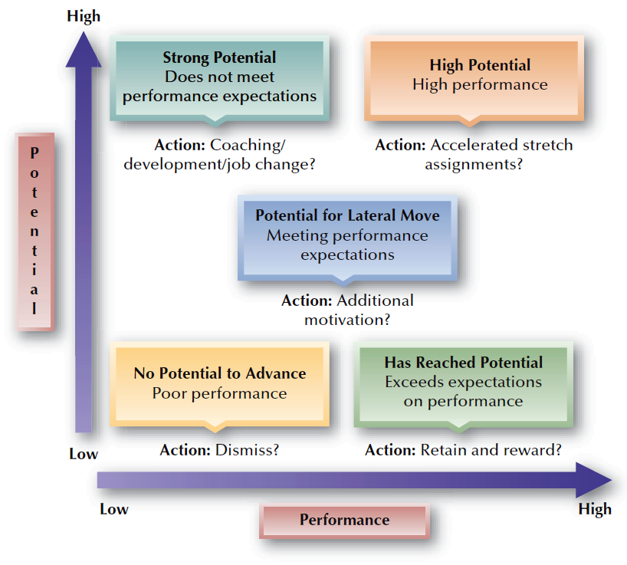
FIGURE 9–3
Assessing Potential and Current Performance

Slide 12

Values and Benefits of Succession Planning
Having an adequate supply of employees to fill future key openings
Providing career paths and plans for employees, which aids in employee retention and performance motivation
Continually reviewing the need for individuals as organizational changes occur
Enhancing the organizational “brand” and reputation as a desirable place to work

Slide 13
Common Succession Planning Mistakes
Focusing only on CEO and top management succession
Starting too late, when openings are occurring
Not linking well to strategic plans
Allowing the CEO to direct the planning and make all succession decisions
Looking only internally for succession candidates

Slide 14
Careers and Career Planning
Career
  The series of work-related positions a person occupies through life.
Career Paths
  Represent employees’ movements through opportunities over time.

Slide 15

Different Views of Careers
Individual Career Views
Protean career
Career without boundaries
Portfolio career
Authentic career

Slide 16
Careers and Career Planning (cont’d)
Organization-Centered Career Planning
  Focuses on jobs and on identifying career paths that provide for the logical progression of people between jobs in the organization.
Individual-Centered Career Planning
  Focuses on an individual’s career rather than in organizational needs.

Slide 17
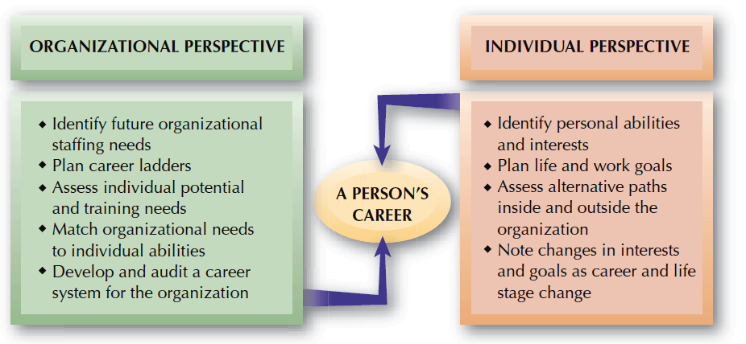
FIGURE 9–4
Organizational and Individual Career Planning Perspectives

Slide 18

Individual-Centered Career Planning
Individual Career Management
Feedback
on Reality
Setting of
Career Goals
Self-Assessment

Slide 19
Individual Career Choices
Career Choice
Interests
Self-Image
Personality
Social Background

Slide 20
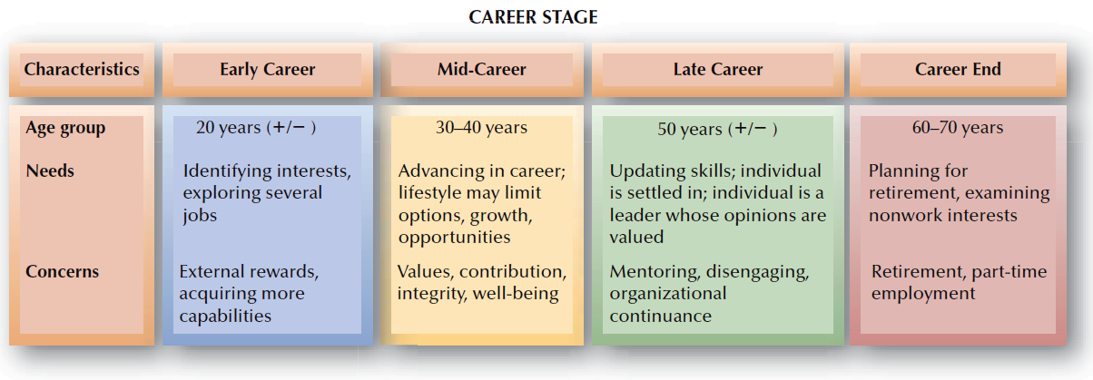
FIGURE 9–5
General Career Periods

Slide 21
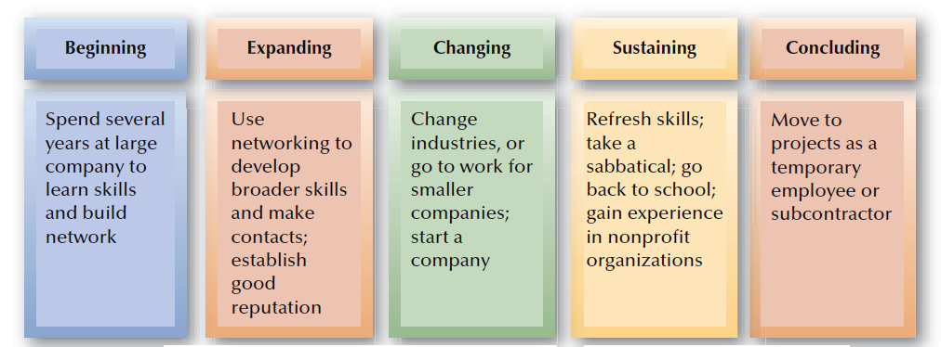
FIGURE 9–6
Portable Career Path

Slide 22
Career Transitions and HR
Entry Shock for New Employees
Supervisors
Feedback
Time
The Work

Slide 23
Special Individual Career Issues
Technical and Professional Workers
Dual Career Ladders
Women and Careers
Sequencing
Glass Ceiling
Special Individual Career
Issues
Global Career Concerns
Repatriation
Global Development
Dual-Career Couples
Family-Career Issues
Relocation

Slide 24
Developing Human Resources
Development
  Efforts to improve employees’ abilities to handle a variety of assignments and to cultivate employees’ capabilities beyond those required by the current job.
Developing Specific Capabilities/Competencies
  Lifelong learning
  Redevelopment

Slide 25

Possible Development Focuses
For Managers
For Technical Personnel
An action orientation
Quality decision-making skills
Ethical values
Technical skills
Team building
Developing subordinates
Direct others
Dealing with uncertainty
Ability to work under pressure
Ability to work independently
To solve problems quickly
To use past knowledge in a new situation

Slide 26
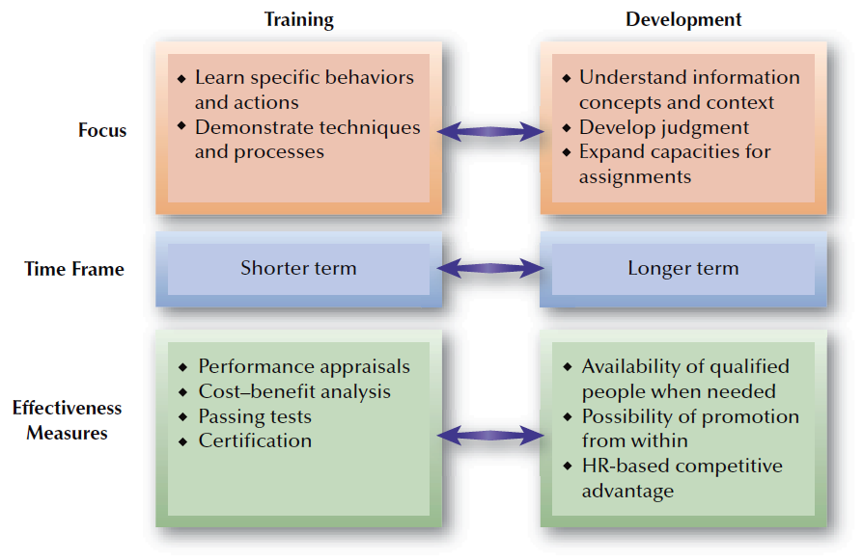
FIGURE 9–7
Development versus Training

Slide 27
Developing Human Resources (cont’d)
Employee Development
Needs Analysis Methods
Assessment Centers
Psychological Testing
Performance Appraisals

Slide 28
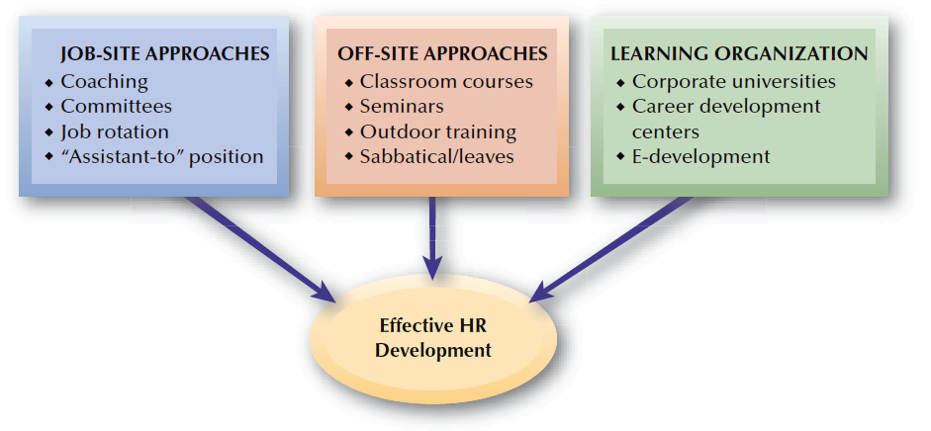
FIGURE 9–8
HR Development Approaches

Slide 29
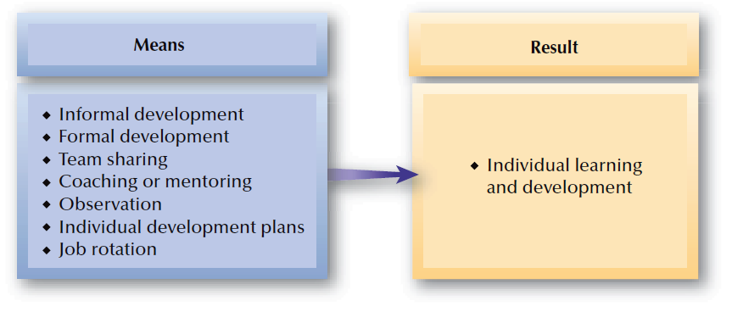
FIGURE 9–9
Possible Means for Developing Employees
in a Learning Organization

Slide 30
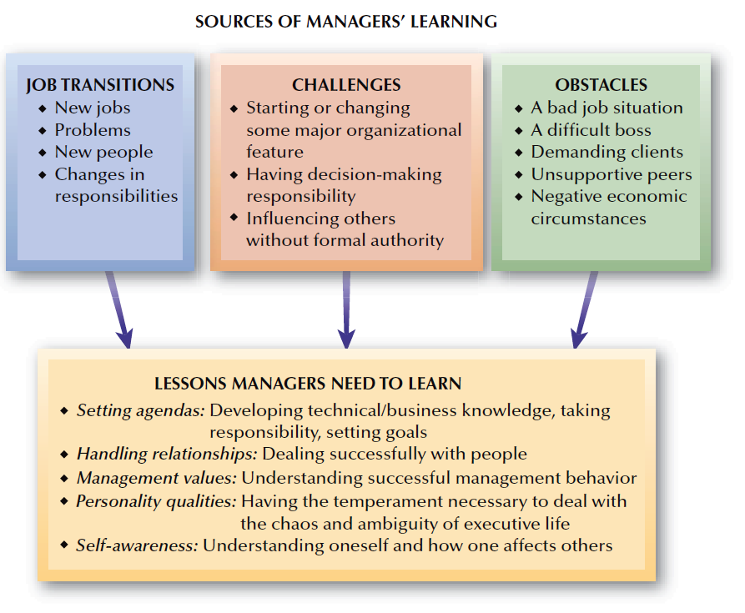
FIGURE 9–10
Management Lessons Learned from Job Experience

Slide 31
Supervisor Development
Supervisor Development Topics
Basic management responsibilities
Time
management
Human relations training

Slide 32
Leadership Development
Modeling
Leadership Development
Coaching
Management Mentoring
Executive
Education

Slide 33
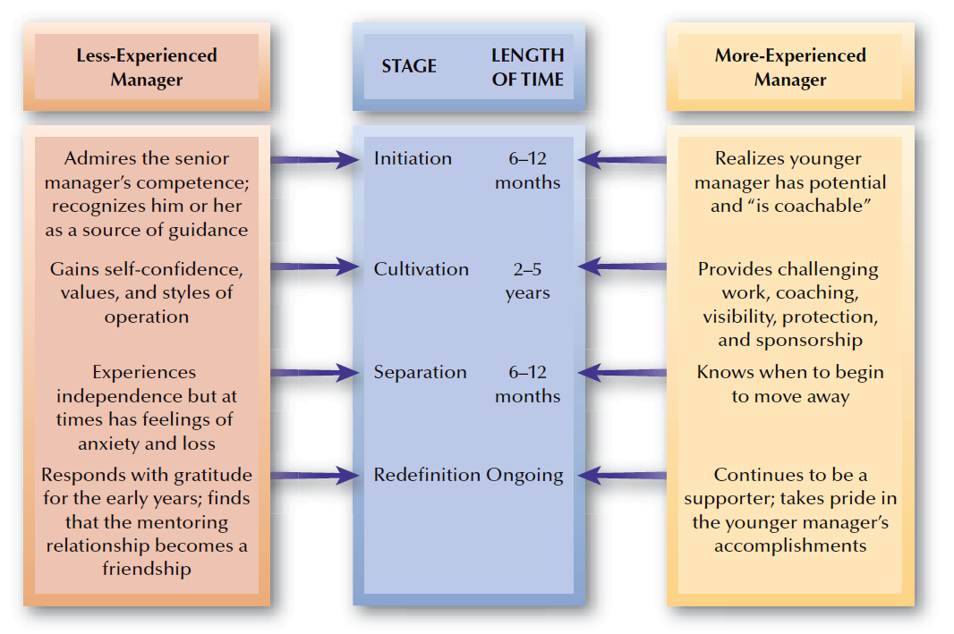
FIGURE 9–11
Stages in Management Mentoring Relationships

Slide 34
Problems with Management Development Efforts
Failing to conduct an adequate needs analysis
Trying out fad programs or training methods
Common Problems in Management Development
Failing to address organizational factors that result in encapsulated development
Substituting training instead of selecting qualified individuals

