Slide 1
CHAPTER 8
Training Human Resources

Slide 2
Nature of Training
Training
  A process whereby people acquire capabilities to aid in the achievement of organizational goals.
    Includes both hard and soft skills
  Poorly trained employees may perform poorly and make costly mistakes.

Slide 3
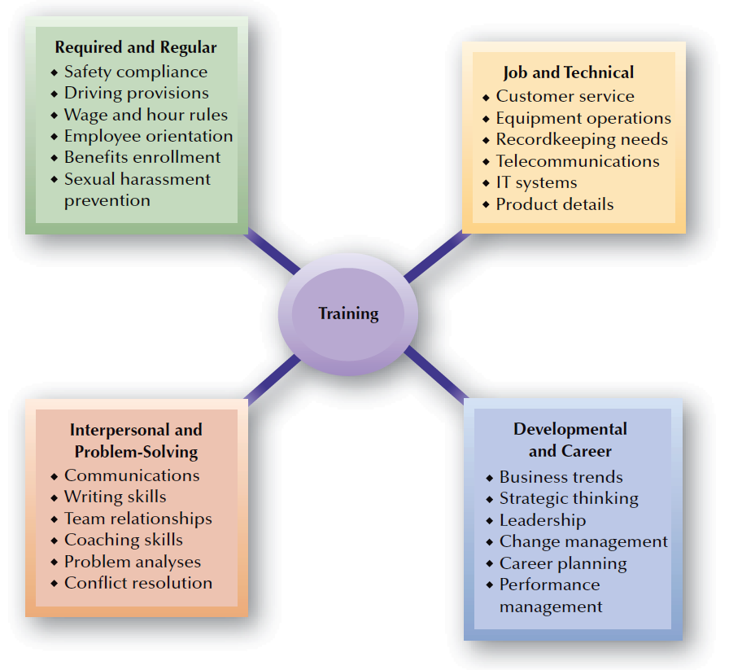
FIGURE 8–1
Types of Training

Slide 4

Legal Issues and Training
Training Design and Delivery
Criteria and practices used to select individuals
Accommodation of individuals with disabilities
Requiring signing of training contracts

Slide 5
Organizational Strategy and Training
Benefits of Strategic Training
  HR and trainers partner with operating managers
  to solve problems, and to make contributions to organizational results.
  Managers are less likely to think that training alone can solve performance problems.
Training’s Effects on Competitiveness
  Training makes organizations more competitive.
  Training helps retain valuable employees.
  Training helps accomplish organizational strategies.

Slide 6
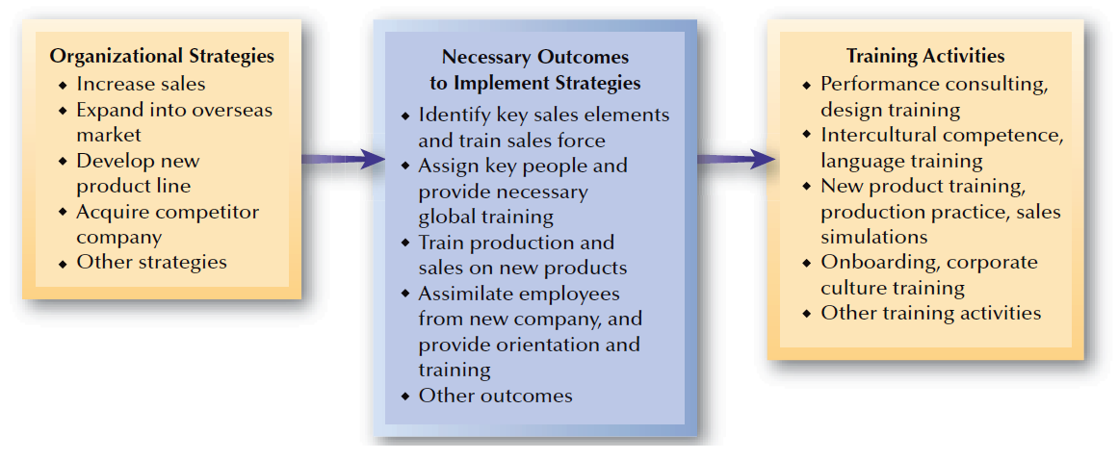
FIGURE 8–2
Linking Strategies and Training

Slide 7
Organizational Competitiveness and Training
Knowledge Management
  Is identifying and leveraging intellectual capital to create value and be competitive.
  Gets the right knowledge to the right people at the right time so that it can be shared and put into action.
Training as a Revenue Source
  Marketing training with or alongside products can contribute significantly to a firm’s revenues.

Slide 8
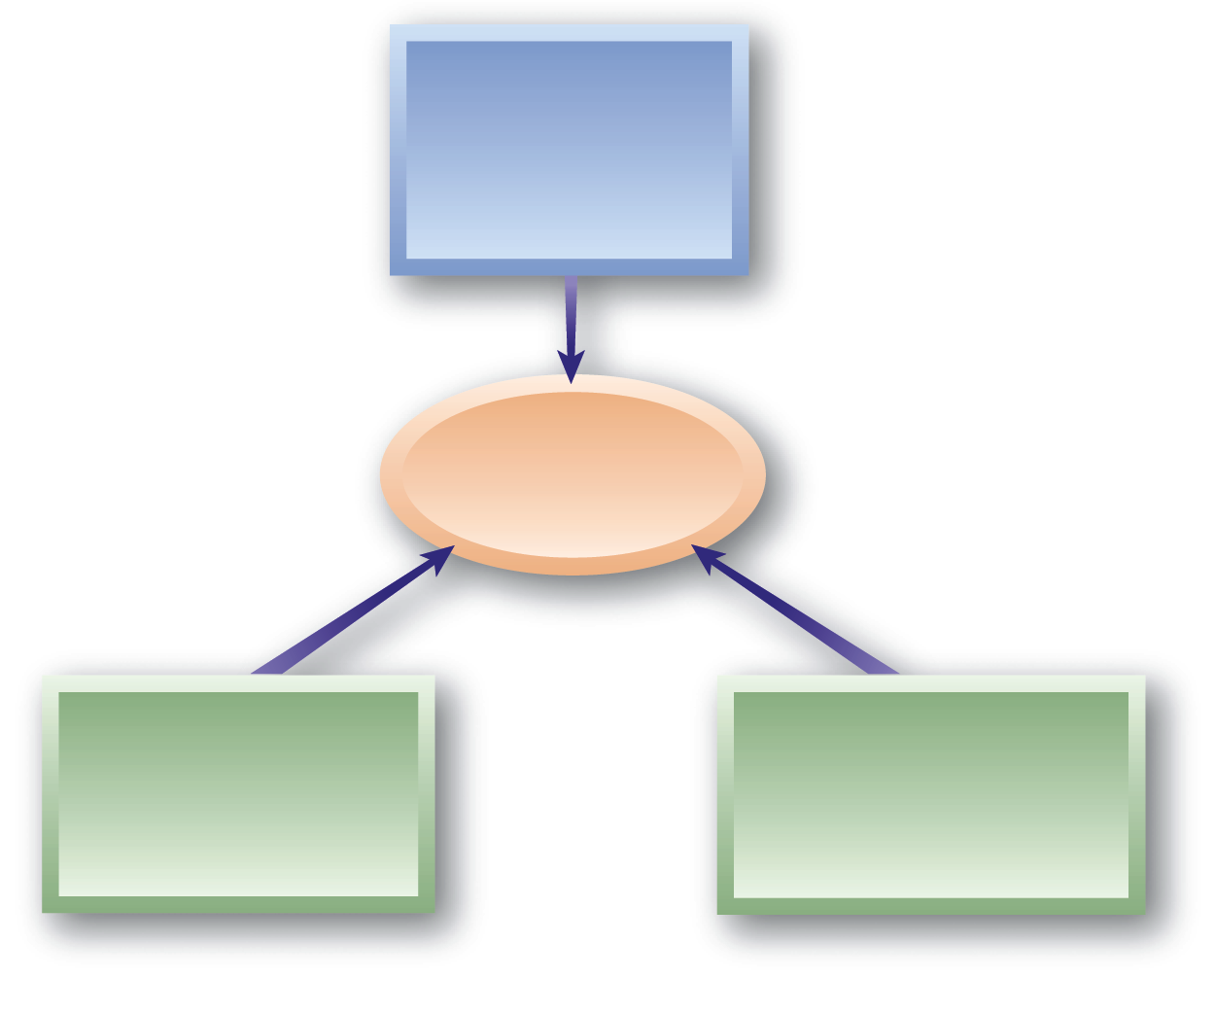
Performance Consulting Approach
Focusing on identifying and addressing root causes of performance problems
Performance Consulting
Documenting and
comparing high performers with typical performers
Recognizing the interaction of individual and organizational factors

Slide 9
Training for Global Strategies
Global Assignment Training
  Cross-cultural training is crucial to global strategic success as businesses expand overseas.
Intercultural Competence
Training Components
Cognitive
Emotional
Behavioral

Slide 10
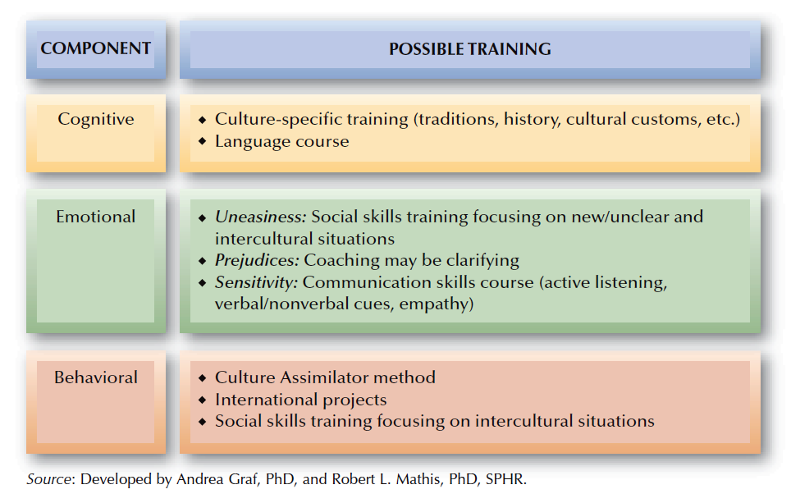
FIGURE 8–3
Intercultural Competence Training

Slide 11
Developing Strategic Training Plans
Effective training efforts consider the following questions:
  Is there really a need for the training?
  Who needs to be trained?
  Who will do the training?
  What form will the training take?
  How will knowledge be transferred to the job?
  How will the training be evaluated?

Slide 12

Orientation: Planning for New Employees
Establishes favorable employee impression of the organization
Provides organization
and job information.
Achievements of Effective Orientation
Bring more work-related experiences into the process
Accelerates socialization and integration of new employees
Ensures employee performance
and productivity begins quickly

Slide 13


Effective New Employee Orientation
Sample
Prepare for new employees
Sample
Evaluate and
follow up
Consider using
mentors
Sample
Making Employee Orientation
More Effective
Sample
Sample
Avoid information overload
Use an orientation checklist
Sample
Sample
Present orientation information effectively
Cover needed information

Slide 14

Evaluating Orientation and Metrics
Orientation Metrics
Tenure turnover rate
New hires failure factor
Employee upgrade rate
Development program participation

Slide 15
Analysis of Training Needs
Assessing Training Needs
Organizational Analysis
Job/Task
Analysis
Individual
Analysis

Slide 16
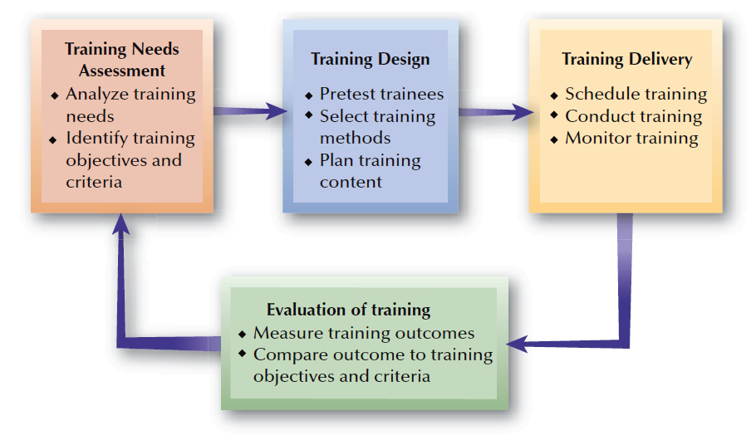
FIGURE 8–4
Systematic Training Process

Slide 17
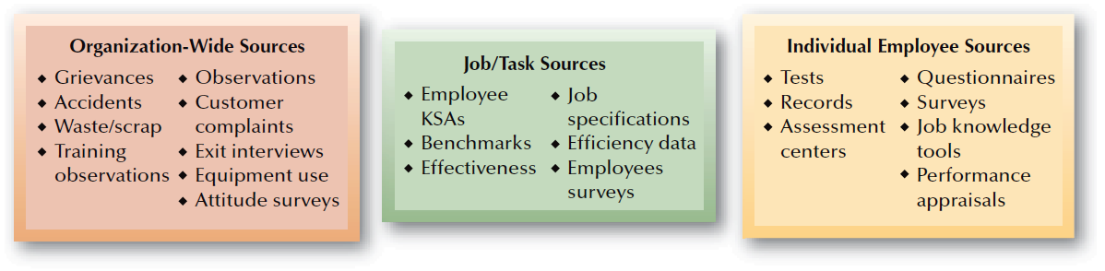
FIGURE 8–5
Sources of Information for Training Needs Assessment

Slide 18
Establishing Training Objectives and Priorities
Gap Analysis
  The distance between where an organization is with its employee capabilities and where it needs to be.
Types of Training Objectives
Attitude
Knowledge
Skill

Slide 19
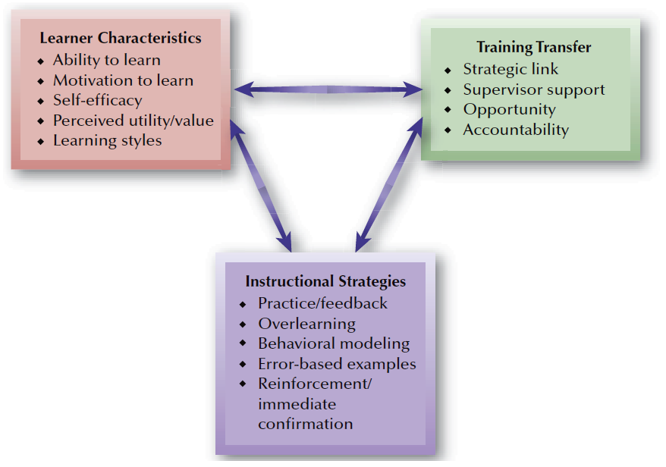
FIGURE 8–6
Training Design Elements

Slide 20
Training Design
Learning Styles
Auditory
learners
Tactile
learners
Visual
Learners

Slide 21


Training Design (cont’d)
Ability
to Learn
Learner
Readiness
Self-Efficacy
Motivation
to Learn
Perceived
Utility/Value

Slide 22
Principles of Adult Learning
Have need to know why they
are learning something
Have need to be self-directed
Bring more work-related experiences into the process
Adult Learning
Employ a problem-solving approach to learning
Are motivated by both extrinsic and intrinsic factors

Slide 23
Instructional Strategies
Learner
Participation
Active Practice
Spaced Practice
Massed Practice

Slide 24
Other Instructional Strategies
Overlearning
Individual Training Methods
Behavioral Modeling
Error-Based Examples
Reinforcement and Immediate Confirmation

Slide 25
From Training to the Job
Transfer of Training
  Occurs when trainees actually use on the job what they learned and maintain use of the learned material over time.
Increasing the Transfer of training
  Offering trainees an overview of training content and process.
  Ensuring that the training mirrors the job context.

Slide 26
Training Delivery: Considerations
Nature of training
Subject matter
Number of trainees
Individual versus team
Self-paced versus guided
Training resources/costs
E-learning versus traditional learning
Geographic locations
Time allotted
Completion timeline

Slide 27
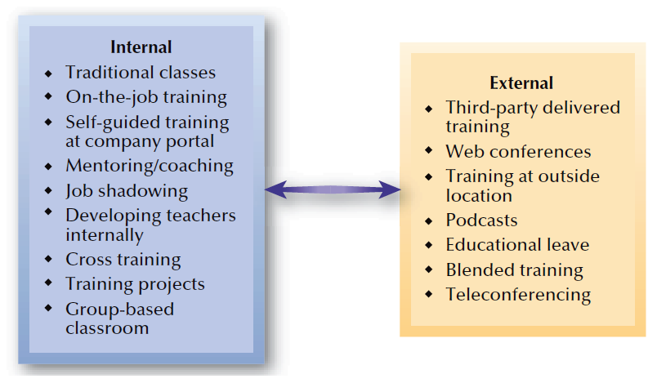
FIGURE 8–7
Training Delivery Options

Slide 28
Internal Training
Informal Training
  Training that occurs through interactions and feedback among employees.
On-the-Job Training (OJT)
  Based on a guided form of training known as job instruction training (JIT)
  Problems with OJT:
    Poorly-qualified or indifferent trainers
    Disruption of regular work
    Bad or incorrect habits passed on

Slide 29
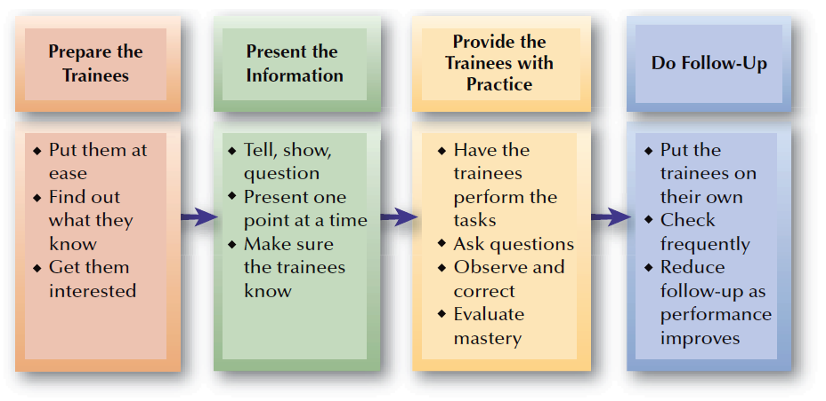
FIGURE 8–8
Stages for On-the-Job Training

Slide 30
Internal Training
Cross-Training
  Is training people to do more than one job.
  Increases flexibility and development
Challenges of Cross-Training
  Is not favored by employees
  Threatens unions with loss of job jurisdiction and broadening of jobs
  Requires different scheduling during training
  Causes loss of productivity as people learn

Slide 31
External Training
Reasons for External Training
  Less expensive to outsource training
  Insufficient time to develop training
  Lack of expertise
  Advantages of interacting with outsiders
Outsourcing of Training
  Cost and greater emphasis on internal linking of training to organizational strategies, and other issues.
  Increasing popularity of vendor training/certification
  Government-supported job training
  Educational assistance programs

Slide 32
Combination Training Approaches
Forms of Cooperative Training
School-to-Work Transition
Apprentice
Training
Internship

Slide 33

FIGURE 8–9
Most Common Apprenticeship Occupations

Slide 34
E-Learning: On-Line Training
E-Learning
  The use of the Internet or an organizational intranet to conduct training on-line.
E-Learning Methods
Distance Training/ Learning
Simulations
and Training
Blended
Learning

Slide 35

Developing E-Learning
Criteria for adopting e-learning:
Top management support and available funding
Accepting that training is being decentralized and individualized.
Current training methods are not meeting training needs.
Trainees are computer literate and have access to the Internet.
Travel time and costs for geographically-dispersed trainees
Trainees are self-motivated and can direct their own learning.

Slide 36
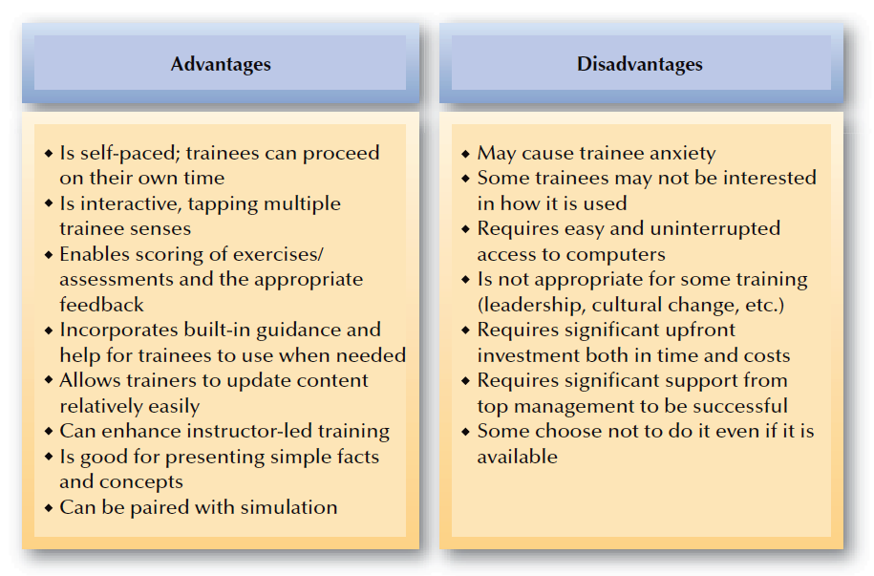
FIGURE 8–10
Advantages and Disadvantages of E-Learning

Slide 37
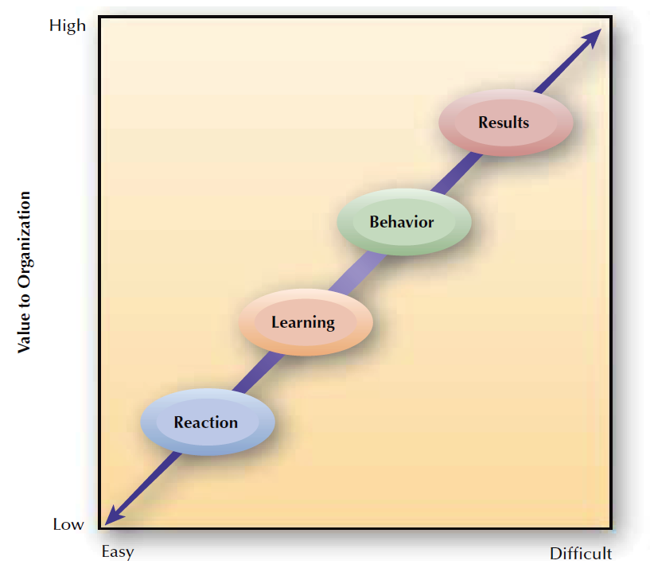
FIGURE 8–11
Levels of Training Evaluation
Ease of Measurement

Slide 38
Training Evaluation Metrics
Cost-Benefit Analysis
  A comparison of costs and benefits associated with organizational training efforts
    Measurement of both the costs and the benefits may be difficult.
Return on Investment (ROI) Analysis
Benchmarking

Slide 39



Calculating Training Costs and Benefits
1. Determine overall
training costs
Cost-Benefit
Analysis
2. Identify potential
savings results
3. Compute potential
savings
4. Conduct costs and savings benefits comparison

Slide 40
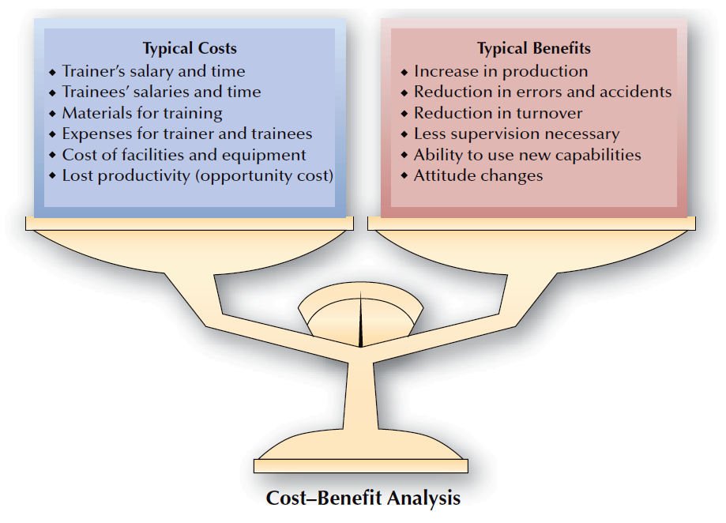
FIGURE 8–12
Possible Costs and Benefits in Training

Slide 41
Internal Evaluation of Training
Training Evaluation Designs
Pre/Post-Measure with Control Group
Post-Measure
Pre/Post-Measure

