Slide 1
CHAPTER 7
Selecting Human Resources

Slide 2
Selection and Placement
Selection
  The process of choosing individuals with qualifications needed to fill jobs in an organization.
  Organizations need qualified employees to succeed.
    “Hire hard, manage easy.”
    “Good training will not make up for bad selection.”
Placement
  Fitting a person to the right job.

Slide 3
Applicant Knowledge, Skills, and Abilities
Person-Job Fit
  Matching the knowledge, skills and abilities (KSAs) of people to the characteristics of jobs (tasks, duties and responsibilities–TDRs).
  Benefits of person-job fit:
    Higher employee performance
    Lower turnover and absenteeism
Person-Organization Fit
  The congruence between individuals and organizational factors.
KSAs = TDRs = Job Success?

Slide 4
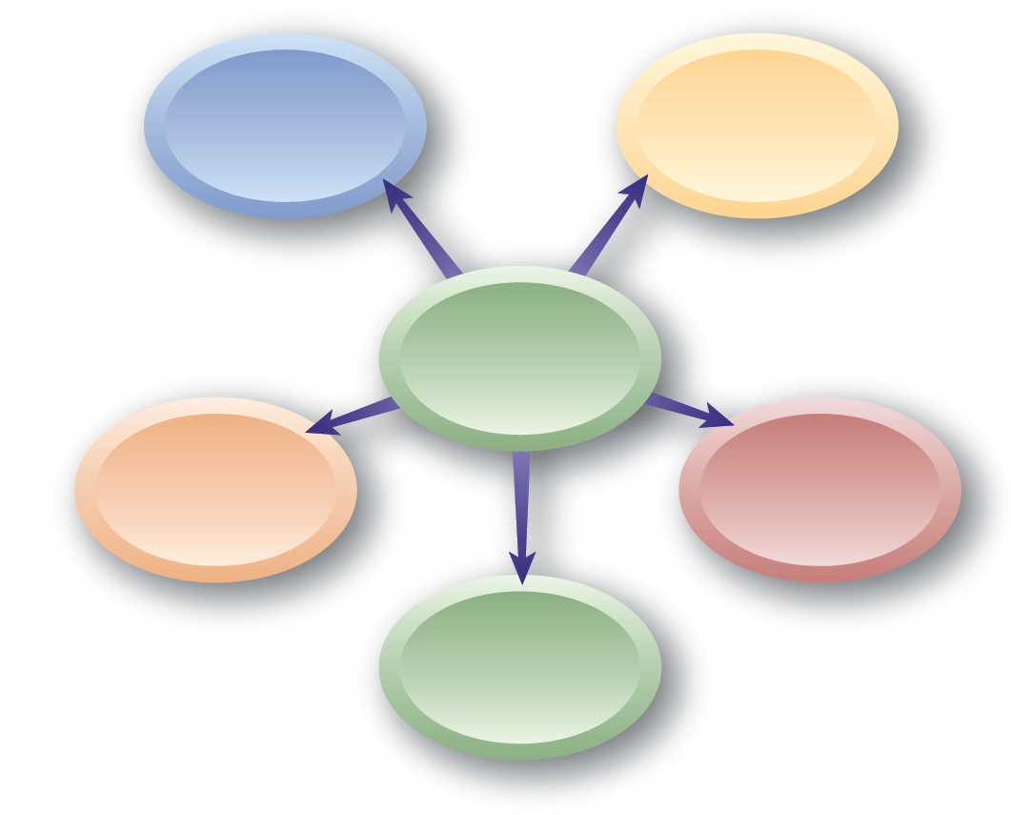
Person/Job Fit Mismatches
Skills/job qualifications
Geography/
job location
Mismatch Situations
Time/amount of work
Earnings/
expectations
Work/family

Slide 5
Criteria, Predictors, and Job Performance
Selection Criterion
  A characteristic that a person must have to successfully perform work.
Predictors of Selection Criteria
  Measurable or visible indicators of selection criteria.
Validity
  The correlation between a predictor and job performance.
Reliability
  The extent to which a predictor repeatedly produces the same results over time.

Slide 6
Validity
Correlation Coefficient
  Is an index number that gives the relationship between a predictor variable and a criterion variable.
Concurrent Validity
  Is measured when an employer tests current employees and correlates the scores with their performance ratings.
Predictive Validity
  Measured when test results of applicants are compared with subsequent job performance.

Slide 7
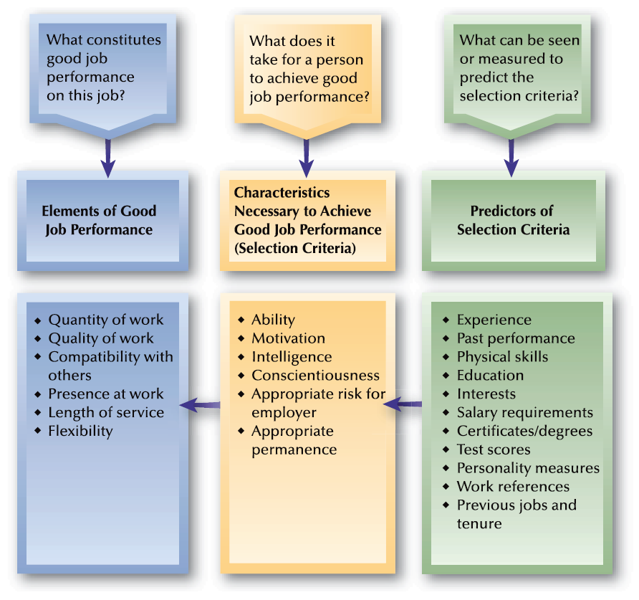
FIGURE 7–1
Job Performance, Selection Criteria, and Predictors

Slide 8
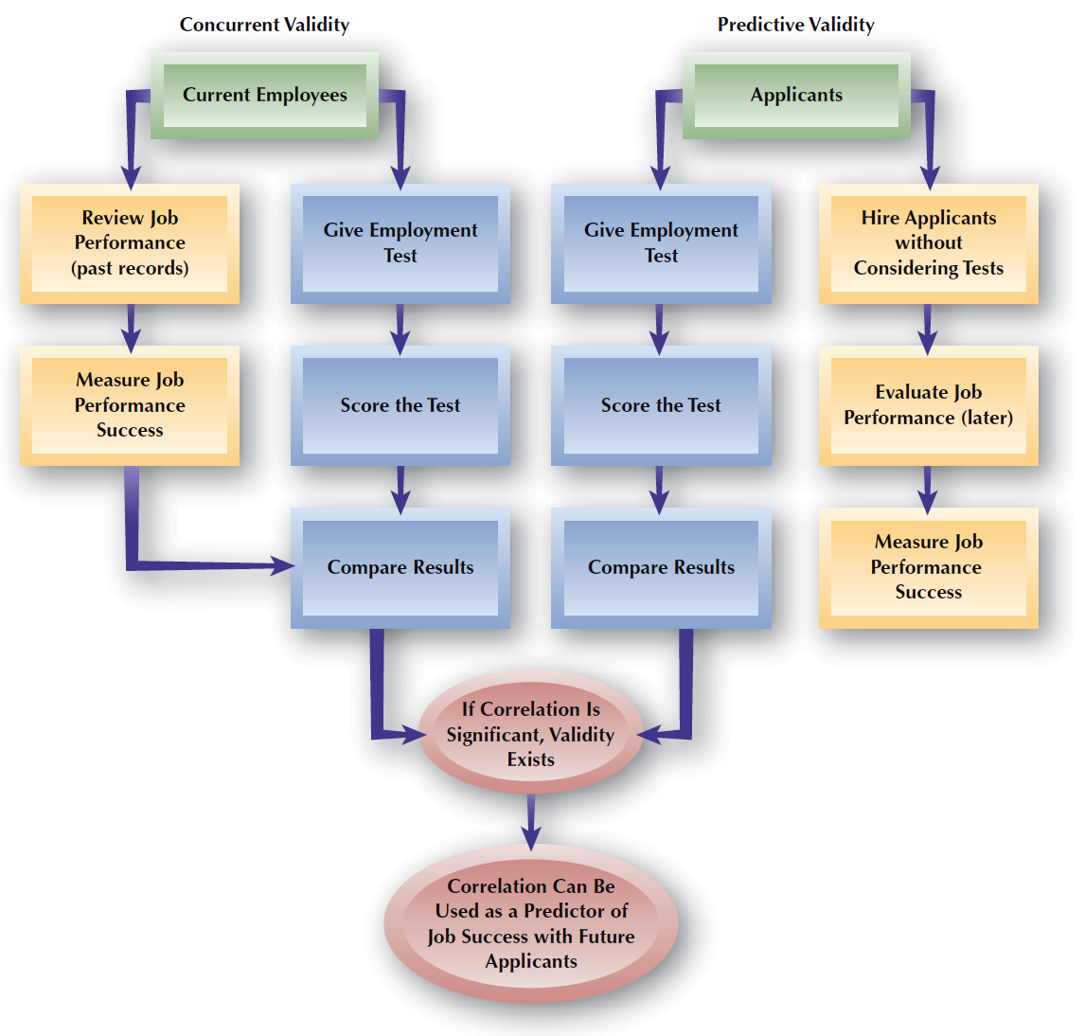
FIGURE 7–2
Concurrent
and Predictive
Validity

Slide 9
Combining Predictors
Multiple Hurdles
  Establishing a minimum cutoff (level of performance) for each predictor, and requiring that each applicant must score at least the minimum on each predictor to be considered for hiring.
Compensatory Approach
  Scores on all predictors are added together, allowing a higher score on one predictor to offset a lower score on another predictor.

Slide 10
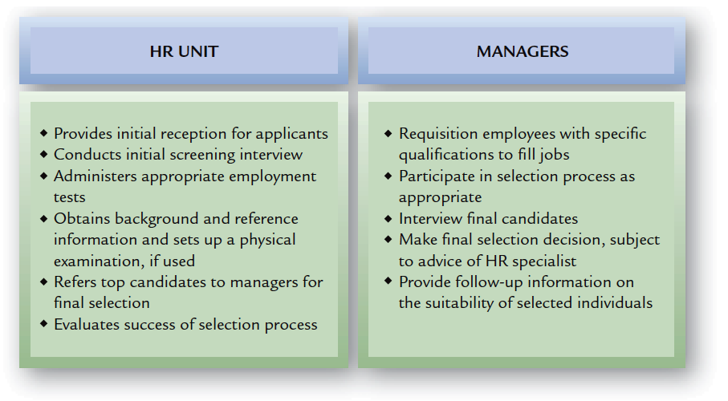
FIGURE 7–3
Typical Division of HR Responsibilities: Selection

Slide 11

HR Employment Functions
Receiving applications
Interviewing applicants
Administering tests to applicants
Conducting background investigations
Arranging physical examinations
Placing and assigning new employees
Coordinating follow-up of new employees
Exit interviewing departing employees
Maintaining employee records and reports

Slide 12
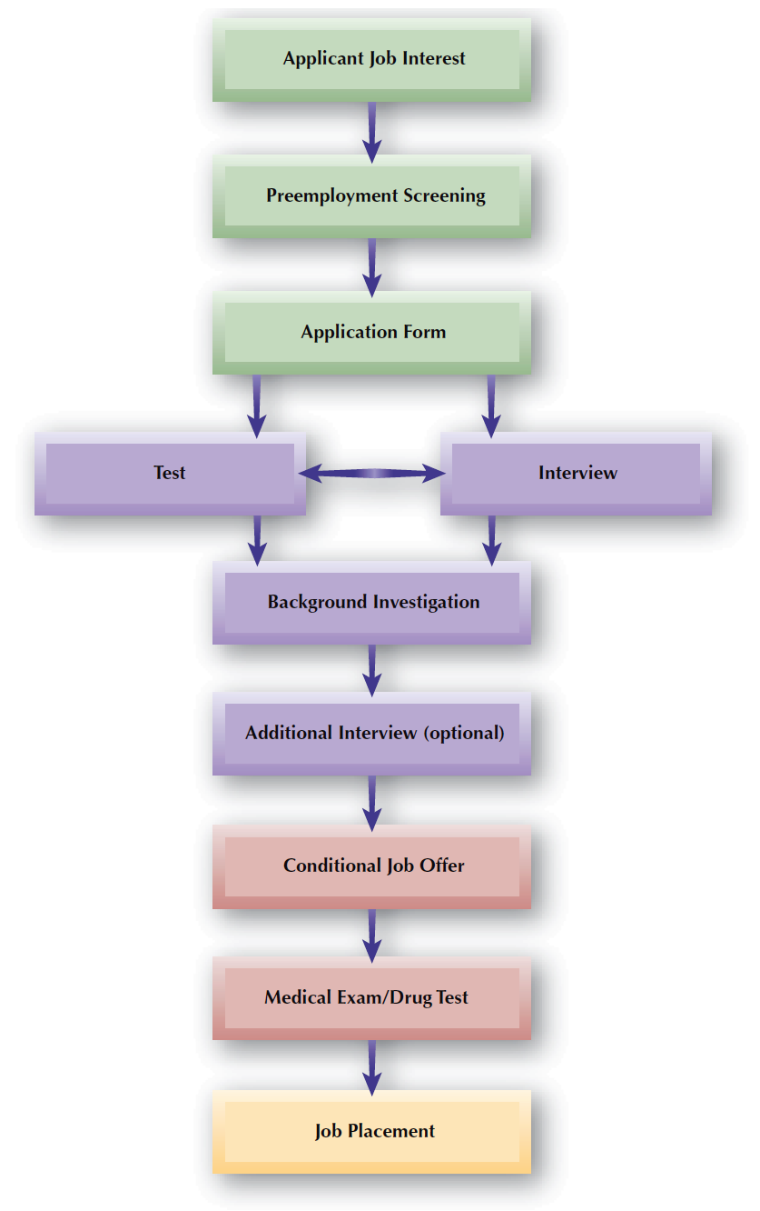
FIGURE 7–4
Selection Process Flowchart

Slide 13
Applicant Job Interest
Realistic Job Preview
  The process through which a job applicant receives an accurate picture of the job.
    Prevents the development of unrealistic job expectations in new employees.
    Helps avoid truth-in-hiring lawsuits

Slide 14

Pre-Employment Screening
Electronic Assessment
Screening
There is a large volume
of applicants
Quality of hires needs
to be increased
When To Use Electronic Screening
Hiring cycles need
to be shortened
The cost of hiring needs
to be reduced
There is a need to reach unvisited geographic areas

Slide 15
Application Disclaimers and Notices
Employment-At-Will
References Contacts
Application
Form
Employment Testing
Application Time Limit
Information Falsification

Slide 16
Applications
Purposes of Applications
  Record of applicant’s desire for the job
  Provides a profile of the applicant
  Basic record for applicants hired
  Research effectiveness of the selection process
Resumes as Applications
  Resumes are applications for EEO purposes.
  Resumes should be checked for truthfullness.

Slide 17
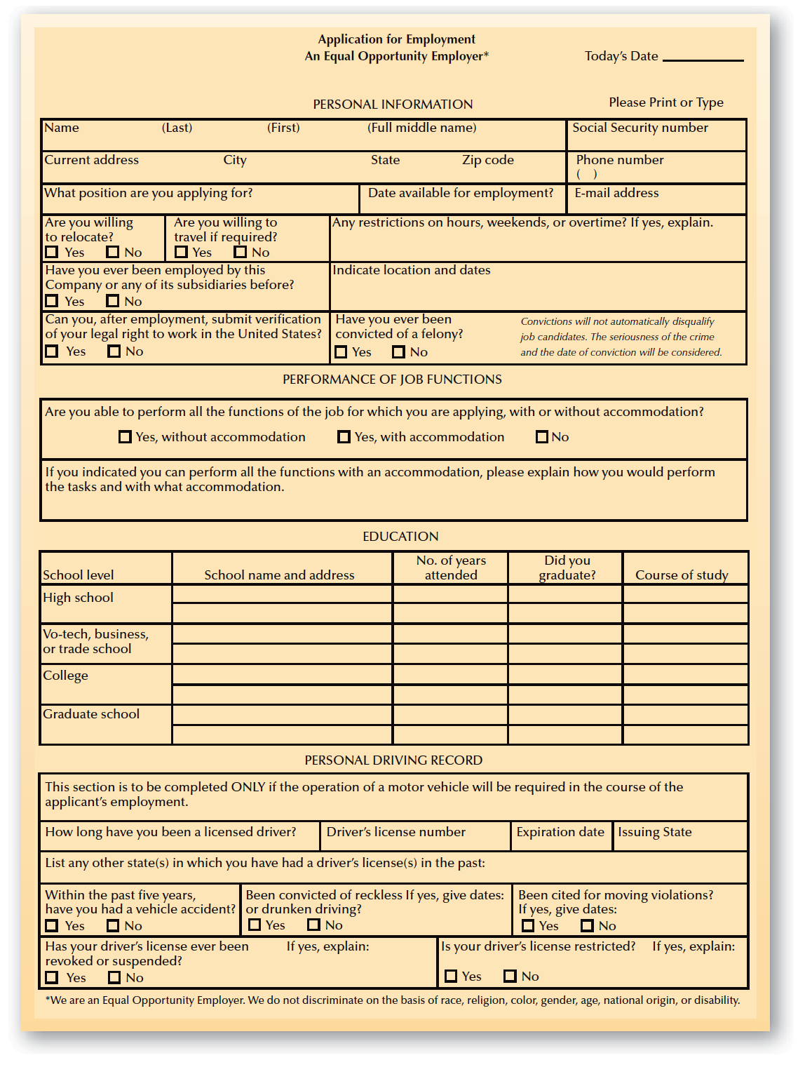
FIGURE 7–5
Sample Application Form

Slide 18
EEO Considerations and Application Forms
Applications should not contain illegal (nonjob-related) questions concerning:
  Marital status
  Height/weight
  Number and ages of dependents
  Information on spouse
  Date of high school graduation
  Contact in case of emergency

Slide 19
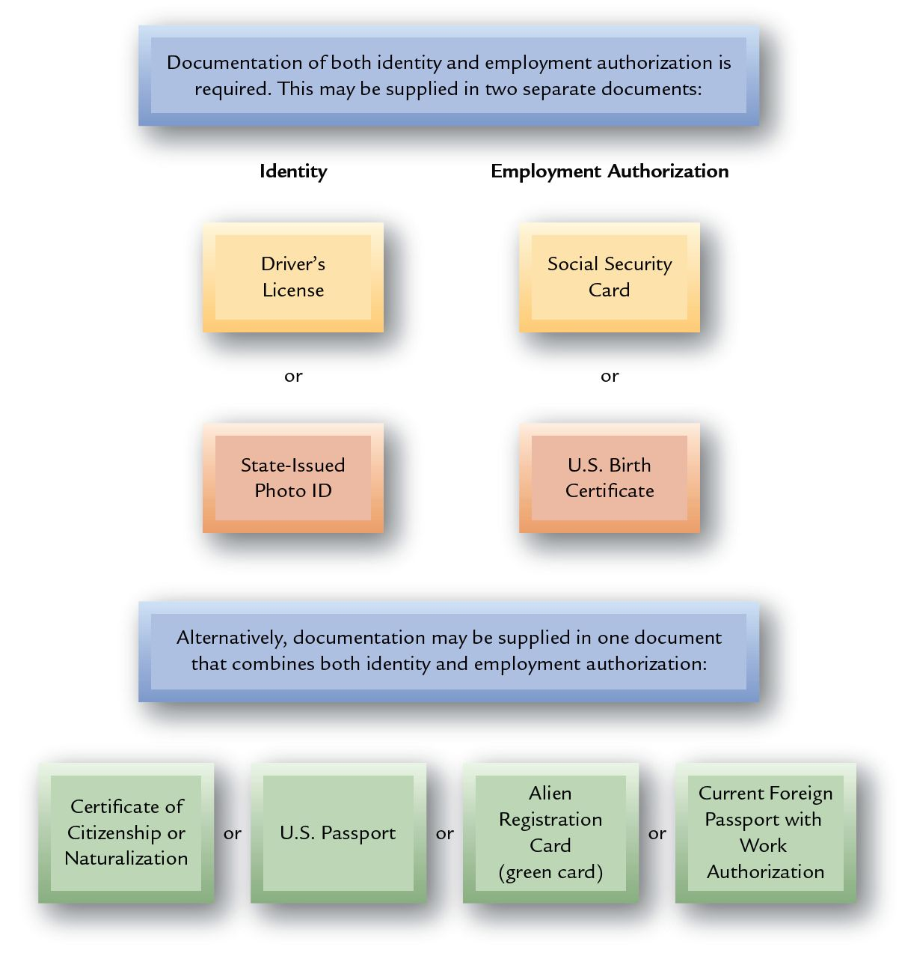
Acceptable Documents for Verifying Eligibility to Work in the United States

Slide 20


Selection Testing: Ability Tests
Cognitive Ability
Tests
Physical Ability
Tests
Psychomotor
Tests
Ability Tests
Aptitude and Achievement
Work Sample
Tests
Situational Judgment Tests
Assessment
Centers

Slide 21
Other Tests
Personality Tests
  Minnesota Multiphasic Personality Inventory (MMPI)
  Myers-Briggs
  “Fakability” and personality tests
Honest/Integrity Tests
  Socially desirable responses
  False positives
  Polygraph tests (“lie detector”)
    The Employee Polygraph Protection Act prohibits pre-employment testing (in most instances).

Slide 22
Controversies in Selection Testing
General Mental Ability Testing
  Minority groups tend to score lower on tests
  Requires business necessity defense and validation.
Personality Testing
  Explains very little about actual job outcomes.

Slide 23



Selection Interviewing
Interviewing for Selection
  Gathering valid information
  Focusing on ways to minimize selection errors
Initial screening
interview
Assessing the qualifications of applicants
In-depth selection
interview

Slide 24
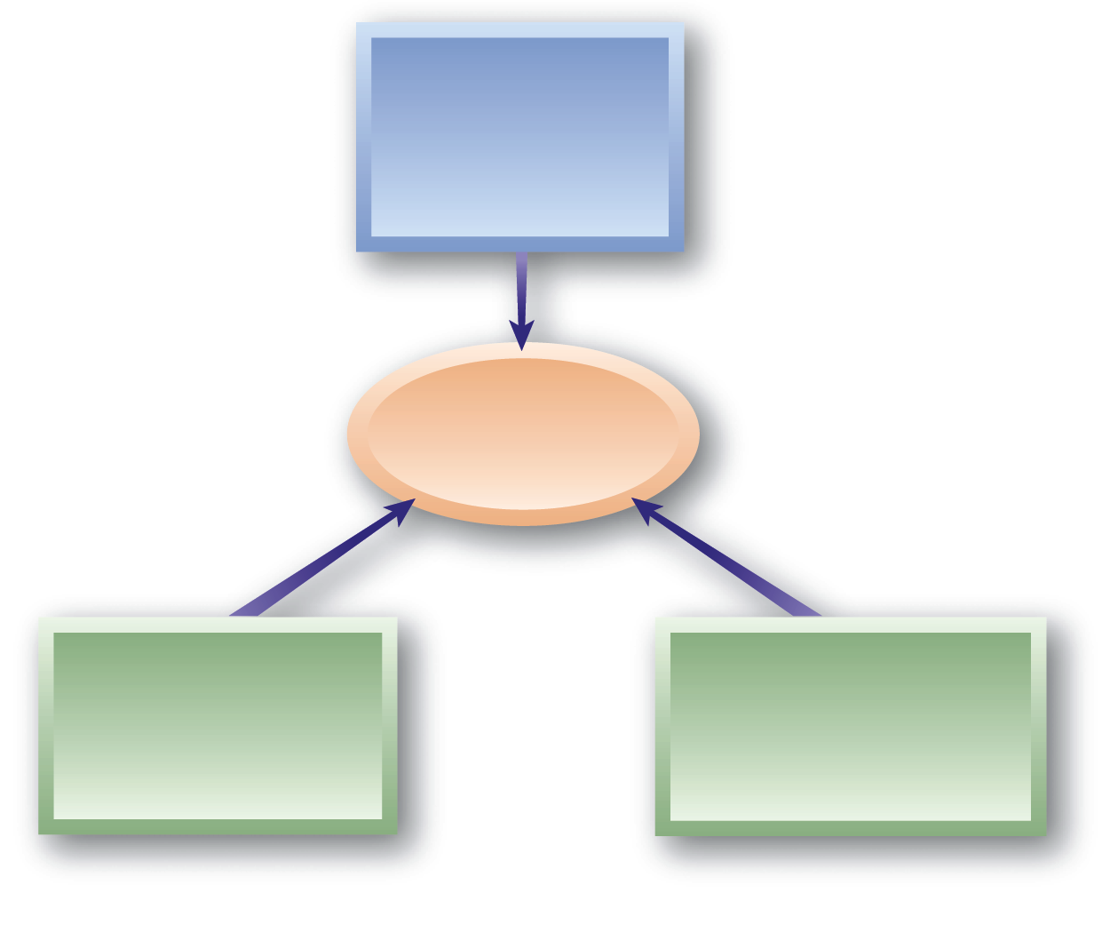
Selection Interviewing
Issues
Face
Validity
Interview
Reliability and Validity
Intra-rater
Reliability
Inter-rater
Reliability

Slide 25

Structured Interviews
Structured Interviews
Biographical Interview
Behavioral Interview
Competency Interview
Situational Interview

Slide 26
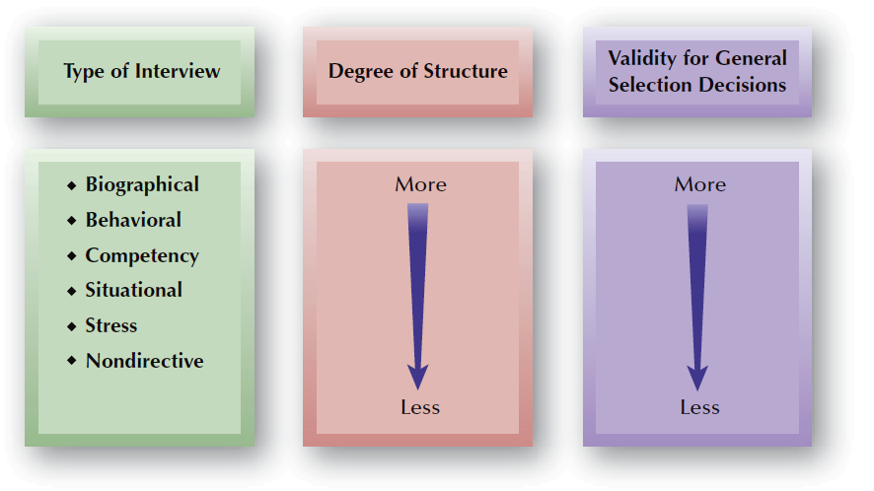
FIGURE 7–7
Validity and Structure in Selection Interviews

Slide 27

Structured Interviews (cont’d)
Benefits of Structured Interviews
Obtain consistent information needed for a selection decision
Are more reliable and valid than other interview formats
Meet federal EEO guidelines for the selection process

Slide 28
Less Structured Interviews
Nondirective Interview
  Questions are developed from the answers to previous questions.
  Possibility of not obtaining needed information.
  Information obtained may not be not job-related or comparable to that obtained from other applicants.
Stress Interviews
  An interview designed to create anxiety and put pressure on an applicant to see how the person responds.

Slide 29
Other Interview Formats
Panel Interview
  Interview in which several interviewers meet with candidate at the same time.
Team Interview
  Interview in which applicants are interviewed by the team members with whom they will work.

Slide 30
Who Conducts Interviews?
Interviewers
Individuals
Individuals Sequentially
Panel Interview
Team Interview

Slide 31



Effective Interviewing
Conducting an Effective Interview
Plan the Interview
Control the Interview
Use Effective Questioning Techniques
Questions to Avoid:
  Yes/No questions
  Obvious questions
  Questions that rarely produce a true answer
  Leading questions
  Illegal questions
  Questions that are not job related

Slide 32
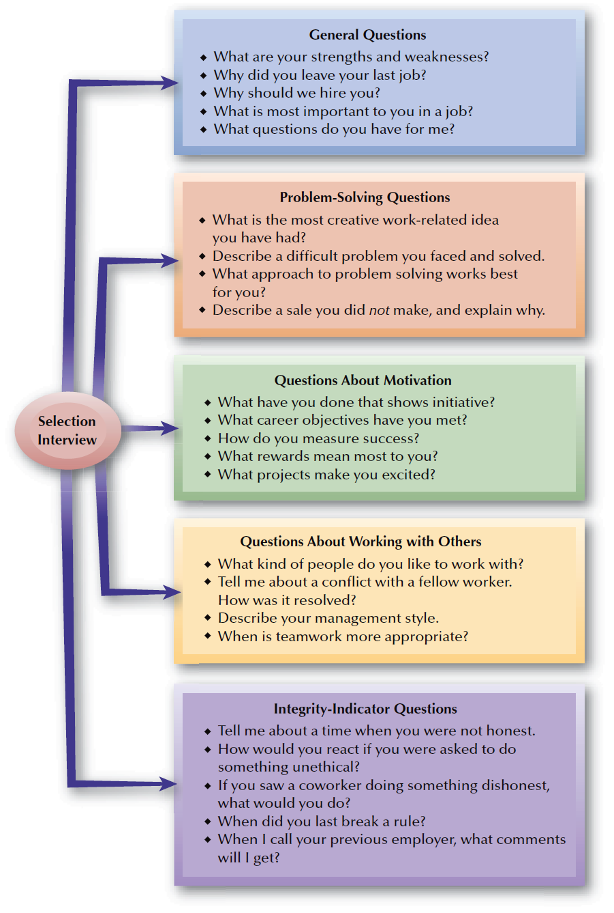
FIGURE 7–8
Questions Commonly Asked in Selection Interviews

Slide 33
Problems in the Interview
Snap Judgments
Negative Emphasis
Poor Interviewing Techniques
Halo Effect
Biases and Stereotyping
Cultural Noise

Slide 34
Background Investigations
Negligent Hiring
  Occurs when an employer fails to check the background of an employee who injures someone.
  Employers are liable for employees’ actions.
Negligent Retention
  Occurs when an employer is aware an employee may be unfit for employment, continues to employ the person, and the person injures someone.

Slide 35
Background Investigation (cont’d)
Fair Credit Reporting Act
  Requires disclosure of a credit check.
  Requires written consent of applicant.
  Requires copy of report be given to the applicant.

Slide 36
Medical Examinations and Inquires
American With Disabilities Act (ADA)
  Prohibits pre-employment medical exams.
  Prohibits rejecting persons for disabilities or asking disability-related questions until after a conditional job offer is made.
Drug Testing
  Use of drug testing in the selection process is increasing.
  Tests must be monitored to protect integrity of results.

Slide 37
References
Questions to Ask:
  Dates of employment
  Position held
  What were the job duties?
  What strengths/weaknesses did you observe?
  Were there any problems?
  Would you rehire?

Slide 38
Making the Job Offer
Offer Guidelines
  Formalize the offer with a letter to the applicant clearly stating the terms and conditions of employment.
  Avoid vague, general statements and promises.
  Require return of a signed acceptance of the offer.

Slide 39
Global Staffing Issues
Types of Global Employees
Host-Country Nationals
Third-Country Nationals
Expatriates

Slide 40
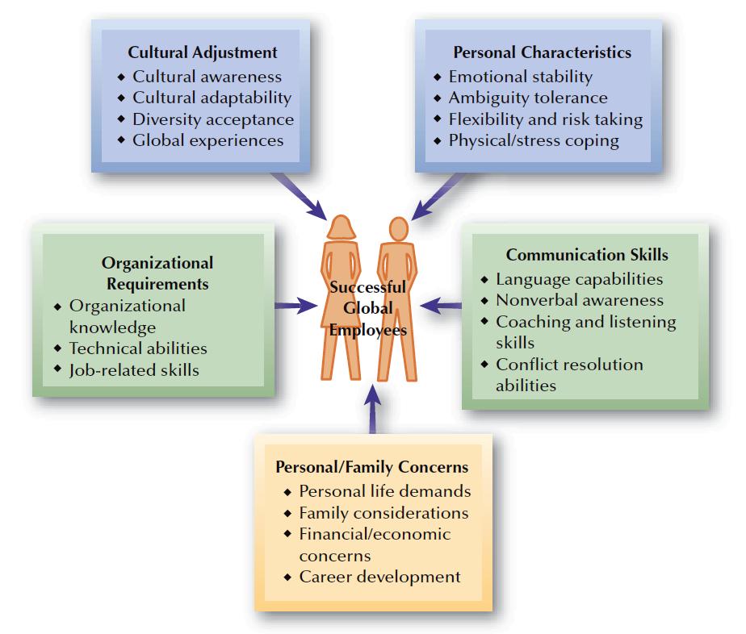
FIGURE 7–9
Selection Factors
for Global
Employees

Slide 41
Who Is an Applicant?
EEOC and OFCCP definition of “applicant”:
  Has expressed interest through the Internet or electronically and is being considered for a specific position by the employer.
  Has identified that he or she has the basic position qualifications.
  Does not remove his or her interest in the position at anytime during the selection process.
  Has been ranked using “hit features” by employer software or other data techniques that are not linked to assessment qualifications.

Slide 42
Legal Concerns in the Selection Process
Selection Activities
Defining Who Is an Applicant
Applicant Flow Documentation
Selection for
“Soft Skills”

