Slide 1
CHAPTER 6
Recruiting and Labor Markets

Slide 2



The Importance of Recruiting
Recruiting
  Is the process of generating a pool of qualified applicants for organizational jobs
  Seeks to improve workforce quality for competitive advantage:
Cost of
recruiting
Quality of recruited candidates
Cost of
unfilled jobs

Slide 3
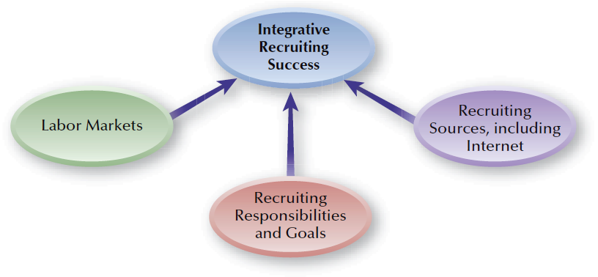
FIGURE 6–1
Integrating Recruiting Components

Slide 4
Strategic Recruiting and HR Planning
Effective Recruiting Requires:
  Knowing the business and industry
  Identifying keys to success in the labor market
  Cultivating networks and relationships
  Promoting the “company brand”
  Using metrics to measure recruiting effectiveness
  Identifying talent before it is needed
Training Recruiters and Managers
  Recruiting-related job skills
  Diversity and sensitivity skills
  Ethical recruiting behaviors

Slide 5
Labor Markets
Labor Markets
  The external supply pool from which organizations attract their employees
Unemployment Rates and Applicant Population
  Low unemployment creates competition for employees, raising labor costs.
  High unemployment results the availability of more applicants and more qualified applicants.

Slide 6

FIGURE 6–2
Labor Market Components

Slide 7
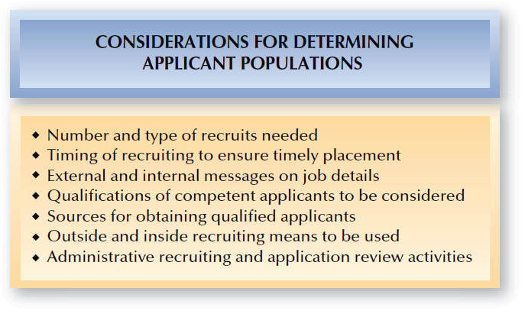
FIGURE 6–3
Considerations for Determining Applicant Populations

Slide 8

Reaching the Applicant Population
Recruiting Decisions
Recruiting Method
Recruiting Message
Applicant Qualifications
Administrative Procedures

Slide 9

Different Labor Markets and Recruiting
Geographic Labor Markets
Global Labor
Markets
Labor
Markets
Industry and Occupational Labor Markets
Educational and Technical Labor Markets

Slide 10


Strategic Recruiting Decisions
Sample
Organization-Based
vs.
Outsourced Recruiting
Recruiting Source Choices:
Internal vs. External
Sample
Recruiting Presence and Image
Sample
Strategic Recruiting Decisions
Sample
Sample
Recruiting Nontraditional
Workers
Training of
Recruiters
Sample
Sample
Recruiting and EEO:
Diversity
Considerations
Regular vs.
Flexible Staffing
Sample
Realistic Job
Previews

Slide 11

Internet Recruiting
Effects of Internet Recruiting
Adjusting to new recruiting approaches
Identifying new types of recruiting for specific jobs
Training for managers and HR recruiters

Slide 12
Internet Recruiting (cont’d)
E-Recruiting Places
Internet Job Boards
Professional/
Career Websites
Employer Websites

Slide 13

Recruiting and Internet Social Networking
Social Networking Recruiting Advantages:
Allows job seekers to connect with employees of potential employers
Allows employers to engage in social collaboration by joining and accessing social technology networks to help applicants post resumes and complete applications online

Slide 14
Recruiting Using Special Technology Means
Internet Recruiting Tools
Blogs
E-Video
Twitter

Slide 15

Legal Issues in Internet Recruiting
The use (or misuse) of
screening software
Collection of federally required applicant information
Legal Issues in Internet Recruiting
Exclusion of protected classes from the process
Proper identification of
“real” applicants
Maintaining confidentiality
and privacy

Slide 16

Internet Recruiting
Advantages
Disadvantages
Recruiting cost savings
Recruiting time savings
Expanded (global) pool of applicants
Better targeting of specific audiences
More unqualified applicants
Additional work for HR staff
Many applicants are not seriously seeking employment
Access limited or unavailable to some applicants
Privacy of information and discrimination issues

Slide 17
External Recruiting
Media Sources
Competitive Recruiting Sources
Employment Agencies
External Recruiting
Sources
Labor Unions
Job Fairs
Educational Institutions

Slide 18
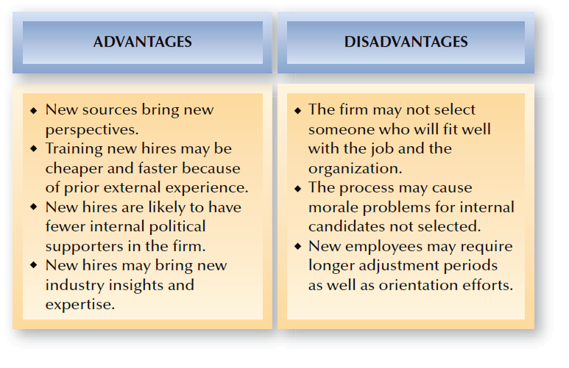
FIGURE 6–5
Advantages and Disadvantages of External Recruiting

Slide 19
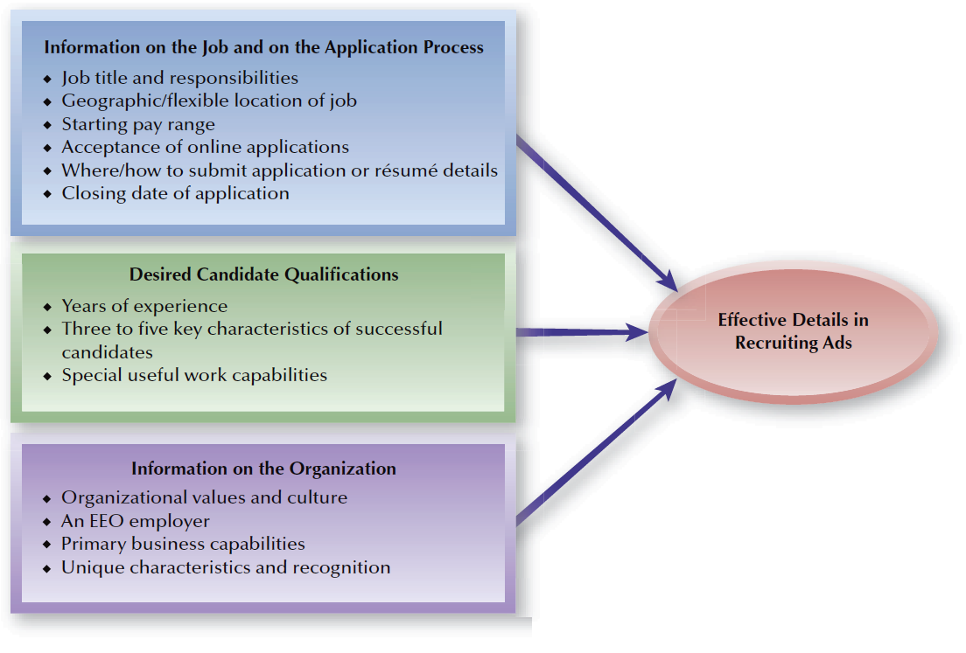
FIGURE 6–6
What to Include in an Effective Recruiting Ad

Slide 20
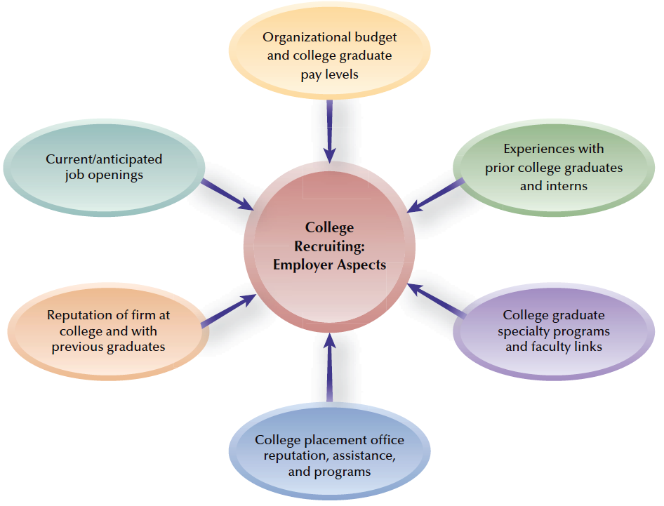
FIGURE 6–7
College Recruiting: Considerations for Employers

Slide 21

Internal Recruiting
Employee Databases
Job
Postings
Internal Recruiting Sources
Former Employees and Applicants
Promotions and Transfers
Current-Employee Referrals

Slide 22
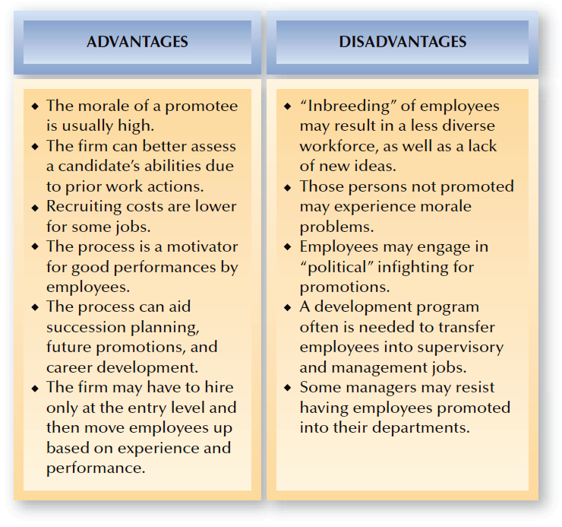
FIGURE 6–8
Advantages and Disadvantages of Internal Recruiting

Slide 23
Recruiting Evaluation and Metrics
Evaluating Recruiting Quality and Quantity
Evaluating Recruiting Satisfaction
Evaluating Recruiting Efforts
Evaluating the Time Required to Fill Openings
Evaluating the Cost
of Recruiting

Slide 24
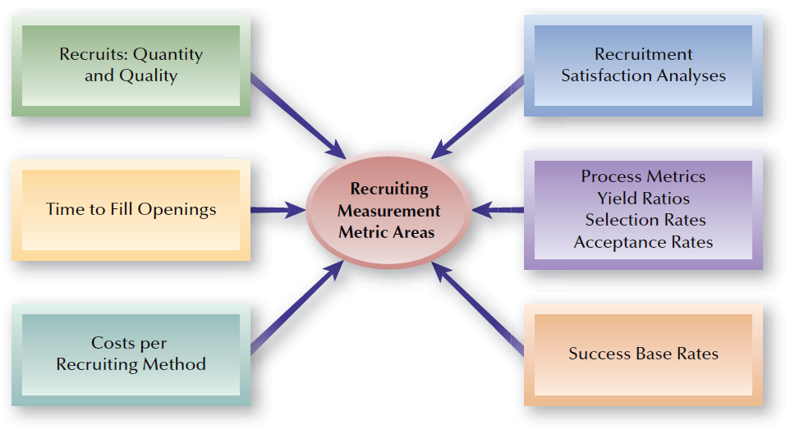
FIGURE 6–9
Recruiting Measurement Areas

Slide 25
Recruiting Metrics
General Recruiting Process Metrics
Yield
Ratios
Selection
Rate
Acceptance
Rate
Success Base
Rate

Slide 26
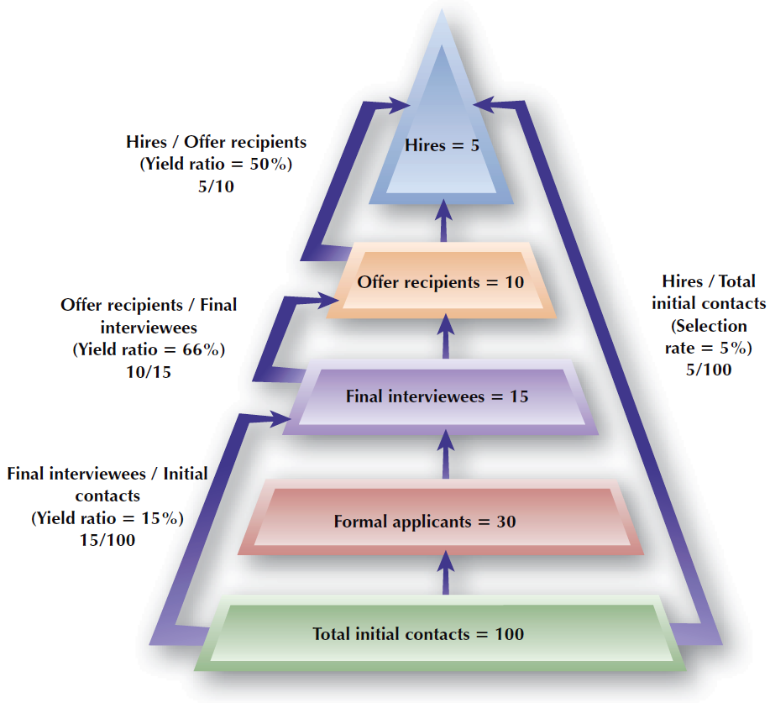
FIGURE 6–10
Sample Recruiting Evaluation Pyramid

Slide 27
Increasing Recruiting Effectiveness
Technical Approaches
Non-Technical Approaches
Resume mining software
Applicant tracking
Employer career websites
Internal mobility tracking system
Personable recruiters
Emphasizing positives about the job and employer within a realistic job preview
Fair and considerate treatment in the recruiting process
Enhancing applicants’ perceived fit with the organization

