Slide 1
CHAPTER 5
Human Resource Planning and Retention

Slide 2
Human Resource Planning
Human Resource (HR) Planning
  The process of analyzing and identifying the need for and availability of human resources so that the organization can meet its objectives.
HR Planning Responsibilities
  Top HR executive and subordinates gather information from other managers to use in the development of HR projections for top management to use in strategic planning and setting organizational goals.

Slide 3

Purpose of HR Planning
Effective HR Planning
Right
people
Right
capabilities
Right
times
Right
places

Slide 4







HR Forecasting
Strategic HR Planning
Forecast HR requirements (demand)
Forecast HR availability (supply)
Yes
Match?
No
Develop programs to increase supply or reduce demand
Develop programs to decrease supply or increase demand

Slide 5
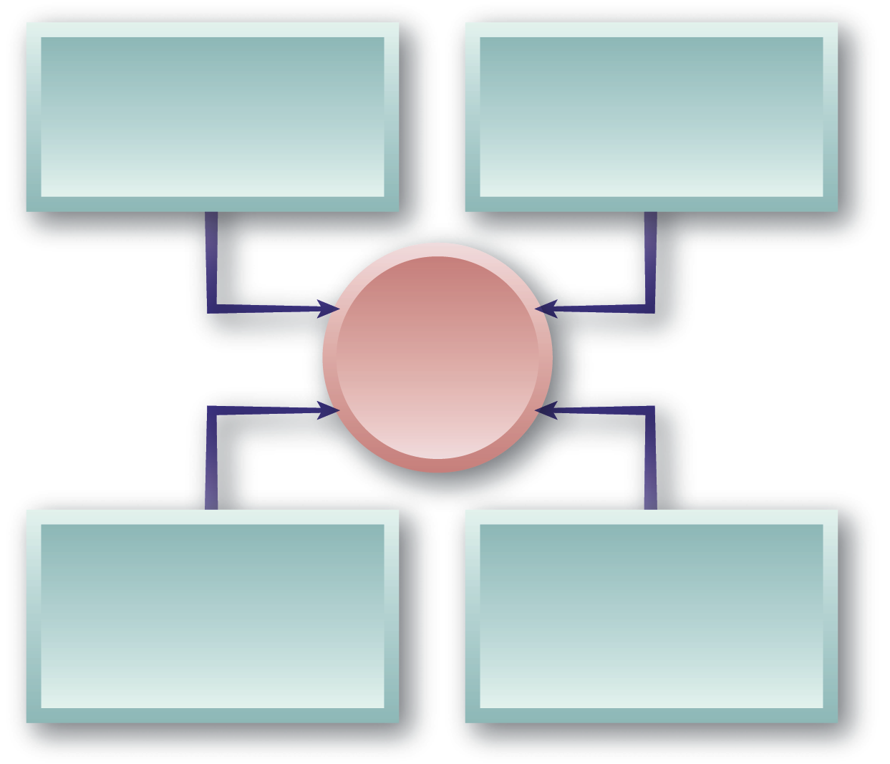
Small Businesses and HR Planning
Attracting and retaining qualified outsiders
Management succession between generations of owners
HR Planning Issues in Small Businesses
Evolution of HR activities as the business grows
Family relationships and HR policies

Slide 6
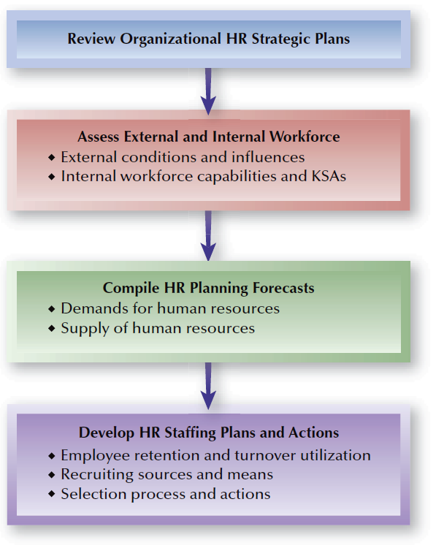
FIGURE 5–1
HR Planning Process

Slide 7

Assessing the External Workforce
External Workforce
Economic and Governmental Factors
Competitive Evaluations
Changing Workforce Considerations

Slide 8
Assessing the Internal Workforce
Jobs and Skills Audit
  What jobs exist now and how essential is each job?
  How many individuals are performing each job?
  What are the reporting relationships of jobs?
  What are the vital KSAs needed in the jobs?
  What jobs will be needed to implement future organizational strategies?
  What are the characteristics of those anticipated jobs?

Slide 9
Assessing the Internal Workforce (cont’d)
Organizational Capabilities Inventory
  HR databanks—sources of information about employees’ knowledge, skills, and abilities (KSAs)
  Components of an organizational capabilities inventory:
    Individual employee demographics
    Individual career progression
    Individual performance data

Slide 10
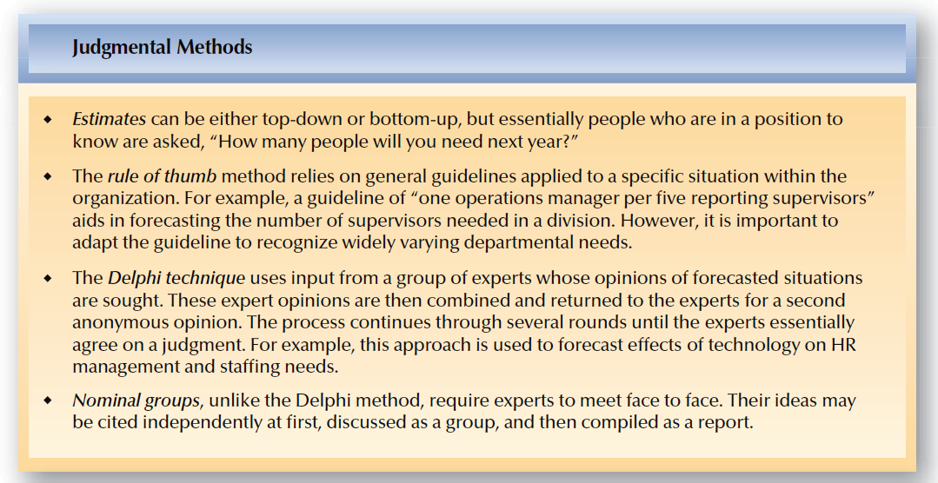
FIGURE 5–2
HR Forecasting Example Methods

Slide 11
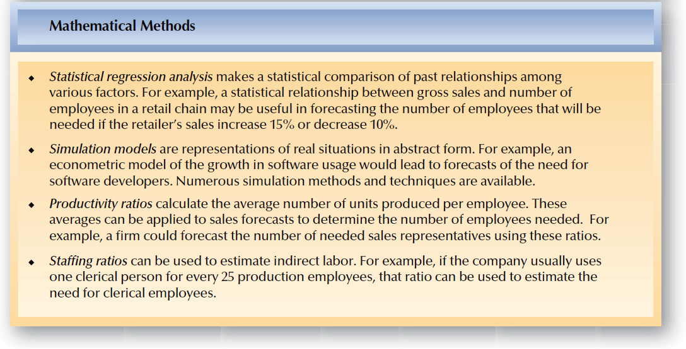
FIGURE 5–2
HR Forecasting Example Methods (cont’d)

Slide 12
Forecasting HR Supply and Demand
Forecasting
  Using information from the past and the present to identify expected future conditions.
Types of Forecasts
  HR Demand
  Internal Supply
  External Supply
Forecasting Periods
  Short-term—less than one year
  Intermediate—up to five years
  Long-range—more than five years

Slide 13

HR Forecasting Methods
Judgmental
Mathematical
Estimates
Rules of thumb
Delphi Technique
Nominal Groups
Statistical regression analysis
Simulation models
Productivity ratios
Staffing ratios

Slide 14
Forecasting Demand for Human Resources
Organization-Wide Estimate for Total HR Demand
  Unit breakdown for specific skill needs by number and type of employee
    Develop decision rules (“fill rates”) for positions to be filled internally and externally.
    Develop additional decision rules for positions impacted by the chain effects of internal promotions and transfers.

Slide 15
Forecasting Supply of Human Resources
Forecasting External HR Supply
  Factors affecting external supply:
    Net migration into and out of an area
    Individuals entering and leaving the workforce
    Individuals graduating from schools and colleges
    Changing workforce composition and patterns
    Economic forecasts
    Technological developments and shifts
    Actions of competing employers
    Government regulations and pressures
    Other circumstances affecting the workforce

Slide 16
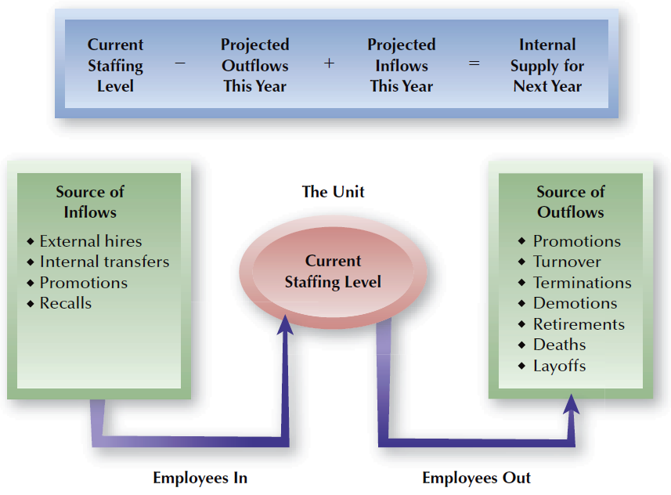
FIGURE 5–3
Estimating Internal Labor Supply for a Given Unit

Slide 17
Individual/Organizational Relationships
The Psychological Contract
  The unwritten expectations employees and employers have about the nature of their work relationships.
    Affected by age of employee and changes in economic conditions.
    Focuses on expectations about “fairness” that may not be defined clearly by employees.
Psychological Ownership
  When individuals feel that they have some control and perceived rights in the organization, they are more likely to be committed to the organization.

Slide 18
Components of the Psychological Contract
Employers provide:
Employees contribute:
Competitive compensation and benefits
Flexibility to balance work and home life
Career development opportunities
Continuous skill improvement and increased productivity
Reasonable time with the organization
Extra efforts and results when needed

Slide 19
Individual Employee Performance and Motivation
Individual Performance Factors
  Individual’s ability to do the work
  Effort expended
  Organizational support
Performance (P) = Ability (A) x Effort (E) x Support (S)

Slide 20
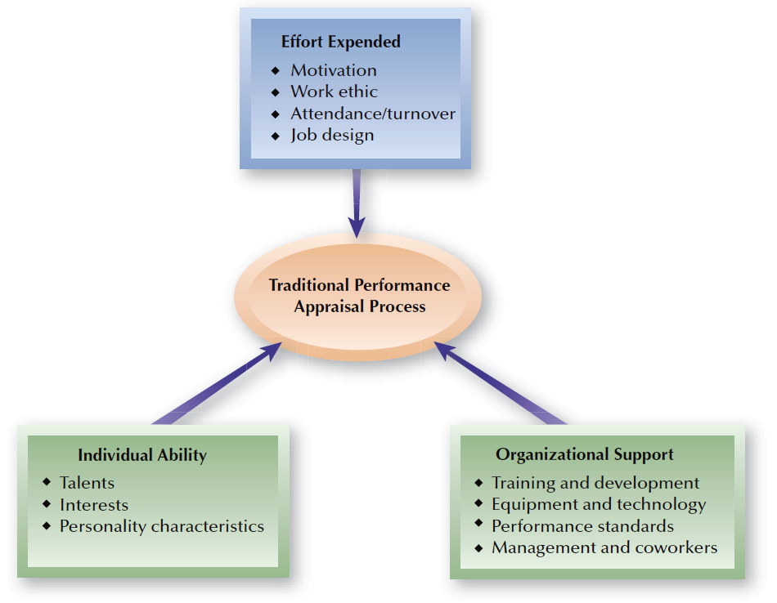
FIGURE 5–4
Components of Individual Performance

Slide 21
Individual Motivation
Motivation
  The desire within a person causing that person to act to reach a goal.
Management Implications for Motivating Individual Performance
  Broad-based strategies and tactics to address individual employee concerns about:
    Consistency in organizational rewards
    Organizational support for employee efforts
    Accurate measurement of employee performance
    Desirability of rewards by employees

Slide 22
Nature of Job Satisfaction
Job Satisfaction
  A positive emotional state resulting from evaluating one’s job experience.
Organization Commitment (Loyalty)
  The degree to which employees believe in and accept organizational goals and desire to remain with the organization.
  Employee engagement: the extent to which an employee feels linked to organizational success.
  Continuance commitment: the likelihood that an individual will stay with rather than withdraw from the organization.

Slide 23
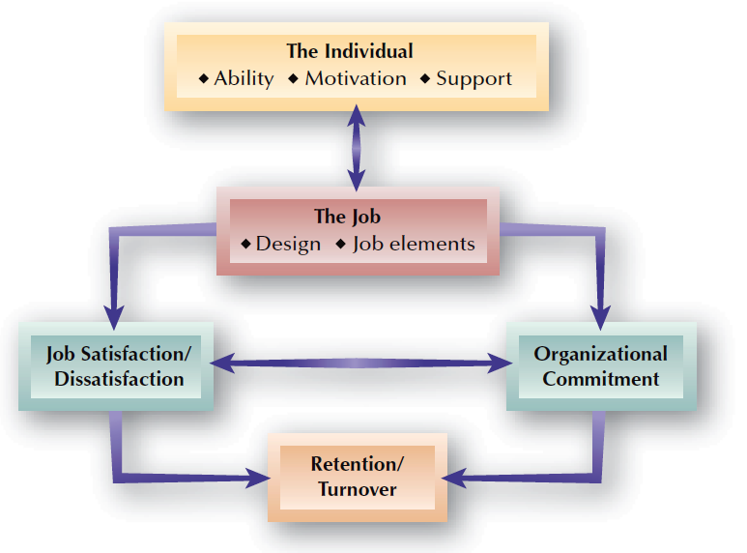
FIGURE 5–5
Factors Affecting Job Satisfaction and Organizational Commitment

Slide 24
Employee Turnover
Turnover
  The process in which employees leave an organization and have to be replaced.
Impact of Turnover
  Inability to achieve business goals
  Loss of “image” to attract other individuals
  High costs of turnover and replacement
    Churn—hiring new workers while laying off others

Slide 25
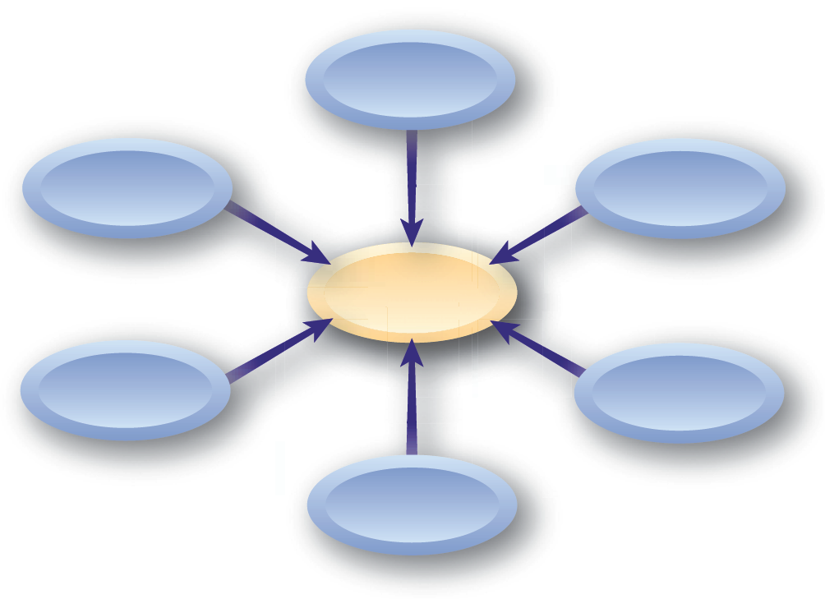
Types of Turnover
Involuntary
Controllable
Voluntary
Turnover
Uncontrollable
Functional
Dysfunctional

Slide 26
Measuring Employee Turnover
Computing the Turnover Rate:
Determining Turnover Costs
  Separation costs
  Vacancy costs
  Replacement costs
  Training costs
  Hidden/indirect costs

Slide 27
Measuring Employee Turnover (cont’d)
Ways to Measure Turnover:
  Job and job levels
  Department, units, and location
  Reason for leaving
  Length of service
  Demographic characteristics
  Education and training
  Knowledge, skills and abilities
  Performance ratings/levels

Slide 28
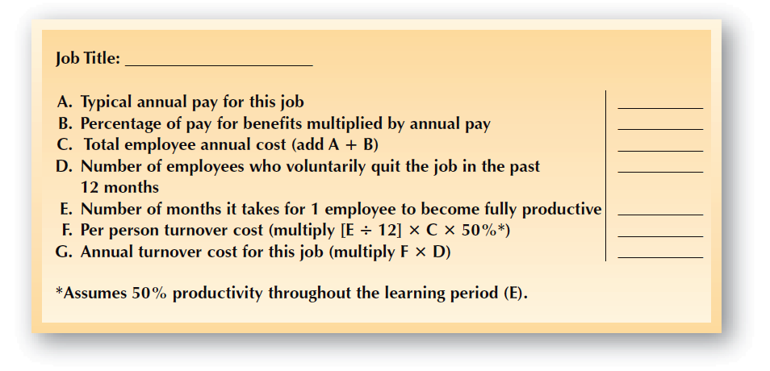
FIGURE 5–6
Model for Costing Lost Productivity

Slide 29
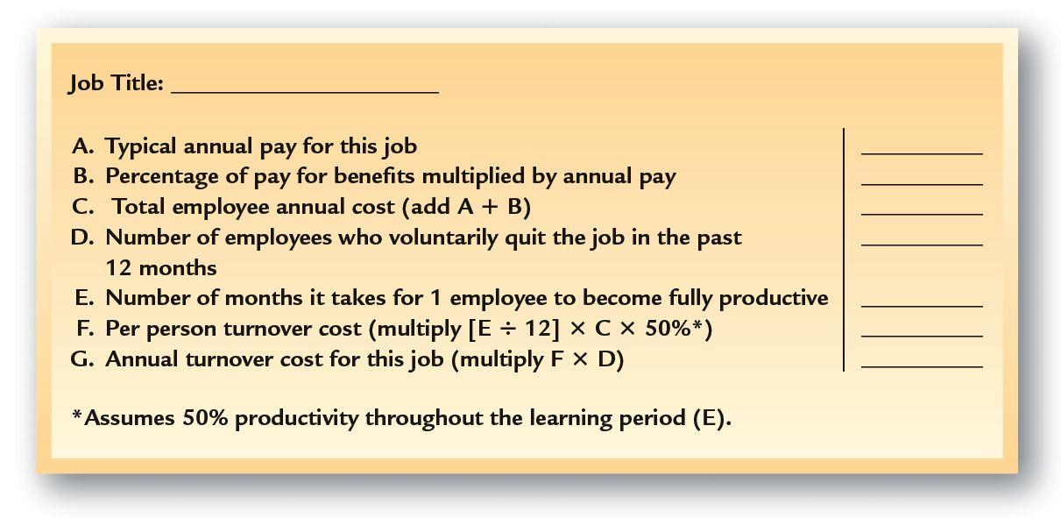
FIGURE 5–6
Costing Lost Productivity: Text Example
Teller
20,000
(40%)
8,000
28,000
20
3
3,500
70,000

Slide 30
Retention of Human Resources
Myths About Retention
  Money is the main reason people leave.
  Hiring has little to do with retention.
  If you train people, you are only
  training them for another employer.
  Do not be concerned about retention during organizational change.
  If solid performers want to leave,
  the company cannot hold them.

Slide 31
Drivers of Retention
Why Satisfactory Employees Leave:
  Unhappiness with management
  Limited career advancement
  Lack of recognition
  Insufficient pay and benefits
  Job boredom
I’m Gone

Slide 32
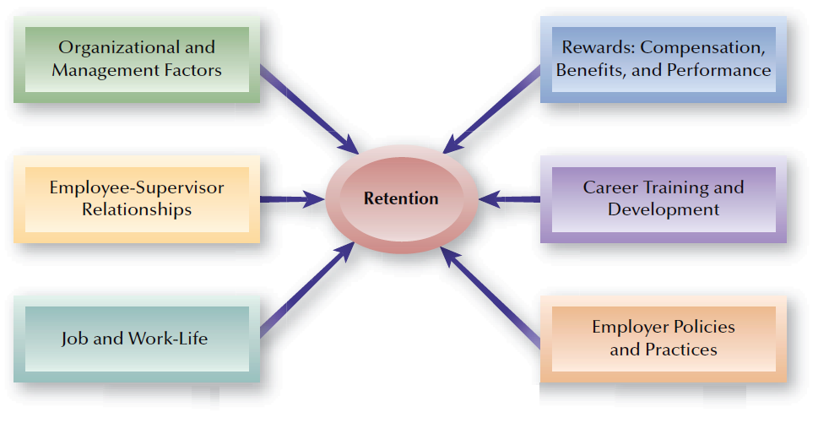
FIGURE 5–7
Drivers of Retention

Slide 33
Possible Retention Interventions
Improved Retention
Spot cash awards for good work
Develop profiles of successful employees and hire to the profile
Learning bonuses
Focus groups on employee issues
Voluntary job sharing
Realist job avenues
Excellent employee development
Payback agreement for moving expenses
Clear goals
Accurate performance appraisals
Competitive benefits
Career counseling
Mentoring
Diverse workplace
Sabbatical leaves
Facilitate promotion/transfer
Reward managers with low turnover
“Fair” pay
Fulfilling work
Avoid hiring those with a history of turnover
Tuition reimbursement and promotion for education
Retention bonuses
Subsidized child/elder care
Retrain for promotion/transfer
Pay tied to performance
Telecommuting
Recognize good work
Good working conditions
Friendly work culture/co-workers
Considerate supervisors

Slide 34
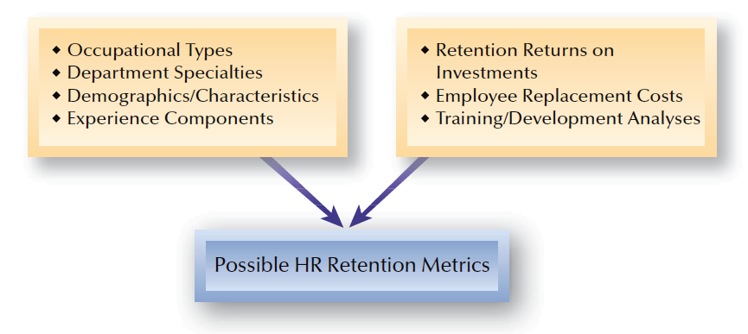
FIGURE 5–8
Retention Measurement and Assessment Sources

Slide 35
Managing Retention
Retention Assessment and Metrics
Employee Surveys
Exit
Interviews
First-Year Turnover Evaluations

