Slide 1
CHAPTER 4
Workers, Jobs, and Job Analysis

Slide 2
Workforce Composition
Changes in the U.S. Workforce
  Increases in health care and health-related jobs
  Declines in manufacturing jobs and workers
  Increased need for workers with technical skills
  Increasing diversity in the workforce
Diversity
  Differences in human characteristics and composition in an organization
    Race/ethnicity • National origin/immigration
    Age/generational differences • Sexual orientation
    Gender • Marital and family status
    Disabilities • Religion

Slide 3
Business Contribution of Diverse Workers
“Business Case” for Diversity:
  Allows new talent and ideas from employees of different backgrounds, which can enhance organizational performance.
  Helps recruiting and retention because protected-class individuals often prefer to work in organizations with coworkers of various demographics.
  Allows for an increase of market share because customers can be attracted to purchase products and services with varied demographic marketing activities.
  Can lead to lower costs because there may be fewer discrimination lawsuits.

Slide 4
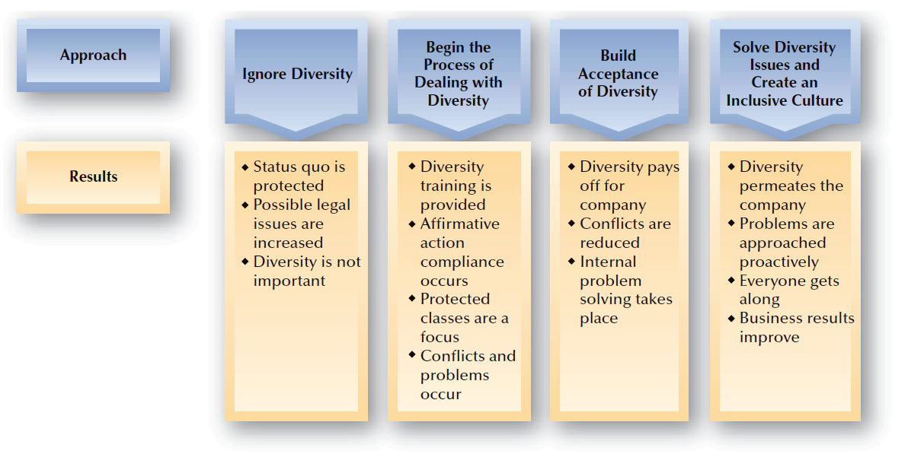
FIGURE 4–1
Various Approaches to Diversity and Their Results

Slide 5

Diversity Training
Issues in Diversity Training
  Mixed Results for Diversity Training
  Backlash against Diversity Training Efforts
Diversity Training Components
Legal
awareness
Cultural
awareness
Sensitivity training

Slide 6
Generational Differences
Age/generational Groups:
  Matures (born before 1946)
  Baby boomers (born 1946–1964)
  Generation Xers (born 1965–1980)
  Generation Yers (millenials) (born 1981–2000)
Challenges:
  Older workers delaying retirement
  Shortage of experienced and skilled workers
  Generational differences in expectations from jobs

Slide 7
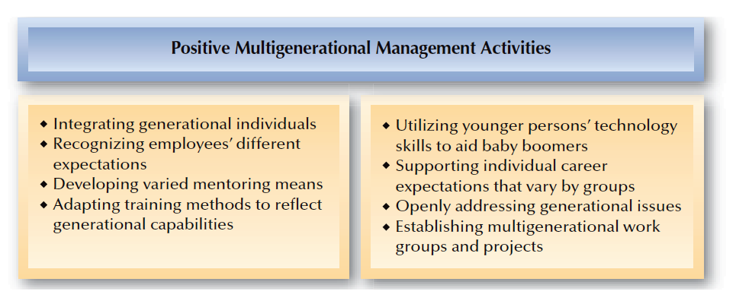
FIGURE 4–2
Positive Multigenerational Management Activities

Slide 8
Nature of Jobs and Work
Dividing Work into Jobs
  Work
    Effort directed toward producing or accomplishing results.
  Job
    A grouping of tasks, duties, and responsibilities that constitutes the total work assignment for an employee.

Slide 9










Influences Affecting Jobs, People, and Related HR Policies
Organizational Values
Organizational Strategy
Customer
Needs
Nature of Work
Jobs
Needed
People Needed
for Jobs
HR Activities Focusing on Jobs
  Job analysis • Recruiting
  Training and development
  Performance management
  Health, safety, and security
  Employee relations • Compensation

Slide 10






Workflow Analysis
Workflow Analysis
  The study of the way work (inputs, activities, and outputs) moves through an organization.
Inputs
People, materials, equipment
Activities
Tasks and
jobs
Outputs
Goods and
services
Evaluation

Slide 11
Business Process Re-Engineering
Business Process Re-engineering (BPR)
  Measures for improving such activities as product development, customer service, and service delivery.
Rethink
Redesign
Retool

Slide 12
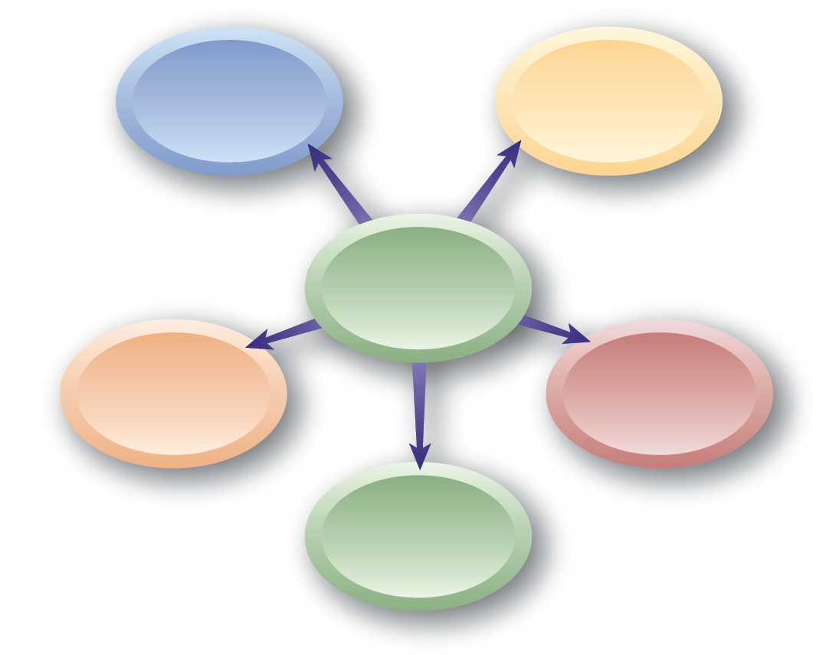
Workers and Job Design
Full-time employees
Part-time employees
Types of Workers
Independent contractors
Temporary workers
Contingent workers

Slide 13
Job Design
Job Design
  Organizing tasks, duties, and responsibilities into a productive unit of work.
Person-Job Fit
  Matching characteristics of people with characteristics of jobs.
Job Design Impacts
Performance
Job Satisfaction
Physical and Mental Health

Slide 14
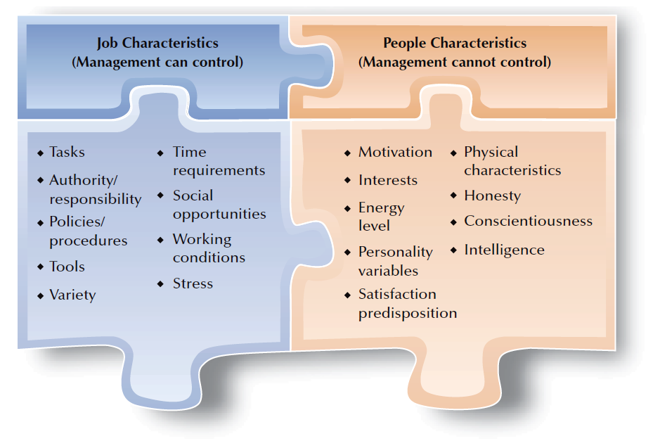
FIGURE 4–3
Some Characteristics of People and Jobs

Slide 15

Common Approaches to Job Design
Job Design Approaches
Job enlargement
Job
enrichment
Job
rotation
Job
sharing

Slide 16
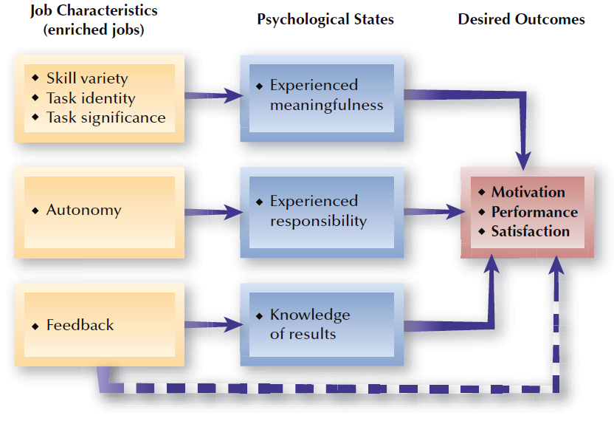
FIGURE 4–4
Job Characteristics Model

Slide 17
Using Worker Teams in Jobs
Types of Teams
Special-Purpose Team
Self-Directed Team
Virtual
Team

Slide 18
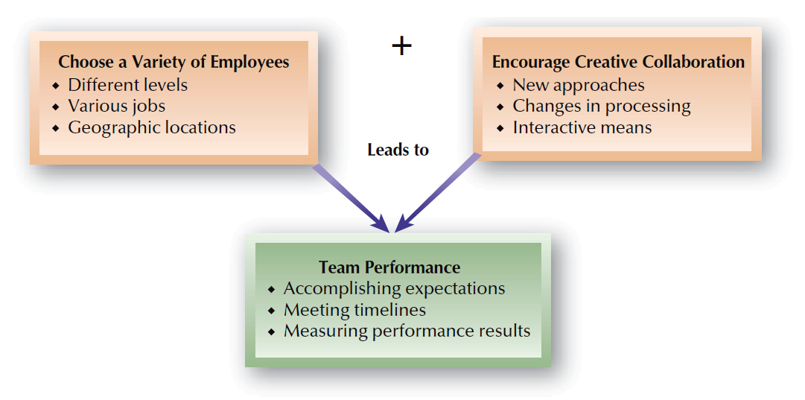
FIGURE 4–5
Encouraging Team Performance Success

Slide 19

Team Jobs
Advantages
Disadvantages
Improved productivity
Increased employee involvement
More widespread employee learning
Greater employee ownership of problems
Requires employees to be “group oriented”
Not appropriate for most work in organizations
Can be overused
Difficult to measure team performance
Individual compensation interferes with team concept

Slide 20
Telework
Telework
  Employees work via electronic telecommunications, and internet means.
Effects of Alternative Work Arrangements
  More self-scheduling by employees
  A shift to evaluating employees on results
  Greater trust, less control and direct supervision
  Legal issues related to state and federal laws
  Career impacts of lack of direct contact (visibility)

Slide 21
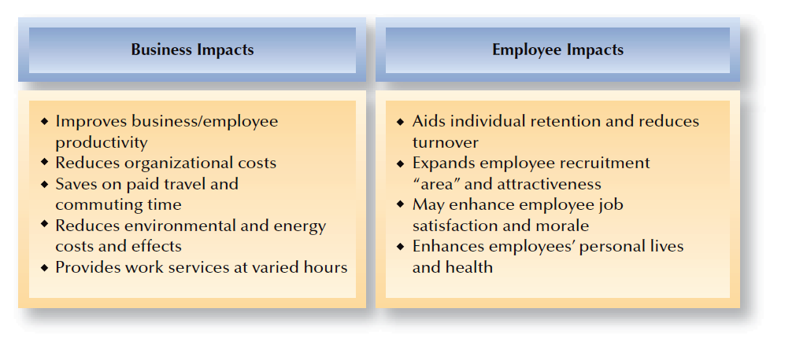
FIGURE 4–6
Telework Advantages for Employers

Slide 22
Work Schedule Alternatives
Global Work Schedule Differences
Work
Schedule Alternatives
Work
Schedules
Job
Sharing
Shift Work
and Compressed Workweek
Flexible Scheduling

Slide 23
Why Have Job Descriptions?
Hiring, Recruitment, and Selection
EEO / ADA
Compensation / Wage and Hour Issues
Training and Development
Performance Management
Health and Safety
Workers’ Compensation
Employee / Labor Relations

Slide 24
Why Are Job Descriptions Not Prepared?
Time, Time, Time
$ Cost $
Lack of Management Support
Not Considered Important
Never Had Them / Don’t Want Them
Not Able to Keep Them Updated
Don’t Want Specialized Employees
They Just Sit on the Shelf

Slide 25
The Nature of Job Analysis
Job Analysis
  A systematic way of gathering and analyzing information about the content, context, and the human requirements of jobs.
    Work activities and behaviors
    Interactions with others
    Performance standards
    Financial and budgeting impact
    Machines and equipment used
    Working conditions
    Supervision given and received
    Knowledge, skills, and abilities needed

Slide 26
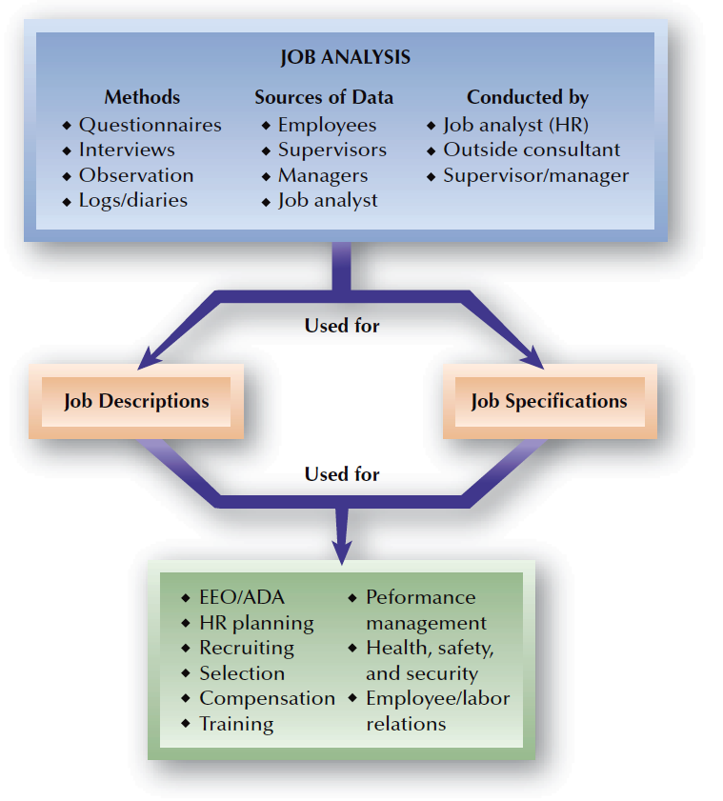
FIGURE 4–7
Job Analysis
in Perspective

Slide 27
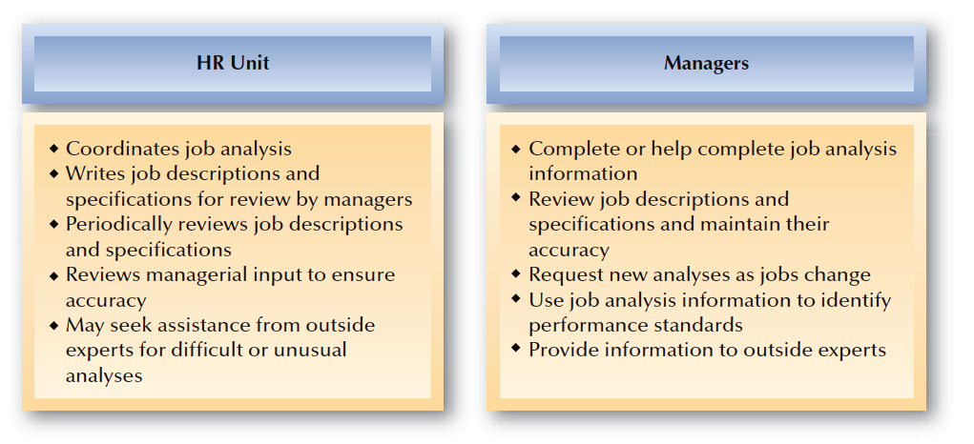
FIGURE 4–8
Typical Division of HR Responsibilities: Job Analysis

Slide 28
Preliminary Questions to Ask
Is it a newly created job?
Is the job in one department or several?
How many incumbents are in the job?
Are there significant variations within the job?
How does the job relate to or interact with other jobs in the organization?
Are there significant changes that will impact the job in the near future?
  Technology changes
  Department reorganization

Slide 29
Task-Based Job Analysis
Responsibility
Duty
Duty
Task
Task
Task
Task

Slide 30
Competency-Based Job Analysis
Competencies
  Individual capabilities that can be linked to enhanced performance by individuals or teams.
    Technical competencies
    Behavioral competencies
Reasons for using a competency approach:
  To articulate valued behaviors within the organization
  To raise competency levels throughout the organization
  To emphasize people’s capabilities for enhancing the competitive advantage of the organization

Slide 31
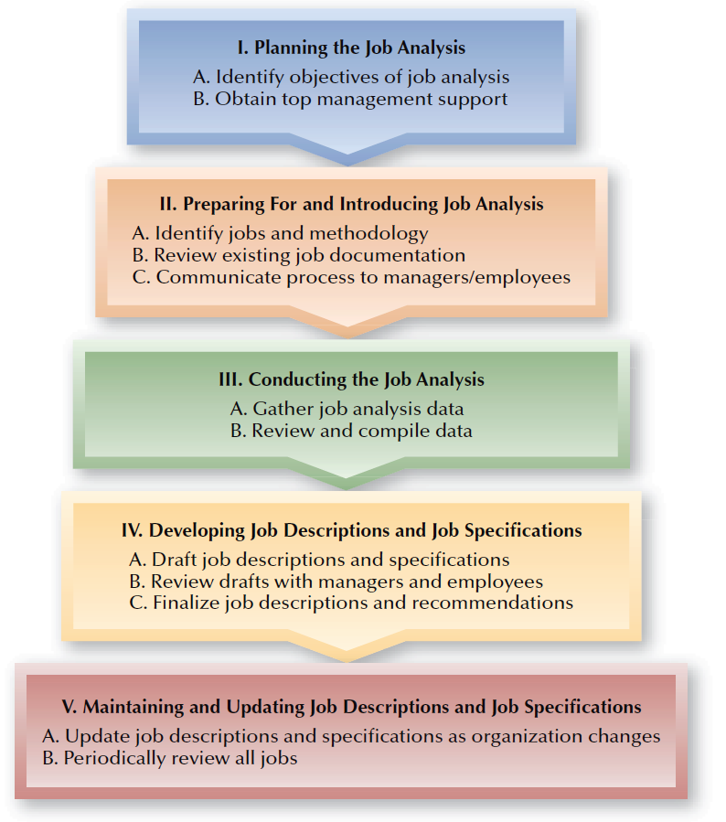
FIGURE 4–9
Stages in the Job Analysis Process

Slide 32
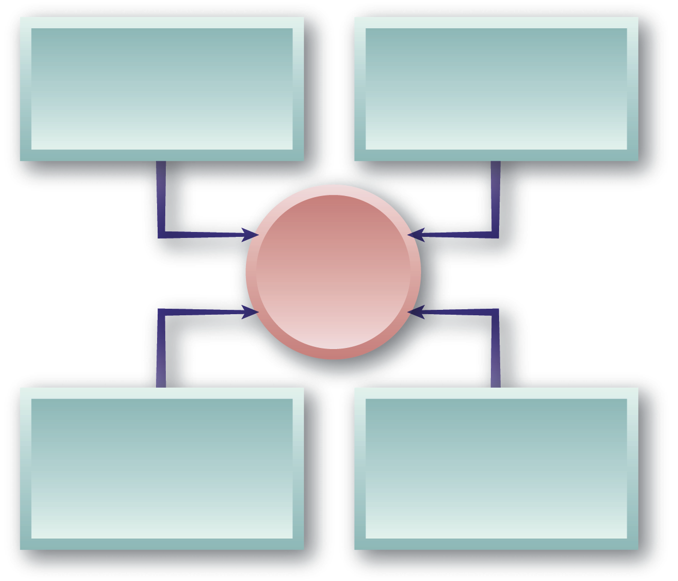
Job Analysis Methods
Observation
Work Sampling
Employee Diary/Log
Interviewing
Standardized Interviews
Panel Interviews
Job
Analysis Methods
Questionnaires
PAQ, MPDQ
Computerized Systems

Slide 33
Criteria for Choice of Job Analysis Methods
Degree of suitability/versatility for use across different jobs.
Degree of standardization in the process and in the reporting of results.
Acceptability of process and results to those who will serve as sources and/or users.
Degree to which method is operational and may be used off-the-shelf without modification, as opposed to a method requiring tailor-made development and application.

Slide 34
Criteria for Choice of Job Analysis Methods
Amount of training required for sources and users of job information.
Costs of the job analysis, both in terms of direct administrative costs and opportunity costs of time involvement by people.
Quality of resultant information in terms or reliability and content validity.
Usability of results in recruitment, selection, and employment activities.

Slide 35
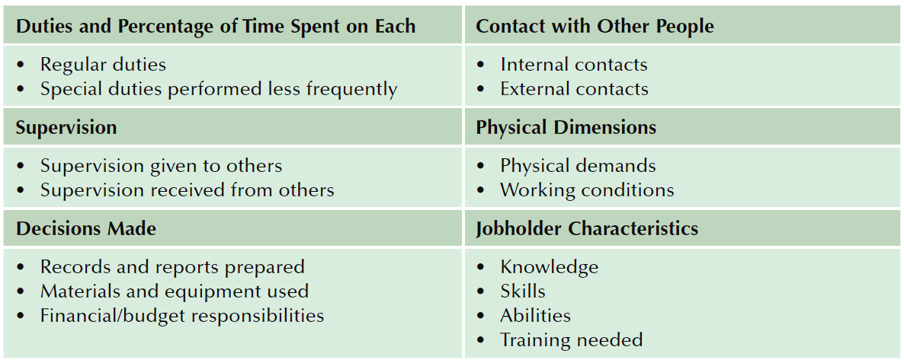
FIGURE 4–10
Typical Areas Covered in a Job Analysis Questionnaire

Slide 36
Identifying Job Functions
A job function is:
  Expressed in terms of work behaviors.
  A description of the major activities that a worker performs to accomplish the objectives of the job.
  A compilation of one or more detailed job tasks or steps required to perform the job.
A job function statement consists of:
  WHAT is done (action verb)
  To WHOM or WHAT (object of verb)
  WHY (to produce what)
  HOW (using what)

Slide 37
Job Functions
Specific, not vague
Logical, easy to understand
Detailed, but not excessively so
Quantified whenever possible
Consistent
Accurate
Miscellaneous clause – “Performs other related duties as assigned by supervisor or manager.”

Slide 38
Example Job Function
Job functions for a safety manager
  NOT: Train all employees.
  INSTEAD: Personally or through the use of loss control representatives or contract trainers, train all employees in safety according to regulations and the company’s IIPP, to reduce or prevent accidents, illnesses, or injuries.
  NOT: Prepare reports.
  INSTEAD: Prepare all safety-related reports as required to meet specific deadlines, ensure compliance, and aid with analysis of accidents, illnesses, and injuries.

Slide 39
Time Spent on Each Job Function
Estimate the amount of time spent on each job function.
This provides an indication of both the complexity and the significance of the function.
Estimates should be based on the job class in general, not on any particular employee’s own position.
The sum of the percentages should equal 100%.
Think in terms of number of hours in a typical work day or work week (or month or year).

Slide 40
Legal Aspects of Job Analysis
Job Analysis and the Americans with Disabilities Act (ADA)
  Essential job functions—fundamental duties of the job that are performed regularly, require significant amounts of time, cannot be easily assigned to another employee, and are necessary to accomplish the job.
  Marginal job functions—duties that are part of the job but are incidental or ancillary to the purpose and nature of the job.

Slide 41
The Americans With Disabilities Act (ADA)
A qualified individual with a disability is a person who meets legitimate skill, experience, education, or other requirements of an employment position that s/he holds or seeks, and who can perform the essential functions of the position with or without reasonable accommodation.
Requiring the ability to perform essential functions assures that an individual with a disability will not be considered unqualified simply because of inability to perform marginal or incidental job functions. If the individual is qualified to perform essential job functions except for limitations caused by a disability, the employer must consider whether the individual could perform these functions with a reasonable accommodation.

Slide 42
The Americans With Disabilities Act (ADA)
If a written job description has been prepared in advance of advertising or interviewing applicants for a job, this will be considered as evidence, although not conclusive evidence, of the essential functions of the job.
Source - ADA Questions and Answers by the U.S. Equal Employment Opportunity Commission and the U.S. Department of Justice.

Slide 43
Job Analysis and O*Net
Organizational Goals
Work
Required to Achieve Goals
Functional
Job Analysis
(People, Data, Things)
Training
Content
Level and Orientation of Work
Performance Standards

Slide 44
Behavioral Aspects of Job Analysis
Behavioral Aspects of Job Analysis
Current Incumbent Emphasis
“Inflation” of Jobs and Titles
Employee and Managerial Anxieties

Slide 45
Job Analysis and Wage/Hour Regulations
Fair Labor Standards Act (FLSA)
  To qualify for an exemption from the overtime provisions of the act:
    Employees must perform their primary duties as executive, administrative, professional, or outside sales employees.
    Primary has been interpreted to mean occurring at least 50% of the time.

Slide 46
Job Analysis and Wage/Hour Regulations
California – Exempt from Overtime
  Administrative exemption
  Professional exemption
  Executive exemption
  Computer software employee exemption – must also earn $83,132.93 annually or $39.90 per hour (1/1/13)

Slide 47
Job Descriptions and Job Specifications
Job Description
  Identification of the tasks, duties, and responsibilities of a job
Job Specification
  The knowledge, skills, and abilities (KSAs) an individual needs to perform a job satisfactorily.
Performance Standards
  Indicators of what the job accomplishes and how performance is measured in key areas of the job description.

Slide 48
Job Description Components
Identification
  Job title
  Reporting relationships
  Department
  Location
  Date of analysis
General Summary
  Describes the job’s distinguishing responsibilities and components
Essential Functions and Duties
  Lists major tasks, duties and responsibilities
Job Specifications
  Knowledge, skills, and abilities
  Education and experience
  Physical requirements
Disclaimer
  Of implied contract
Approval signatures

Slide 49
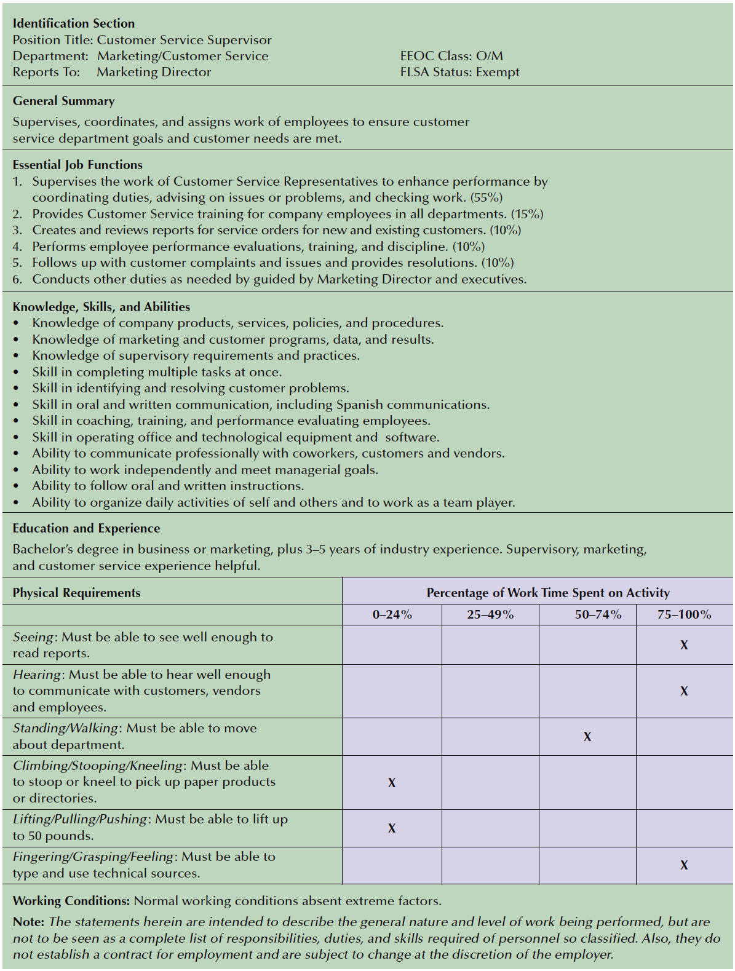
FIGURE 4–11
Sample Job Description

