Slide 1
CHAPTER 3
Human Resource Management in Organizations

Slide 2

Civil Rights Act of 1964, Title VII
Illegal for an employer to:
fail or refuse to hire or discharge any individual, or otherwise discriminate against any individual with respect to his compensation, terms, conditions, or privileges of employment because of such individual’s race, color, religion, sex, or national origin, or
limit, segregate, or classify his employees or applicants for employment in any way that would deprive or tend to deprive any individual of employment
Coverage of the Act:
All private employers of 15 or more persons who are employed 20 or more weeks a year
All educational institutions, public and private
State and local governments
Public and private employment agencies
Labor unions with 15 or more members
Joint labor/management committees for apprenticeships and training

Slide 3
Other Equal Employment Laws
Executive Orders 11246, 11375, and 11478
  Require that employers holding federal government contracts not discriminate on the basis of race, color, religion, national origin, or sex.
The Civil Rights Act of 1991
  Requires employers to show that an employment practice is job related for the position and is consistent with business necessity.
  Allows people who have been targets of intentional discrimination based on sex, religion, or disability to receive both compensatory and punitive damages.

Slide 4
Major EEO Laws - State
California’s Fair Employment and Housing Act
  Established the Department of Fair Employment and Housing
  Coverage
    All private employers with 5 or more employees
    Any person acting as the agent of the employer, directly or indirectly
    State and local governments
    Employment agencies

Slide 5
Discrimination
Discrimination - one person (or group) is treated differently from another person (or group).
Unlawful discrimination – when the reason for the difference in treatment is related to membership of a protected category.
It is illegal to for supervisors and managers to discriminate against employees in any term or condition of employment.

Slide 6
Protected Classes
Federal
  Individuals within a group identified for protection under equal employment laws and regulation.
    • Race • Age (40 and over) • Genetic Information
    • Disability • Color • Religion
    • National origin • Sex (including pregnancy)
California
  Individuals within a group identified for protection under California’s Fair Employment and Housing Act.
    • Race • Medical Condition, Genetic Information
    • Religion • Marital Status
    • Color • Pregnancy (including perceived)
    • Veteran’s Status • Sex (including gender identity)
    • National Origin • Sexual orientation
    • Ancestry • Age (40 and over)
    • Physical or Mental Disability (including HIV and AIDS)

Slide 7


ADA and Job Requirements
Reasonable Accommodation
Essential Job Functions
Undue Hardship
Fundamental job duties of the employment position that an individual with a disability holds or desires.
Significant difficulty or expense imposed on an employer in making an accommodation for individuals with disabilities.

Slide 8
Disability Protections
Disabled Person – Federal Americans with Disabilities Act of 1990 (ADA) – including Amendments Act of 2008 (ADAAA) effective 1/1/09
  Someone who has a physical or mental impairment that substantially limits major life activities, who has a record of such impairment, or who is regarded as having such an impairment.
  Final interpretive guidance on Amendment Act of 2008 issued by EEOC in March 2011.
Disabled Person – California Fair Employment and Housing Act (FEHA)
  Someone who has a physical or mental impairment that limits life activities, who has a record of such impairment, or who is regarded as having such an impairment. (Broader in scope.)

Slide 9
Disability Protections
California Fair Employment and Housing Act (FEHA) – Higher standards than ADA/ADAAA
  Duty for employer to reasonably accommodate a disability.
  Duty to engage in a good faith interactive process with an employee regarding any reasonable accommodations that might be available to permit the employee to perform the essential functions of a position.
  Duty to engage in a good faith interactive process even with an employee who is not disabled but the whom the employer regards as disabled.

Slide 10
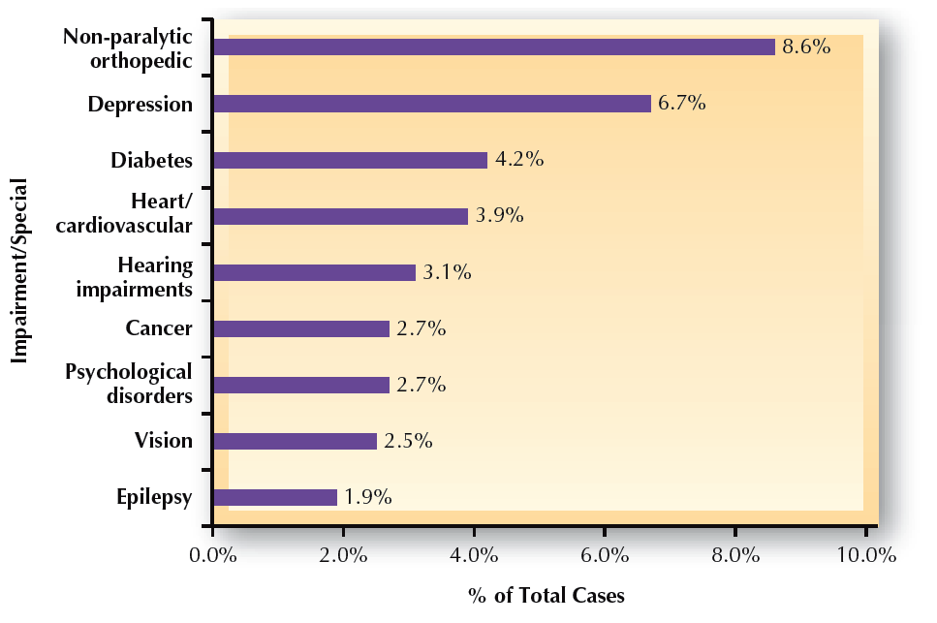
FIGURE 3–8
Most Frequent ADA Disabilities Cited
Source: Based on data from U.S. Equal Employment Opportunity Commission, 2009; see www.eeoc.gov for details.

Slide 11
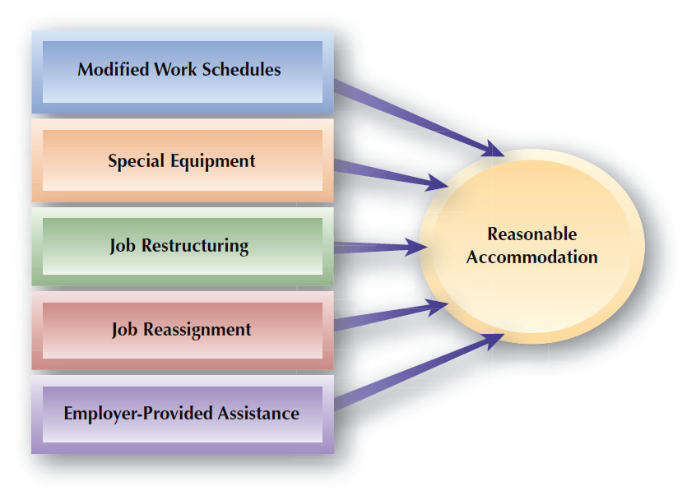
FIGURE 3–9
Common Means of Reasonable Accommodation

Slide 12

Management Focus on ADAAA Adaptation
Define essential functions in advance
Handle requests for accommodation properly
Adapting
to ADAAA
Interact with the employee with good faith and documentation
Know and follow the reasonable accommodation rules

Slide 13
Federal Age and Employment Discrimination Acts
Age Discrimination in Employment (ADEA)
  Prohibits employment discrimination against all individuals age 40 or older working for employers having 20 or more workers.
  Does not apply if age is a job-related qualification (BFOQ).
Older Workers Benefit Protection Act (OWBPA)
  An amendment to the ADEA aimed at protecting employees when they sign liability waivers for age discrimination in exchange for severance packages.

Slide 14
FIGURE 3–1
Illegal Employment Discrimination
Protected Category Members
Disparate Treatment
Disparate Impact
Members of a group are unfairly treated differently from others in employment decisions
A policy that results in substantially different employment outcomes
for a particular group

Slide 15
Nature of EEO (cont’d)
Disparate Treatment
  Occurs in employment-related situations when either:
    Different standards are used to judge different individuals, or the same standard is used, but it is not related to the individuals’ jobs.
  The outcome of the employer’s actions, not the intent, is considered by the regulatory agencies or courts when deciding whether or not illegal discrimination has occurred.

Slide 16
Nature of EEO (cont’d)
Disparate Impact
  Occurs when substantial underrepresentation of protected-class members results from employment decisions that work to their disadvantage.
  Griggs vs. Duke Power (1971) decision:
    Lack of discriminatory intent is no employer defense if discrimination occurs.
    The employer has the burden of proof in proving that an employment requirement is a job-related “business necessity.”

Slide 17
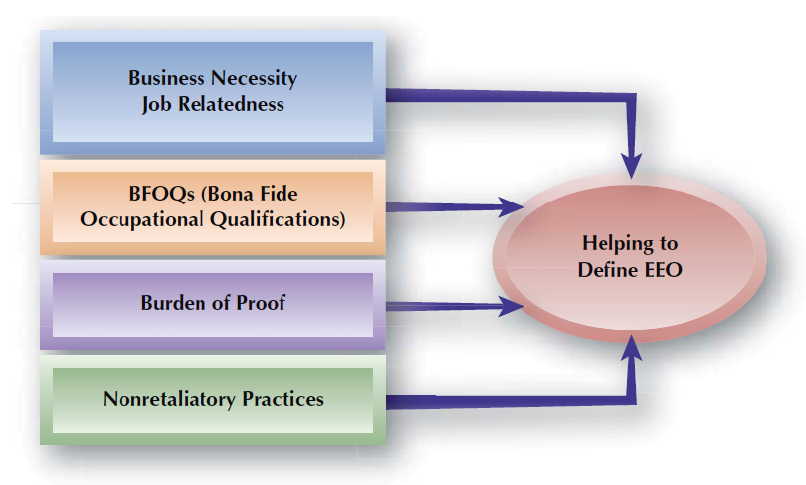
FIGURE 3–2
Equal Employment Opportunity (EEO) Concepts

Slide 18
Burden of Proof
A plaintiff alleging employment discrimination must:
  Be a member of a protected group.
  Show that disparate impact or disparate treatment existed.
Once a court rules that a prima facie case has been made, the burden of proof shifts to the employer.

Slide 19

Nonretaliation
Retaliation
  Punitive actions taken by employers against individuals who exercise their legal rights.
Avoiding Charges of Retaliation
Conduct investigations and document
Take appropriate actions
Train supervisors

Slide 20
Progressing Toward EEO
Equal Employment
  Employment that is not affected by illegal discrimination.
Blind to differences
  Differences among people should be ignored
  and everyone should be treated equally.
Affirmative Action
  Employers are urged to hire groups of people based on their race, age, gender, or national origin to make up for historical discrimination.

Slide 21
Managing Affirmative Action Requirements
Affirmative Action
Affirmative Action Plan (AAP)
AAP Metrics
A document reporting on the composition of an employer’s workforce, required for federal contractors.
Availability analysis
Utilization analysis
Goals and timetables

Slide 22
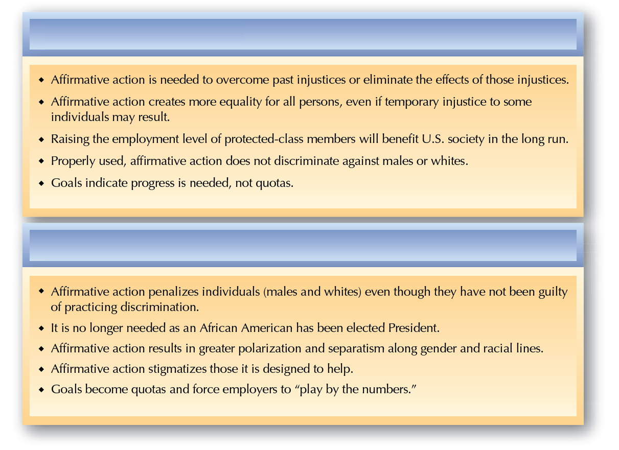
FIGURE 3–3
The Debate about Affirmative Action
Arguments: Why Affirmation Action is Needed
Arguments: Why Affirmation Action is Not Needed

Slide 23
Federal Sex/Gender Discrimination Laws
The Pregnancy Discrimination Act (PDA)
  Requires that any employer with 15 or more employees treat maternity leave the same as other personal or medical leaves.
Family and Medical Leave Act (FMLA)
  Requires that individuals be given up to 12 weeks of family leave without pay and also requires that those taking family be leave be allowed to return to jobs. Domestic partners are not included.

Slide 24
Sex/Gender Discrimination Laws - California
Pregnancy Disability Leave (PDL) –
  Requires that any employer with 5 or more employees be given up to 4 months (693 hours if normally works 40 hours weekly) of leave without pay due to pregnancy or related disability.
  January 2012 – employer must maintain coverage under group health plans for up to 4 months, at the level and under the conditions that would have been provided if employee was not on leave.
  Runs concurrent with FMLA if employee is eligible

Slide 25
Sex/Gender Discrimination Laws - California
California Family Rights Act (CFRA)
  Requires that individuals be given up to 12 weeks of family leave without pay and also requires that those taking family leave be leave be allowed to return to jobs. This leave may be for the birth, adoption, or foster care placement of your child or for your own serious health condition or that of your child, parent, domestic partner, or spouse.
  Employers may not interfere with PDL or CFRA rights - SB 299 and SB 592 (2012).

Slide 26
Sex/Gender Discrimination
The Equal Pay Act - Federal
  Requires employers to pay similar wage rates for similar work without regard to gender.
  Allowable differences in pay:
    Differences in seniority
    Differences in performance
    Differences in quality and/or quantity
    of production
    Factors other than sex, such as skill, effort, and working conditions

Slide 27
Sex/Gender Discrimination (cont’d)
Pay Equity (Comparable Worth)
  The concept that pay for jobs requiring comparable levels of knowledge, skill, and ability should be paid similarity, even if actual duties differ significantly.
  Arises from the continuing gap between the earnings of women and men.
  Courts have consistently ruled against the concept.

Slide 28
Sex/Gender Discrimination (cont’d)
Breast-feeding (California)
  Reasonable accommodation required to express breast milk in a private location
  Additional paid breaks if needed
  Provides recourse for discrimination
Breast-feeding (Federal)
  Reasonable accommodation required
  No recourse provided for discrimination
  Patient Protection and Affordable Care Act of 2010 amended FLSA to provide for this

Slide 29
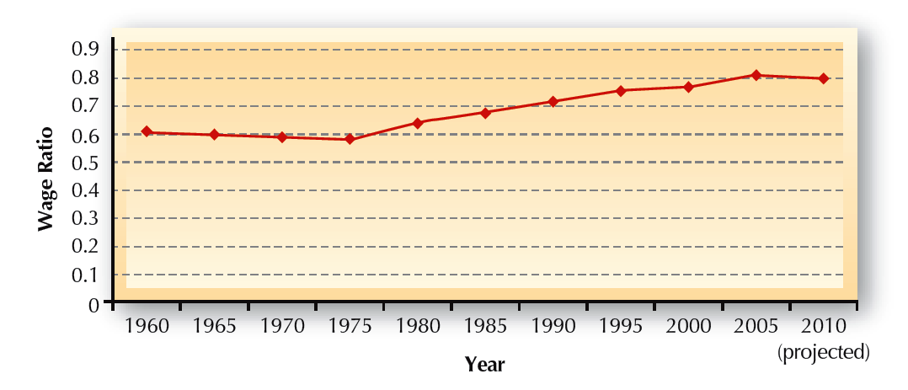
FIGURE 3–4
Female Annual Earnings as Percentage of Male Earnings
Source: U.S. Department of Labor, Bureau of Labor Statistics, 2009, www.bls.gov.

Slide 30
Managing Sex/Gender Issues
Guidelines for avoiding illegal pay inequities:
  Include all benefits and other items that are part of remuneration to calculate total compensation for the most accurate overall picture.
  Make sure people know how the pay practices work.
  Base pay on the value of jobs and performance.
  Benchmark against local and national markets so that pay structures are competitive.
  Conduct frequent audits to ensure there are no gender-based inequities and that pay is fair internally.

Slide 31

The Glass Ceiling
Establish mentoring programs
Provide career area rotation opportunities
Breaking
the Glass
Include women and minorities in top management
Establish retention and progression goals for females
Provide alternative working arrangements

Slide 32
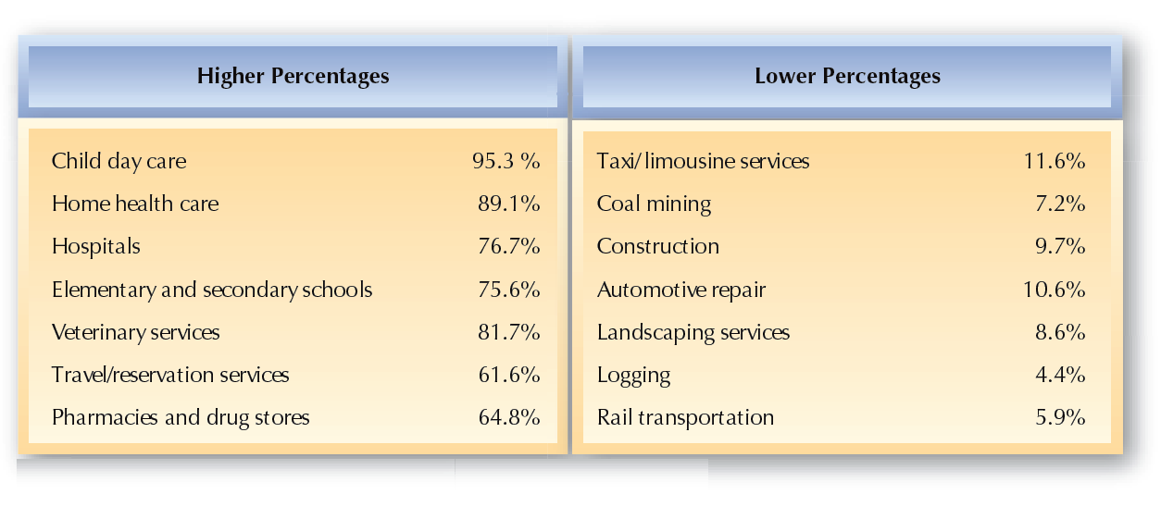
FIGURE 3–5
Women as Percentage of Total Employees by Selected Industries
Source: U.S. Department of Labor, Bureau of Labor Statistics, 2009, www.bls.gov.

Slide 33
Managing Sex/Gender Issues (cont’d)
Sexual Harassment
  Actions that are sexually directed, are unwanted, and subject the worker to adverse employment conditions or create a hostile work environment.
  Can occur between a boss and a subordinate, among co-workers, and when non-employees have business contacts with employees.

Slide 34
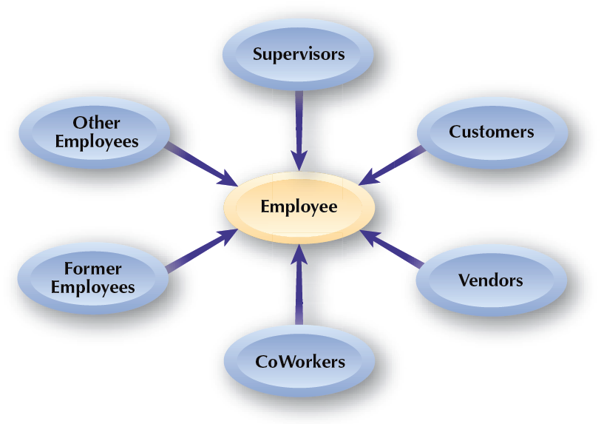
FIGURE 3–6
Potential Sexual Harassers

Slide 35

Types of Sexual Harassment
Quid Pro Quo
Hostile Environment
Harassment in which employment outcomes are linked to the harassed individual granting sexual favors to the harasser
Intimidating or offensive working conditions that unreasonably affect an individual’s work performance or psychological well-being

Slide 36
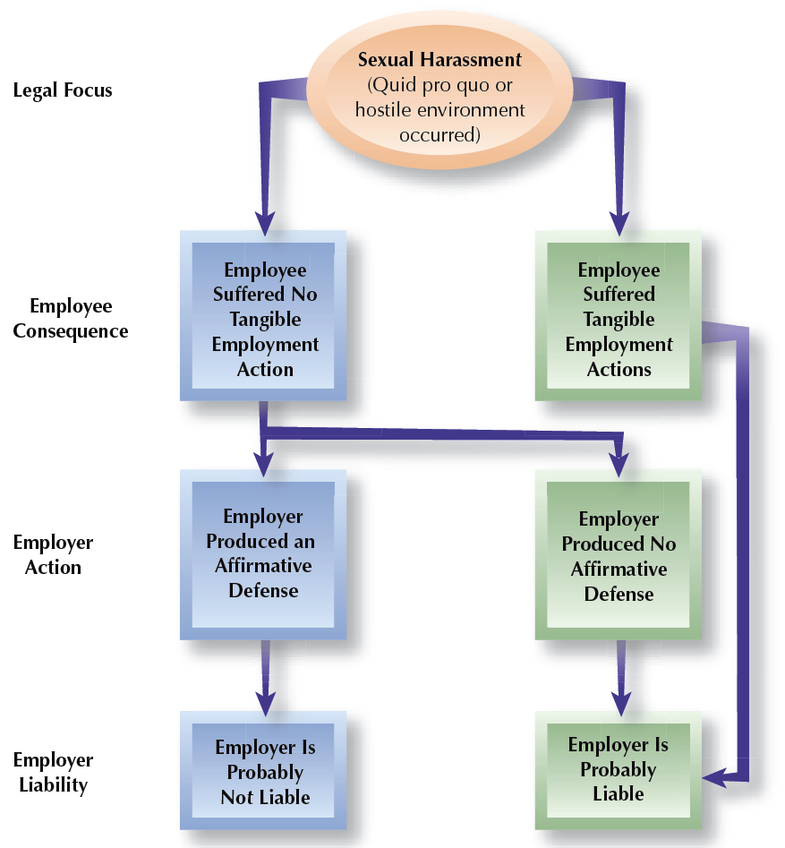
FIGURE 3–7
Sexual Harassment Liability Determination

Slide 37
Sexual Harassment – California
Strict Liability for Employer
  California's DFEH and California case law provide for strict liability (liability regardless of fault) for any acts of sexual harassment by a supervisor or manager:
    Regardless of whether the company knew about it;
    Regardless of whether the company took effective steps after learning about it; and
    Regardless of whether the employee failed to complain or did not use the complaint procedures properly.
  If it is co-worker/co-worker harassment or 3rd party harassment and the company had no notice, then there’s no strict liability.

Slide 38

Employer Responses to Sexual Harassment
Taking
Reasonable Care
Sexual harassment policy
Communicate policy
Train employees
Investigate and take action

Slide 39
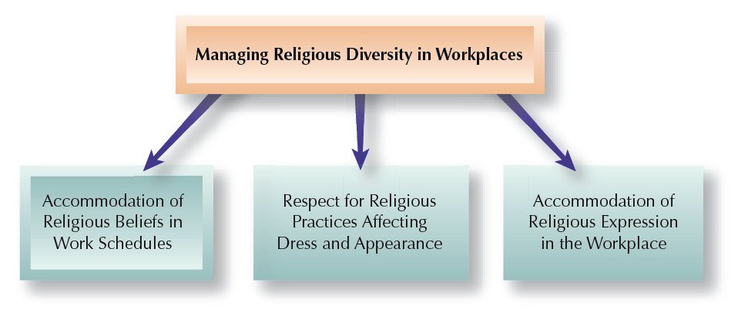
FIGURE 3–10
Managing Religion and Spirituality in Workplaces

Slide 40
Immigration and Discrimination
Immigration Reform and Control Act (IRCA)
  Prohibits employment discrimination against persons legally permitted to work in the United States.
  Requires employers to document (I-9 form) eligibility for employment.
  Provides penalties for knowingly
  employing illegal workers.

Slide 41
Discrimination Laws and the Military
Military Status and USERRA
  The Vietnam-Era Veterans Readjustment Act and the Uniformed Services Employment and Reemployment Act encourage the employment of veterans and require employers to provide leaves of absence and reemployment rights for employees called to active duty.

Slide 42

FIGURE 3–11
Uniformed Services Employment and Reemployment Rights Act (USERRA) Provisions
Common Issues
Leaves of absence
Return to employment rights
Prompt re-employment on return
Protection from discharge/retaliation
Health insurance continuation
Continued seniority rights

Slide 43
Individual Rights and Discrimination
Sexual Orientation
  At present, federal protection against workplace discrimination has not been granted. It is covered under state law in California.
  Court cases and the EEOC have ruled that sex discrimination under Title VII applies to a person’s gender at birth. Under California law is also applies to gender identify (transgender).
Appearance and Weight Discrimination
  Uniform application of dress codes is permitted.
  Height and weight-related job requirements must be job-related.

Slide 44
Diversity Training
Issues in Diversity Training
  Mixed results for diversity training
  Backlash against diversity training efforts
Diversity Training Components
Legal
awareness
Cultural
awareness
Sensitivity training

