Slide 1
CHAPTER 2
Strategic HR Management and Planning

Slide 2

Strategy and Strategic Planning
Strategy
Strategic Planning
The proposition an organization follows for how to compete successfully and thereby survive and grow.
The process of defining organizational strategy and allocating resources toward its achievement.

Slide 3
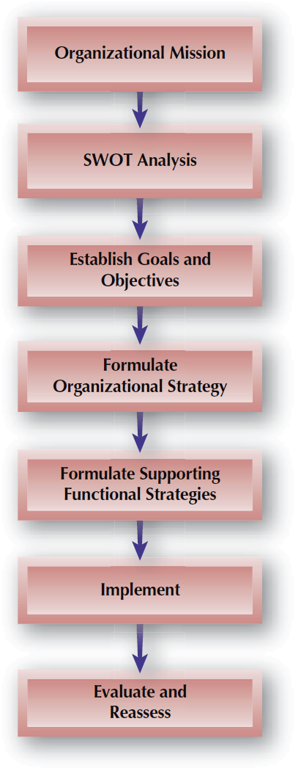
FIGURE 2–1
Strategic Planning Process

Slide 4
Strategy Formulation
Organizational Mission
Strategic HR Management
The guiding force and core reason for the existence of the organization and what makes it unique.
The use of employees to gain or keep a competitive advantage, resulting in greater organizational effectiveness.

Slide 5
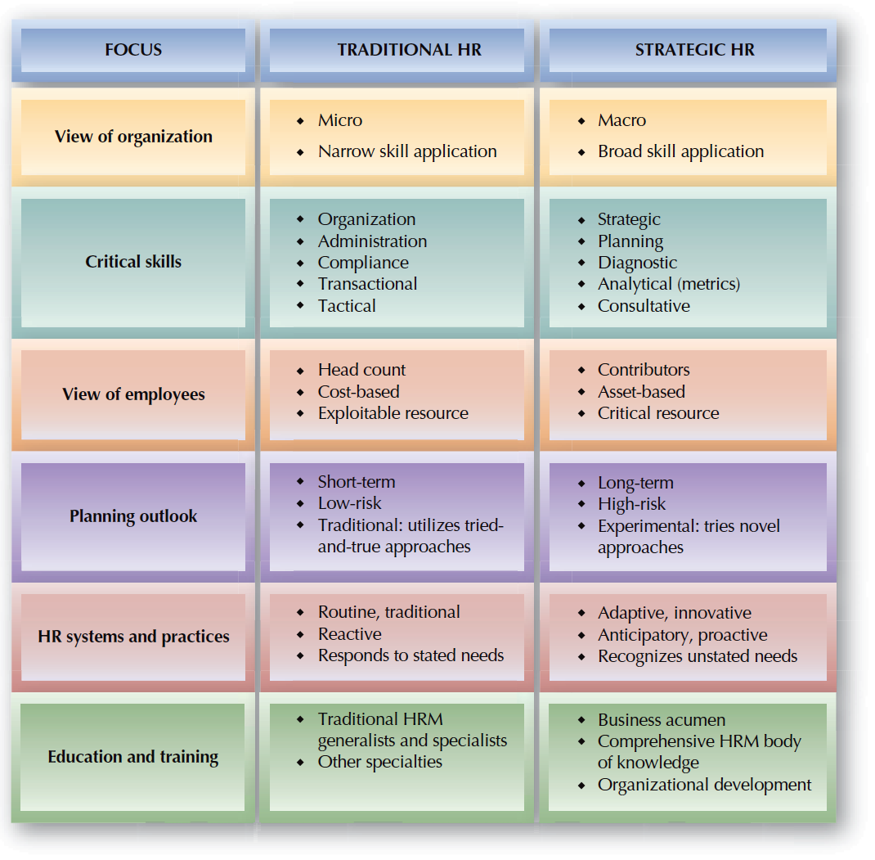
FIGURE 2–2
Traditional HR versus
Strategic HR

Slide 6

Strategic Competencies for HR Professionals
Credible Activist
Culture and Change Steward
Challenges assumptions and offers a point of view
Shapes the organizational culture, makes changes happen
Talent Manager/Org Designer
Strategy Architect
Acquires and deploys talent, embeds capabilities into the organizational structure
Recognizes trends, forecasts obstacles to business success, and builds overall strategy
Operational Executor
Business Ally
Efficiently and effectively
carries out tactical HR
activities
Understands the business value chain, and establishes internal partnerships with line managers

Slide 7

Operationalizing HR Management Strategies
Thinking
Strategically
Understand
the business
Focus on key business goals
Know what
to measure
Prepare for the future

Slide 8
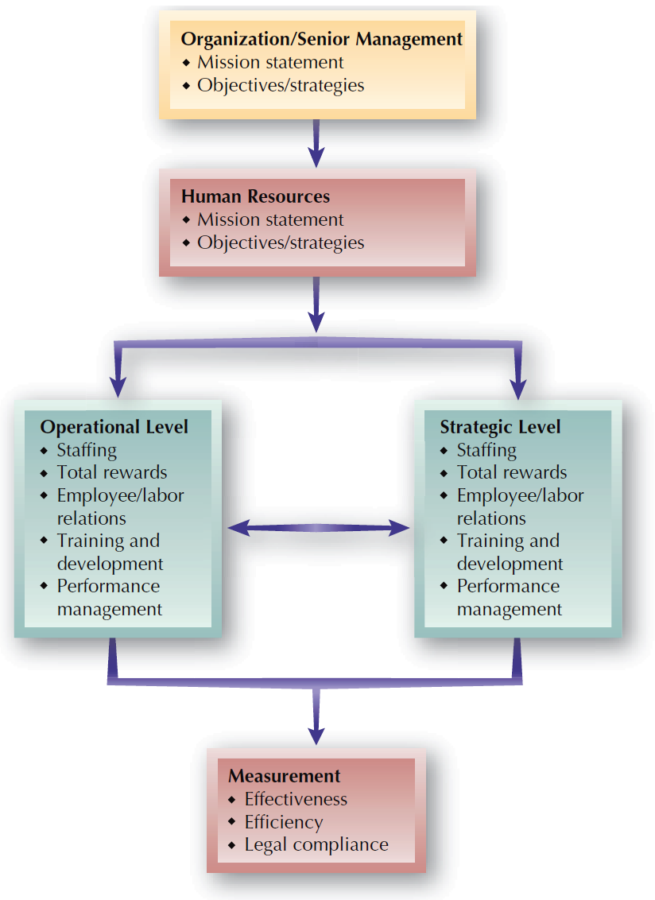
FIGURE 2–3
Strategic Human Resource Management

Slide 9
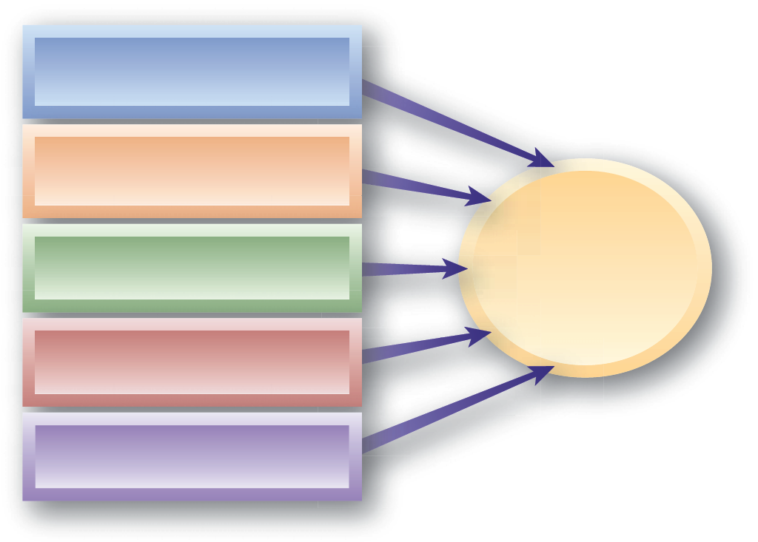
High-Performance Work Practices
Incentive Compensation
Training and Development
High Performance Organization
Employee participation
Selectivity in Hiring
Flexible Work Arrangements

Slide 10
HR Effectiveness and Financial Performance
Effectiveness
  The extent to which goals have been met.
Efficiency
  The degree to which operations are done
  in an economical manner.

Slide 11
SWOT Analysis
Strategic planning tool used to evaluate strengths, weaknesses, opportunities and threats.
A SWOT analysis informs the goal-setting process and provides a context for future strategic planning discussions.
  Strengths and weaknesses are internal to an organization
  Opportunities and threats originate from outside the organization

Slide 12
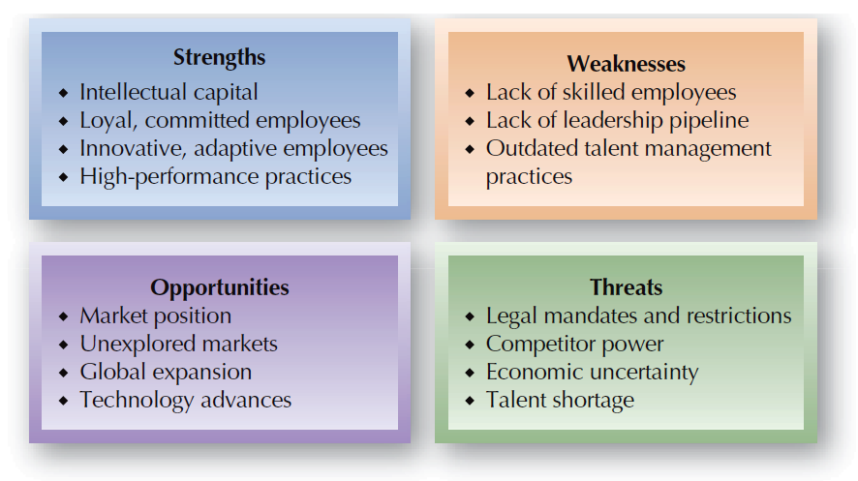
FIGURE 2–4
HR Factors in the SWOT Analysis

Slide 13
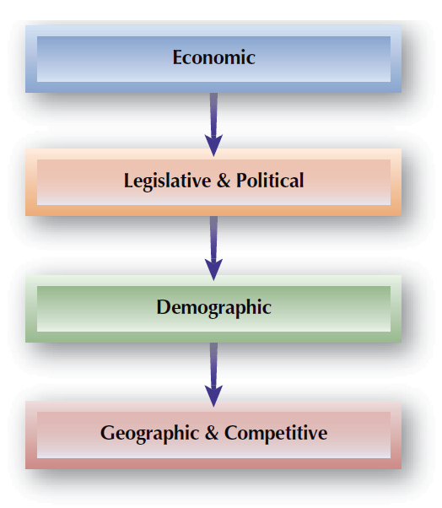
FIGURE 2–5
Areas of External Environmental Scan

Slide 14
A Sample SWOT Analysis Matrix
Positive
Negative
Strengths High-quality employees. Strong, committed HR staff. Good reputation in the organization. Location (close to our stakeholders). Good rapport with other departments. Work well as a team. Good technical competence and tools. | Weaknesses Vagueness of role in our acquisition strategy. Lack of data or measurements. Poor communication. HR partner bandwidth. The volume of HR initiative on the table. Compensation design and benefit program.
Opportunities Stability in leadership. Expansion of services. Referral centers. Integrate talent management systems. Secure new talent via our merger. Further develop our self-service model. | Threats Budgetary constraints. Stagnation/complacency. Turnover/leadership changes. Rising health care costs. Internal conflicts & overworked employees. Marketplace uncertainty.
Internal
External

Slide 15

Global Competitiveness and Strategic HR
Global Framework
Global Legal and Regulatory Factors
Offshoring Operations
Global
Staffing

Slide 16
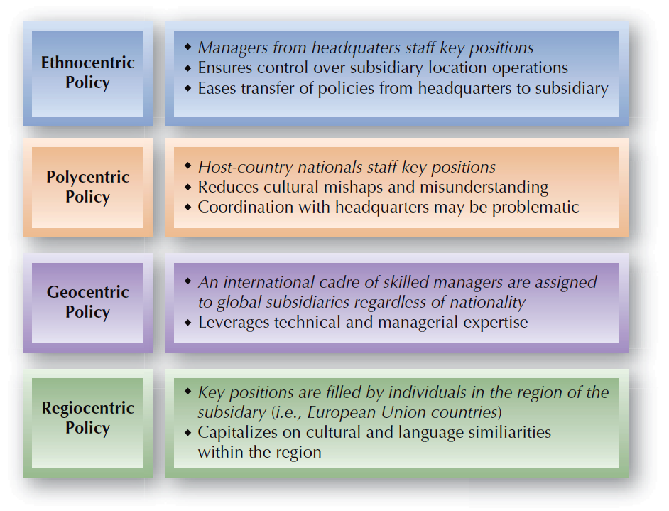
FIGURE 2–6
Strategic Approaches to International Staffing

Slide 17
HR Planning in Mergers and Acquisitions
Cultural Compatibility
  The extent to which such factors as decision-making styles, levels of teamwork, information-sharing philosophies, and the formality of the two organizations are similar.
HR’s Role in Mergers and Acquisitions
  Communicating decisions
  Revising the organization structure
  Merging HR activities

Slide 18
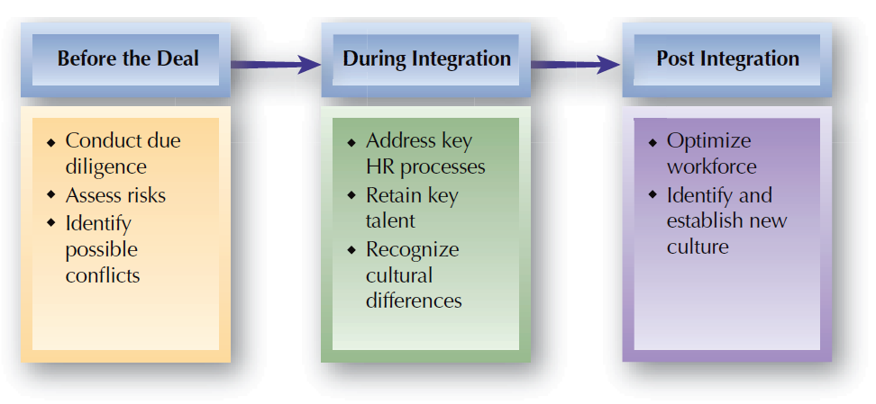
FIGURE 2–7
HR Activities during Mergers and Acquisitions

Slide 19
Key Factors in Cultural Fit
Degree of internal integration
Autonomy
Cultural Fit
in Mergers and Acquisitions
Adaptability
Employee trust
Diversity

Slide 20
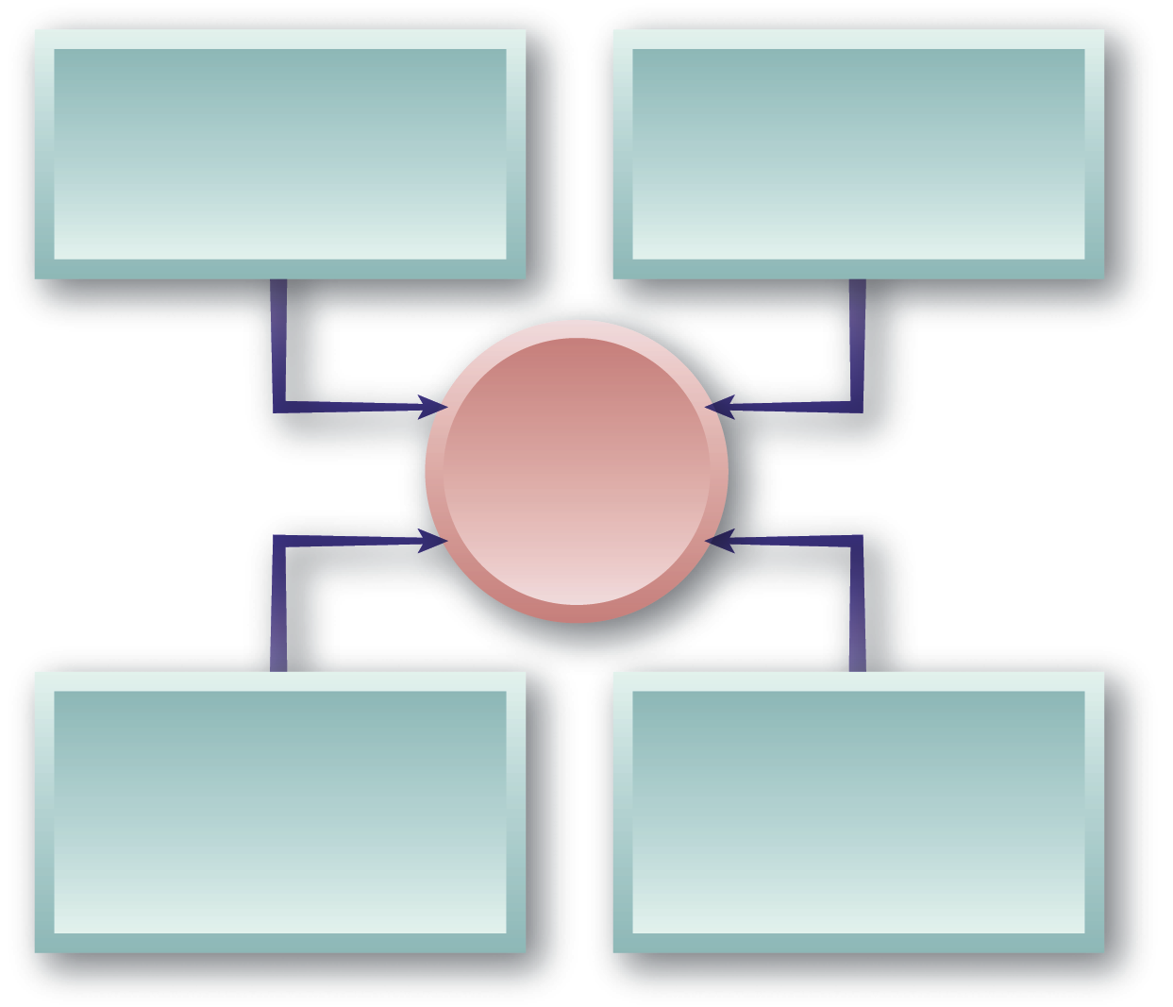
Changing the Organizational Culture
Define the desired behaviors
Deploy role
models
Culture
Provide meaningful incentives
Provide clear and consistent messages

Slide 21
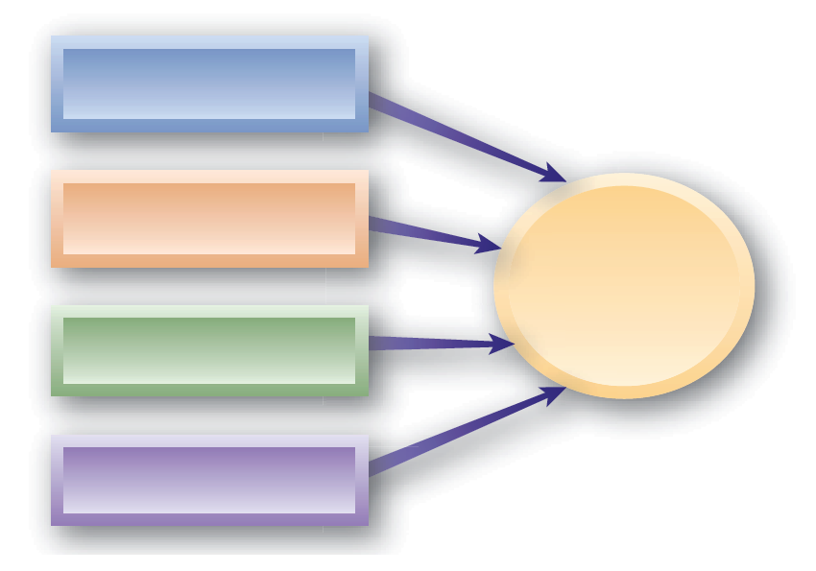
Managing a Talent Surplus
Reduction in Work Hours or Compensation
Attrition and Hiring Freezes
Workforce Reductions
Voluntary Separation Programs
Workforce Downsizing

Slide 22
Legal Considerations for Workforce Reductions
Workforce Adjustments
Severance benefits
COBRA
coverage
OWBPA
Warn
Act

Slide 23


Managing a Talent Shortage
Use
overtime
Outsource
work
Implement alternative work arrangements
Tactics to
Reduce
a Talent
Shortage
Bring back
recent retirees
Use contingent workers
Reduce
turnover

Slide 24
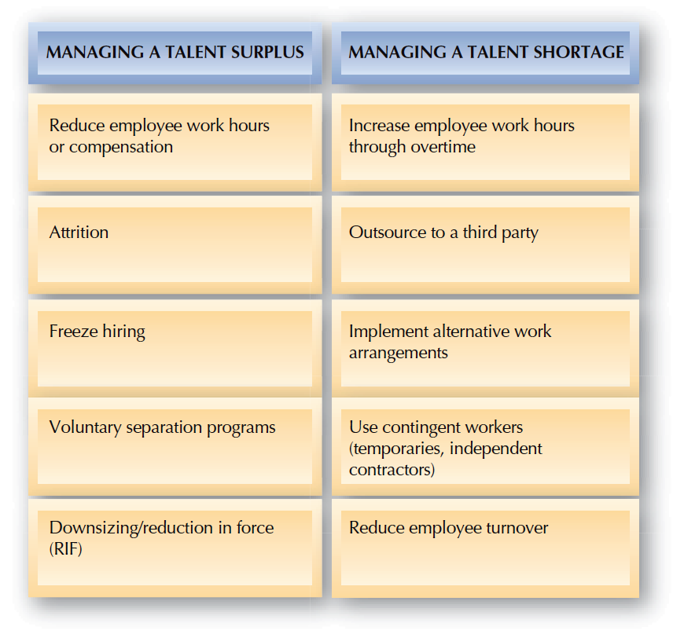
FIGURE 2–8
Managing Talent Supply Imbalances

Slide 25
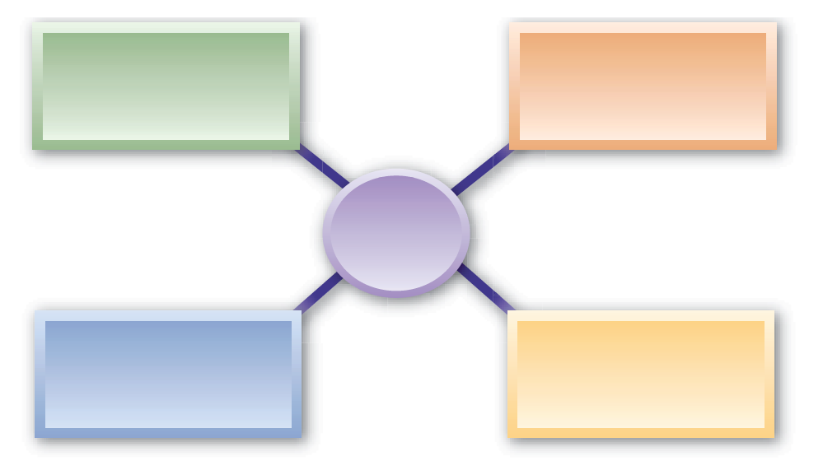
Technology Challenges
Effects on Work and Organizations
Effects on Work Processes
Technology
Effects on Communication
Effects on
HR Activities

Slide 26
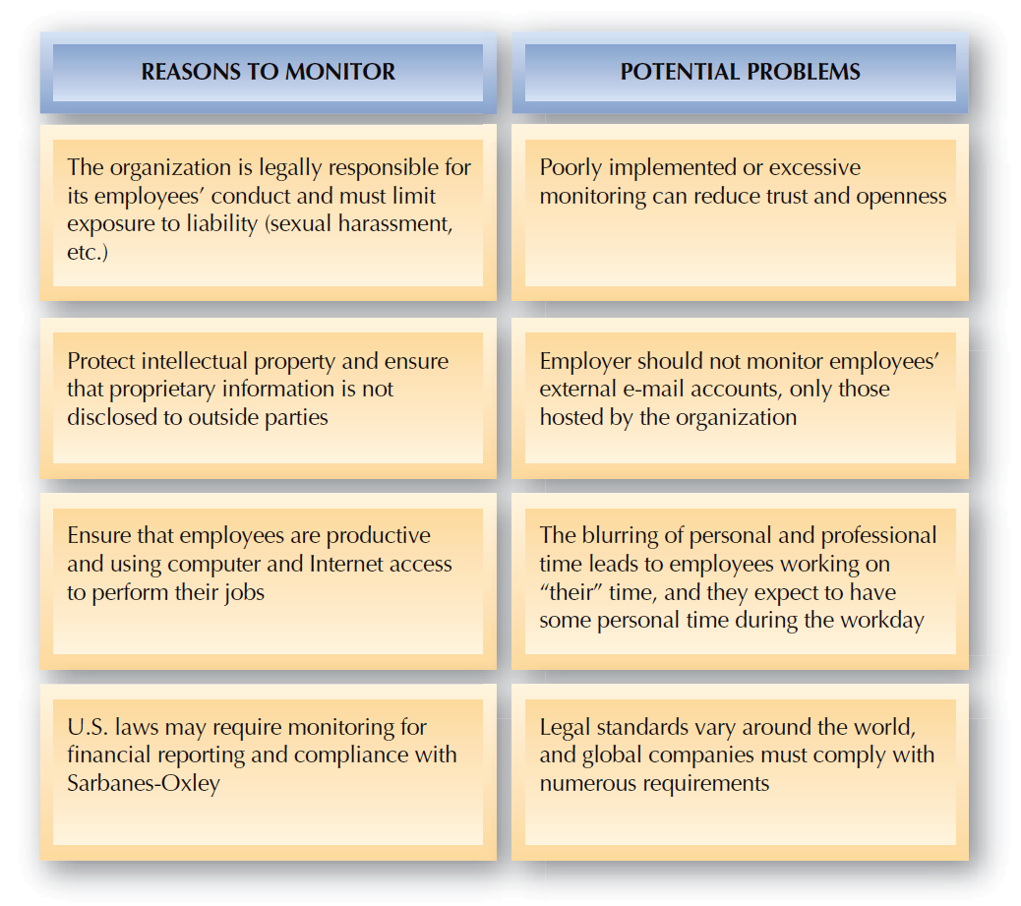
FIGURE 2–9
Factors Involved in Proper Monitoring of Employee E-Mail

Slide 27
Measuring Effectiveness of HR Initiatives
HR Metrics
  Specific measures tied to HR performance indicators.
    Development and use of metrics that can better demonstrate HR’s value and track its performance.
  Characteristics of good HR metrics:
    Are accurate.
    Are linked to strategic and operational objectives.
    Have clearly understood calculations.
    Meet information needs.
    Can be compared internally and internally.
    Can be used to drive HR management efforts.

Slide 28
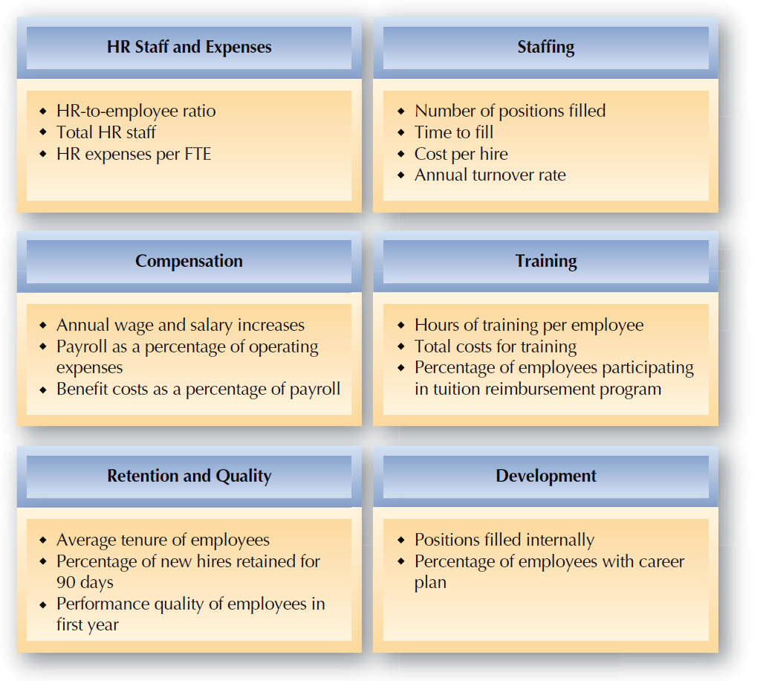
FIGURE 2–10
Key HR Metrics

Slide 29
HR and Benchmarking
Benchmarking
  Comparing specific measures of performance to an industry standard or best practices in other “best-in-class” organizations.
Common Benchmarks
  Total compensation as a percentage of net income before taxes
  Percent of management positions filled internally
  Dollar sales per employee
  Benefits as a percentage of payroll cost

Slide 30
HR and the Balanced Scorecard
The Balanced Scorecard
  Measurement tool to evaluate organizational strategy; looks at financial, customer, operations, and learning and growth measures; performance measures to align performance efforts with organizational strategy.
  Avoids a limited focus on financial measures by focusing on long-term drivers of performance and organizational sustainability.
  Requires spending considerable time and effort to identify the appropriate HR measures and how they tie to strategic organizational success.
  Address three elements—accountability, validity, and actionable results.

Slide 31
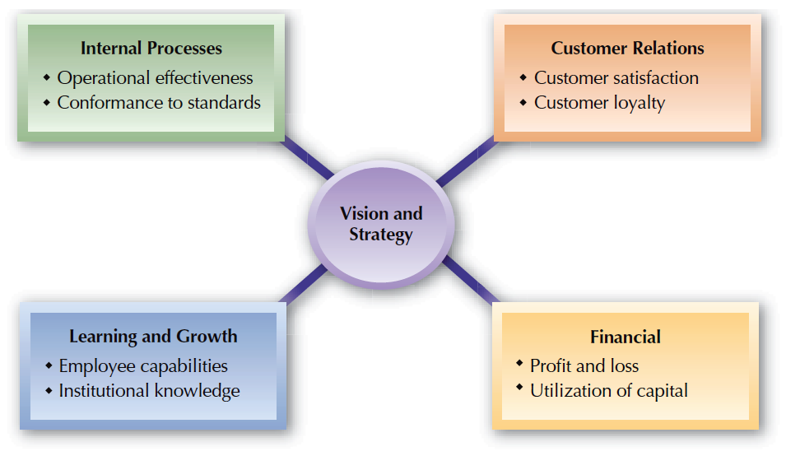
FIGURE 2–11
Balanced Scorecard Framework

Slide 32
Human Capital Effectiveness Measures
Return on Investment (ROI)
  Shows the value of investments in HR activities.
A = Operating costs for a new or enhance system for the time period
B = One-time cost of acquisition and implementation
C = Value of gains from productivity improvements for the time period

Slide 33


Other Effectiveness Measures
Human capital value added (HCVA)
Human capital return on investment (HCROI)
Human economic value added (HEVA)

Slide 34
Assessing HR Effectiveness
HR Audit
  A formal research effort that evaluates the current state of HR management in an organization
  Audit areas:
    Staffing
    Compensation
    Health and safety
    Legal compliance
    Administrative processes and recordkeeping
    Employee retention
    Benefits

