Slide 1
CHAPTER 1
Human Resource Management in Organizations

Slide 2
Nature of Human Resource Management
Human Resource (HR) Management
  Designing management systems to ensure that human talent is used effectively and efficiently to accomplish organizational goals.

Slide 3
What is HR?*
I. A Profession: an occupation that:
  Requires extensive training
  Requires study and mastery of specialized knowledge
  Has a professional association
  Has a Code of Ethics
  Has a process of certification
  *From “HR Competencies: Mastery at the Intersection of People and Business”, Ulrich,
  Brockbank, et al

Slide 4
What is HR?
II. An HR Department
  A department or a function
  Can be simple or complex depending on size of organization
  Can be a Business within the Business
    Strategies, goals
    DELIVERS VALUE TO THE ORGANIZATION

Slide 5
HR Myths
People go into HR because they like people.
Anyone can do HR.
HR deals with the soft side of business and is therefore not accountable.
HR focuses on costs, which must be controlled.
HR’s job is to be the policy police and the health-and-happiness patrol.
HR is full of fads.
HR is staffed by nice people.
HR is HR’s job.

Slide 6

HR Management Roles
HR Management Roles
Operational and Employee Advocate
Administrative
Strategic

Slide 7
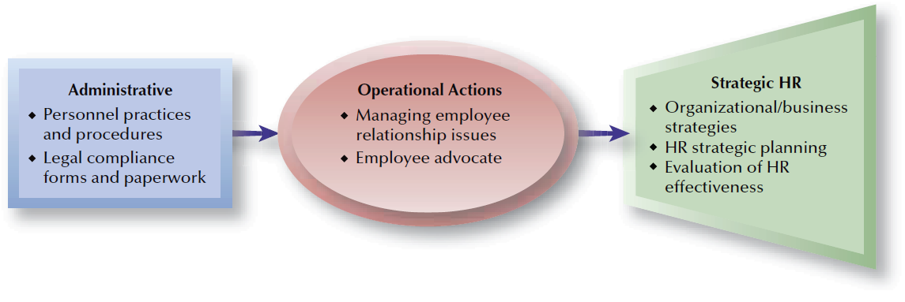
FIGURE 1–9
Roles of HR Management

Slide 8

HR Management Competencies
Strategic Contribution
Business Knowledge
HR
Competencies
HR Delivery
HR Technology
Personal Credibility

Slide 9
SHRM – HR Management Competencies
Human Resource Technical Expertise and Practice
Relationship Management
Consultation
Organizational Leadership and Navigation
Communication
Global and Cultural Effectiveness
Ethical Practice
Critical Evaluation
Business Acumen

Slide 10

HR Management as a Career Field
HR Generalist
HR Specialist
A person who has responsibility for performing a variety
of HR activities.
A person who has in-depth knowledge and expertise in a limited area of HR.

Slide 11
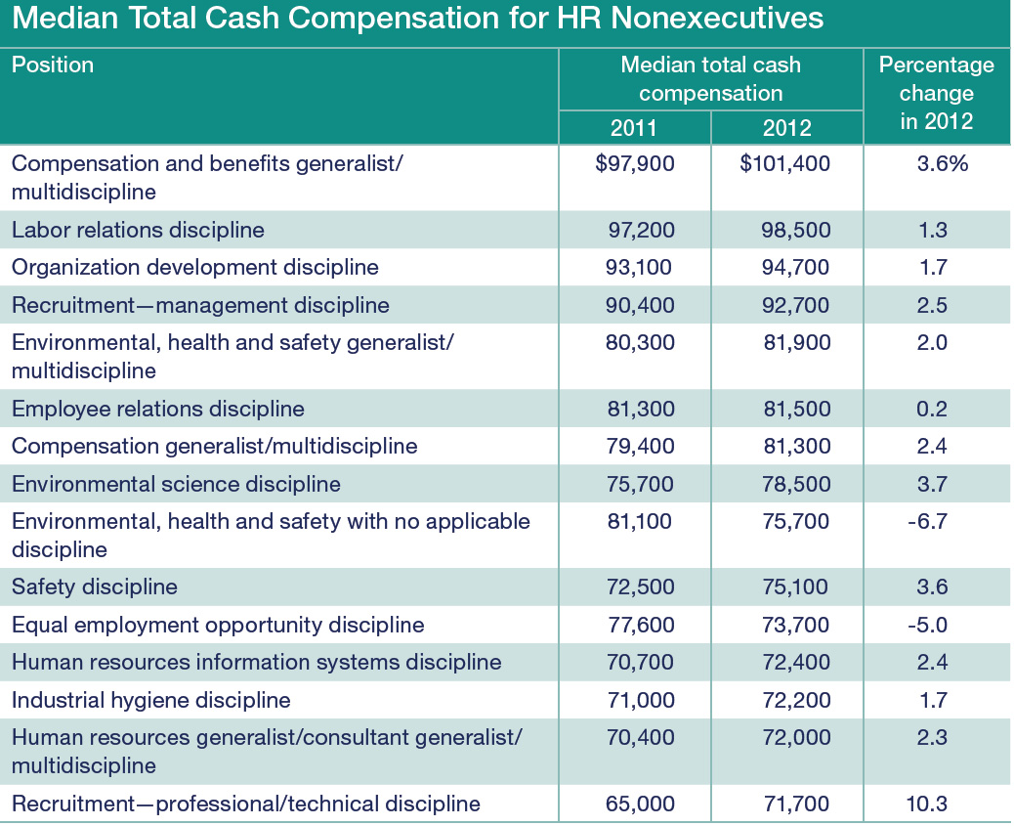

Slide 12
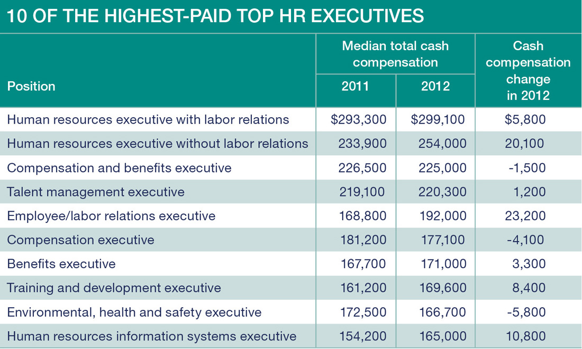

Slide 13
HRCI Certification - Eligibility Requirements
PHR Eligibility
• 4 years of demonstrated exempt-level HR experience with less than a Bachelor’s degree
• 2 years of demonstrated exempt-level HR experience with a Bachelor’s degree
• 1 year of demonstrated exempt-level HR experience with a Master’s degree or higher
SPHR Eligibility
• 7 years of demonstrated exempt-level HR experience with less than a Bachelor’s degree
• 5 years of demonstrated exempt-level HR experience with a Bachelor’s degree
• 4 years of demonstrated exempt-level HR experience with a Master’s degree or higher
GPHR Eligibility
• 4 years of demonstrated exempt-level HR experience (with 2 of the 4 being global HR experience) with less than a Bachelor’s degree
• 3 years of demonstrated exempt-level HR experience (with 2 of the 3 being global HR experience) with a Bachelor’s degree
• 2 years of demonstrated global exempt-level HR experience with a Master’s degree or higher

Slide 14
HRCI - California-Specific Certification
Must already have SPHR or PHR
Can add CA, becomes SPHR-CA or PHR-CA
Body of knowledge:
  Compensation and Benefits – 26%
  Employee and Labor Relations – 46%
  Leaves of Absence and Workers’ Compensation – 17%
  Health, Safety, and Security – 11%

Slide 15
Other HR Certifications
Certified Compensation Professional (CCP), sponsored by the World at Work Association
Certified Employee Benefits Specialist (CEBS), sponsored by the International Foundation of Employee Benefits Plans
Certified Benefits Professional (CBP), sponsored by the WorldatWork Association
Certified Performance Technologist (CPT), co- sponsored by the American Society for Training & Development and the International Society for Performance Improvement
Certified Safety Professional (CSP), sponsored by the Board of Certified Safety Professionals
Occupational Health and Safety Technologist (OHST), given by the American Board of Industrial Hygiene and the Board of Certified Safety Professionals
Certified Professional Outsourcing, provided by New York University and the Human Resource Outsourcing Association

Slide 16

Types of Organizational Assets
Assets
Physical
Financial
Intangible
Human

Slide 17
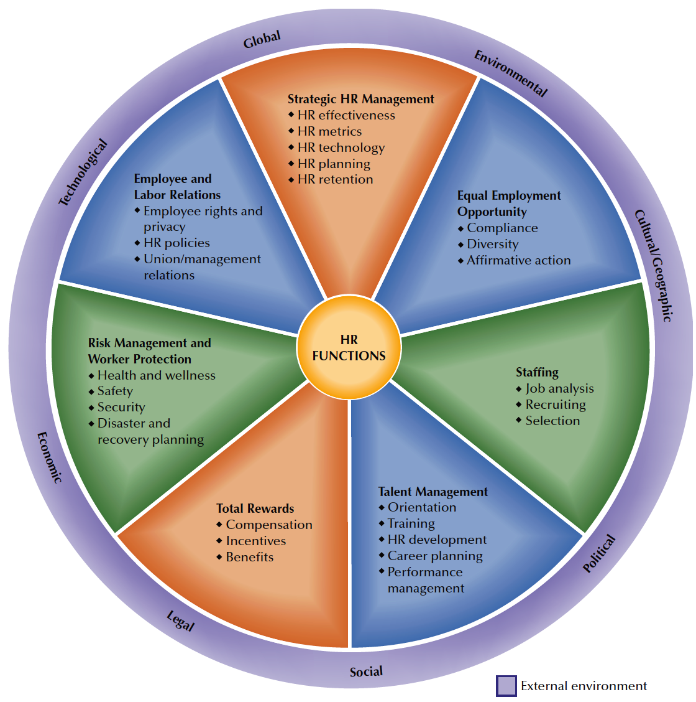
FIGURE 1–2
HR Management Functions

Slide 18
HR Management: Interlinked Functions
Strategic HR Management
Equal Employment Opportunity
Staffing
Talent Management and Development
Total Rewards: Compensation and Benefits
Risk Management and Worker Protection
Employee and Labor Relations

Slide 19

Current HR Management Challenges
Organizational Cost Pressures and Restructuring
Economics
and
Job Changes
Human
Resource
Management
Globalization of Organizations
and HR
Workforce Demographics
and Diversity

Slide 20
Economics and Job Changes
Future
Job Change Concerns
Occupational Shifts
Workforce Availability and Quality
Talent Management
Growth in Contingent Workforce

Slide 21
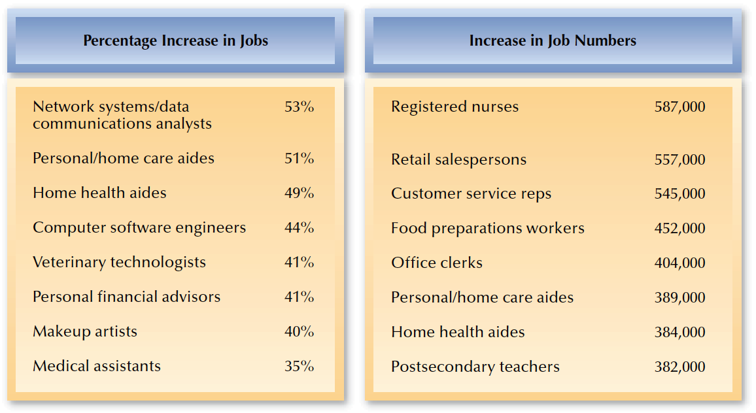
FIGURE 1–6
Fastest Growth in Job Changes to 2016
Source: U.S. Bureau of Labor Statistics, www.bls.gov.

Slide 22
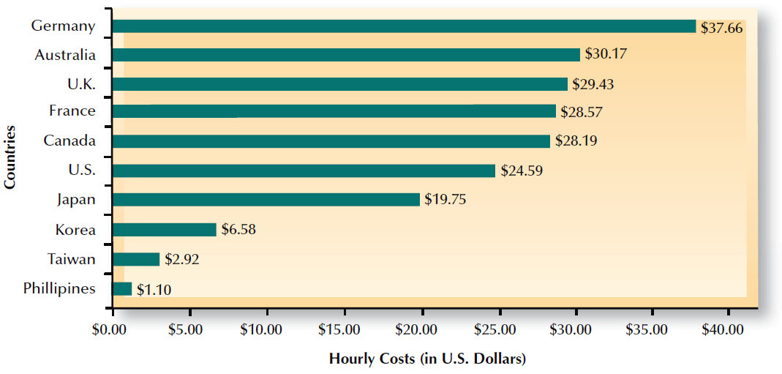
FIGURE 1–7
Hourly Compensation Costs for Manufacturing Production Workers
Source: U.S. Bureau of Labor Statistics, www.bls.gov.

Slide 23
HR Technology
Human Resource Management System (HRMS)
  An integrated system providing information used by HR management in decision making.
Purposes of HRMS Data Collection
  Administrative and operational efficiency in :
    Automation of payroll and benefit activities
    EEO/affirmative action tracking
    Web-based communication with employees
  Availability of data for HR strategic planning

Slide 24
Uses of a Web-Based HRMS
HRMS on the Internet
Bulletin Boards
Data Access
Employee Self-Service
Extended Linkage

Slide 25
Smaller Organizations and HR Management
HR Issues
Shortage of Qualified Workers
Increasing Costs of Benefits
Government Regulation
Compliance
Rising Taxes

Slide 26
HR Cooperation with Operating and Line Managers
HR Unit
  Develops legal, effective interviewing techniques
  Trains managers in conducting selection interviews
  Conducts interviews and testing
  Sends top three applicants to managers for final review
  Checks references
  Does final interviewing and hiring for certain job classifications
Managers
  Advise HR of job openings
  Decide whether to do own final interviewing
  Receive interview training from HR unit
  Do final interviewing and hiring where appropriate
  Review reference information
  Provide feedback to HR unit on hiring/rejection decisions

Slide 27
Organizational Culture and HR
Organizational Culture
  Is the shared values and beliefs in an organization.
  Is the internal “climate” of the organization that employees, managers, customers, and others experience.
  Positively affects service and quality, productivity, and financial results when aligned with HR values and organizational goals.
  Is affected by differences in cultural dimensions from country to country and even within countries.

Slide 28
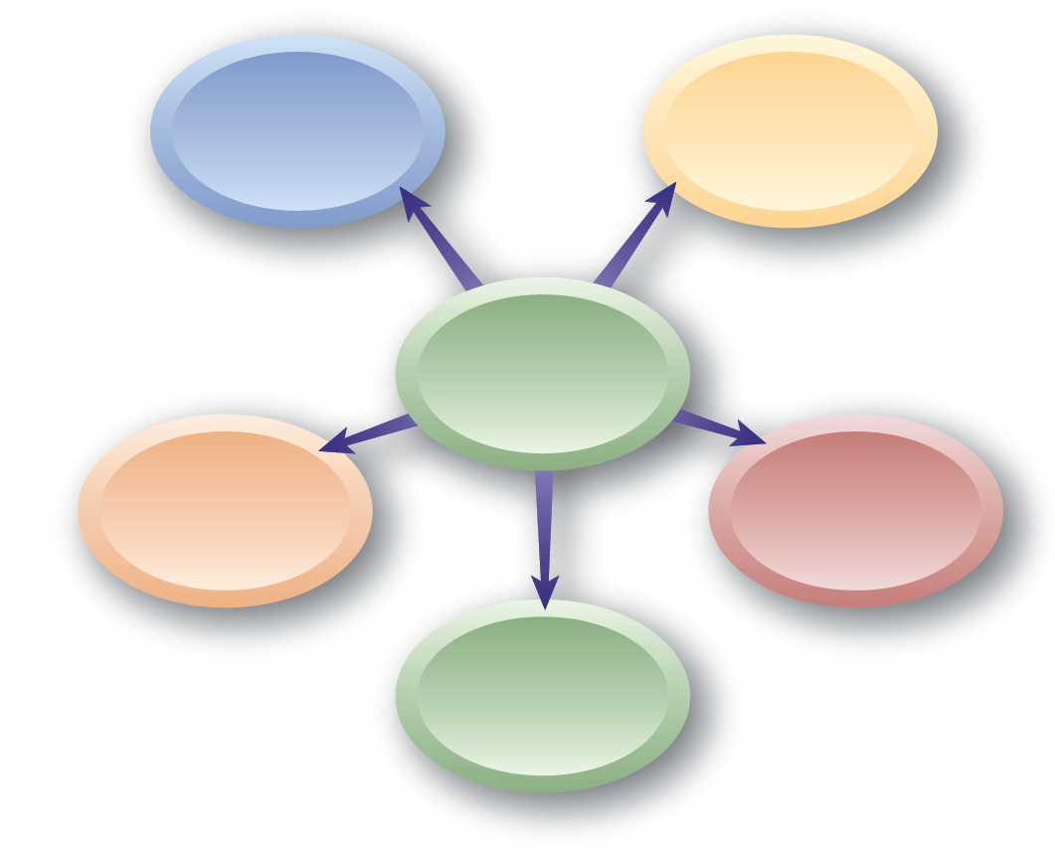
Hofstede’s Dimensions of Culture
Inequality
of Power
Individualism/
Group
Orientation
Culture
Long-term/
Short-term Orientation
Masculinity/
Femininity
Uncertainty Avoidance

Slide 29
Hofstede’s Dimensions of Culture
Inequality of Power – Extent to which less powerful members of organizations and institutions accept unequal distribution of power.
Individualism/Collectivism – Degree to which individuals are integrated into groups.
Uncertainty Avoidance – Level of tolerance for uncertainty and ambiguity; comfortable in unstructured, new, or unexpected situations.

Slide 30
Hofstede’s Dimensions of Culture
Masculine/Feminine –
  Masculine traits: ambitious, preference for speed and size, oriented toward work and achievement; gender roles are district
  Feminine traits: Nurturing, empathetic, oriented toward quality of life, striving for consensus, favoring small size and slow pace; gender roles may overlap
Long-term/Short-Term Orientation –
  Long-term: values thrift, perseverance; orders relationships by status and values observation of this
  Short-term: values social traditions and fulfilling social obligations, being respected; expects reciprocation of greetings, favors, gifts

Slide 31

Organizational Productivity
Productivity
Unit Labor Cost
A measure of the quantity
and quality of work done, considering the cost of
the resources used.
A measure of HR productivity computed by dividing the average cost of workers by their average levels of output.

Slide 32
FIGURE 1–3
Approaches to Improving Organizational Productivity
Restructuring the Organization
Revising organizational structure
Reducing staff
Aiding in mergers and acquisitions
Re-Designing Work
Changing workloads and combining jobs
Reshaping jobs due to technology changes
Goals
Increase
organizational productivity
Reduce unit
labor costs
Aligning HR Activities
Attracting and retaining employees
Training, developing, and evaluating employees
Compensating employees and other
HR activities
Outsourcing
Using domestic vendors/contractors instead of employees
Outsourcing operations internationally

Slide 33
Social Responsibilities and HR
HR Advantages and Social Responsibilities
  Attracting and retaining employees
  Achieving sustainability in dealing
  with economic challenges
  Creating a “green culture”
Global Social Responsibility and HR
  Results in higher organizational images globally, better employee morale and loyalty, and more competitive advantages with consumers

Slide 34
Customer Service and Quality Linked to HR
Linking HR to social responsibility, customer service, and quality significantly affects organizational effectiveness.
Human Resource Management
Social Responsibility
Customer Service
Quality

Slide 35
Employee Engagement and HR Culture
Employee Engagement
  Is the extent to which individuals feel linked to organizational success and how the organization performs positively.
Social Networking
  Involves communicating to other employees, nonwork friends, community contacts, and others.
  Has evolved from personal contacts and oral communications to include:
    E-mail and text messages
    Twitters
    Blogs

Slide 36
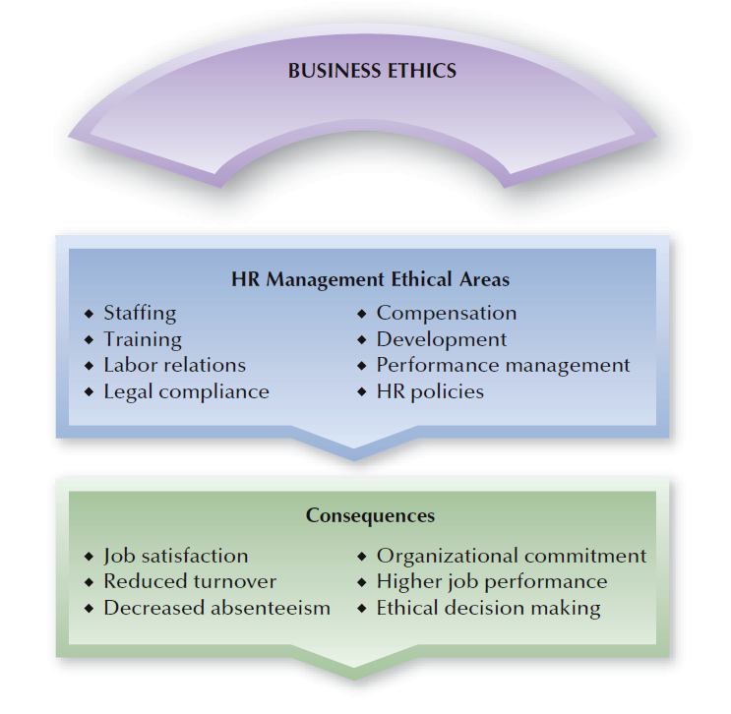
FIGURE 1–4
Business Ethics and HR Management Consequences

Slide 37
Ethical Behavior and Organizational Culture
Ethics Program Elements
Written code of ethics and standards of conduct
Employee training on ethical behaviors
Advice to employees
on ethical situations
Confidential reporting of ethical problems

Slide 38

HR’s Role in Organizational Ethics
Legal Question
Ethical Question
Does the behavior or result meet all applicable laws, regulations, and government codes?
Does the behavior or result meet both organizational standards and professional standards of ethical behavior?

Slide 39
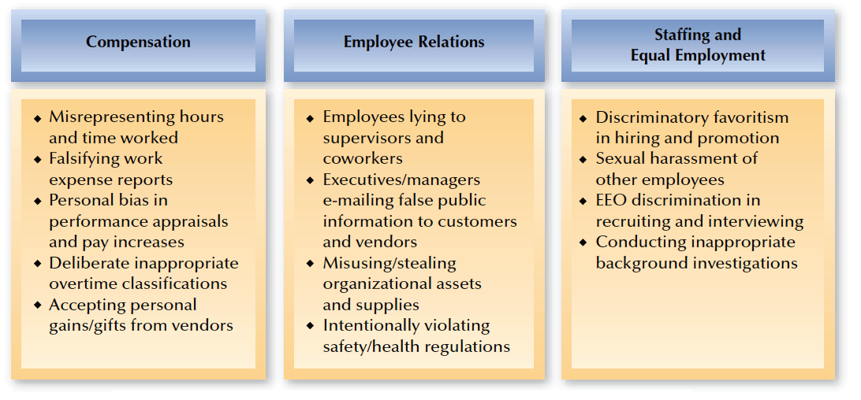
FIGURE 1–5
Examples of HR-Related Ethical Misconduct Activities

Slide 40
HR Ethics and Sarbanes-Oxley (SOX)
Reduce the likelihood of illegal and unethical behaviors by:
  Having a written code of ethics and conduct standards
  Providing ethical behavior training and advice
  Establishing confidential reporting systems for ethical misconduct
  Providing whistle-blower protection
  Supporting HR’s role as “keeper and voice” of organizational ethics

Slide 41


Thought Questions
What is the role of Human Resources in ensuring ethical behavior?
How can HR staff avoid being co-opted?

